Slide 1

The Outpatient
Breastfeeding
Champion Program
Session 8

Slide 2

The Instructor has no conflicts of interest to disclose
Continuing medical education credits (CMEs) and continuing education recognition points (CERPs) for IBCLE are awarded commensurate with participation and complete/submission of the evaluation form
CMEs can be used for nursing credits

Slide 3

Short Review of Session 7 Topics

Slide 4
Which Statement is Accurate Regarding Using a Breast Pump?
The pump parts should be sterilized in boiling water daily.
The parent should pump for at least 10 minutes after the milk stops flowing.
Increase the pump vacuum to the highest comfortable setting.
All pumps start in a stimulation phase, and then automatically switch to expression phase.
Notes:
The correct answer is C.
A- Incorrect- Pump parts do not need to be sterilized daily. Sterilizing is not the same as sanitizing. Sometimes NICU policies request this a few times a week, but the parent with a healthy newborn can wash the pump parts in the dishwasher or hot soapy water after use.
B.- Incorrect- Pumping can stop after flow ceases, often after the second or third letdown. There is no evidence that pumping after milk flow stops is beneficial.
D.- Incorrect- Pump differ greatly on whether they even have a stimulation phase. For example, the Ameda Finesse, as we saw, does not have a stimulation phase. The Spectra does not start in the stimulation phase.

Slide 5
Which of the Following is True regarding Breastmilk Storage?
Freshly expressed breastmilk is not safe to sit out at room temperature.
Frozen breastmilk that was thawed in the refrigerator, is good in the refrigerator for 3 days.
Breastmilk that has been in the freezer for 1 year is acceptable for consumption.
Expressed breastmilk is safe in a refrigerator for at least 8 days.
Notes:
The correct answer is C.
A.- This is incorrect. It is safe for freshly expressed milk to sit out at room temp for 4-6 hours.
B. This is incorrect- thawed refrigerated milk that has not been rewarmed yet should be used within 24 hours.
D. Expressed breastmilk is considered safe in the refrigerator for 4 days, according to the CDC guidelines from 2018 (see session 7)

Slide 6
A mother of a 2-week-old asks you when she should start pumping to store for work. Reasonable advice includes:
Begin storing a few ounces a day starting at around 3 weeks.
Start storing about 15 oz (450ml) a day so you have a freezer full when returning to work.
Don’t pump and store milk because it will drive your production up too much. Wait until you start working.
Notes:
The correct answer is A
B- this is incorrect because the mother does not need a full freezer before returning to work. Pumping so much extra would cause over-production.
C- this is incorrect because she should be fine storing just an extra 1-4 oz (30-120ml) per day.

Slide 7
What is true about The PUMP Act?
The law requires that employers have a sink available in the space to pump/nurse.
The law requires the employer to pay the employee for lactation break time.
A bathroom, even if private, is not a permissible location under the Act.
All the above
Notes:
The correct answer is C
A- incorrect- a sink is not required in the space provided by the employer
B- incorrect- the employer does not need to compensate the employee for the break time taken.

Slide 8

Session 8 Topics
  Medications during lactation
  Alcohol
  Tobacco
  Cannabis
  Using a health equity lens

Slide 9

Session 8 Objectives
Describe 2 basic principles of medications in human milk.
Recite 2 reliable sources of information for medication use while breastfeeding.
List 3 classes of substances that are contraindicated during breastfeeding.
Identify components of an equity lens when working with populations.
Notes:
Please read these objectives for Session 8

Slide 10

Medications and
Mothers Milk
Notes:
First lets talk about Medications in Mothers Milk

Slide 11


Basic Principles of How Medications Get Into Breastmilk
  Volume of distribution
  Half-life of medication
  Infant absorption
  Effect on milk production
Notes:
Basic Principles of Meds in Human Milk
There are several factors that determine whether a medication gets into breastmilk & how long it will stay in the milk. These are some of the factors:
Volume of distribution- Does the medication go into the breastmilk?
Half-life of drug- how long does the medication hang around?
Infant Absorption- Does the infant absorb the medication from the gut into the blood stream?
Effect on Milk Production- some medications seem fine for the baby but could drop the production.
We are going to talk about each of these individually in the next slides

Slide 12

Volume of Distribution
Meds are more likely to enter breastmilk if:
  Absorbed from the parent’s gut
  Medication is fat-soluble
  Little protein binding in the blood
  Small molecule
Notes:
Volume of Distribution
More likely to go into breastmilk if:
The following are factors that play an important role in determining how much of the substance will go into breastmilk:
Absorbed from the parent’s gut- some substances don’t leave the parent’s gut. For example, psyllium in it’s natural form or as metamucil, is not absorbed from the gut into the blood stream. Therefore, the medication won’t end up in the breastmilk.
Drug is fat soluble- Some medicines seek to penetrate into fat. Breastmilk is high in fat, so medicines that prefer a fatty environment will have higher levels in breastmilk than medications that prefer a watery environment. A good example
Little Protein binding-Highly bound meds stay in the blood stream and don’t go in the breastmilk, so we want to choose medications that are highly protein bound. A good example is dicloxacillin. This is a common antibiotic used for mastitis. Very little of this antibiotic goes into breastmilk because it is highly protein bound.
Small Molecules- medications need to be small molecules to pass into breastmilk. Medications that are large don’t pass thru. A few good examples are heparin and enoxaparin. Both are used for blood clots, and are safe during lactation.

Slide 13
Half-Life of Drug
How long does it hang around?
  Choose meds that are short-acting
    Antidepressants
    Anti-anxiety meds
Notes:
Half-Life of Drug
The half-life of a drug is basically how long the medication stays in the body
The longer the medication stays in the body, the more likely the medication will accumulate in the infant, and create side effects for the baby. It is important that providers who write prescriptions for lactating parents know to choose shorter acting medications.
Here is an example of 2 categories of medications where we try to choose shorter acting medications:
Anti-depressants- fluoxetine (Prozac) is a long-acting antidepressant, and can have more side effects in infants because of it lasting longer and accumulating in the infant. A more commonly used antidepressant is sertraline (Zoloft) because it has a shorter duration of action.
Anti-anxiety medications- Some of the medications in the benzodiazepine group such as clonazepam (Klonopin) are long acting, and can cause more sedation to the infant than shorter acting benzodiazepines such as alprazolam (Xanax)

Slide 14

INFANT ABSORPTION
Choose maternal medications that are not well absorbed from the infant gut, e.g. intravenous medications
Notes:
Infant Absorption of Medications that are in breastmilk
Choose medications that are not well absorbed from the infant gut-
There are several medications that make it into breastmilk, but are probably not absorbed well from the infant gut into the infant blood stream.
Good examples are medications given to the parent intravenously. Many medications are given IV because they are not absorbed well when taken by mouth. The medications might penetrate into breastmilk, but are not likely to be absorbed from the infant gut into the infant blood stream.
Intravenous medications such as Enbrel and Humira, used most often for arthritis and intestinal inflammation, are not well absorbed by the infant so are safe during lactation.

Slide 15

M
General Medication Principles
Medications given during pregnancy or to infants are generally safe during lactation
  Except for meds that reduce milk production
Choose the best med in a category
Notes:
Usually meds that are OK during pregnancy or for infants are OK for lactation- in other words, knowing that an infant can be exposed to a medication during pregnancy means that the infant can be exposed to it during lactation. However, sometimes these medications that might be safe for the infant can decrease the production, like we just discussed with decongestants.
Choose the best med a category- in other words, in each medication category, such as antidepressants, pain medications, and certain categories of high blood pressure medication, some medications will be better than others. You would want to choose a medication that is shortest acting and is least likely to go into breastmilk.

Slide 16

Medication Educational Resources
  Lactmed- National Library of Medicine- free
  Medications in Mothers’ Milk by Tom Hale- $
  Infant Risk Center - infantrisk.com- free
  Mother To Baby - mothertobaby.org- free
  E-lactancia.org (from Spain, English and Spanish)- free
Notes:
General Guidelines on Medications During Lactation
Use evidence-based resources for medications during lactation
Lactmed- thru the National Library of Med- this is free and available to families as well as health care providers
Medications in Mothers’ Milk by Tom Hale- this is edited every 1-2 years, and needs to be purchased
Infant Risk Center- also free on the web.
Mothertobaby.org is an excellent resource for parents who need information about the effects of medications during pregnancy and lactation. They can give information about possible birth defects.
E-lactancia.org is a medication database from Spain. It has good information on herbs during lactation, in addition to medications.

Slide 17

The List of Unsafe Meds is Short!
Chemotherapy for maternal cancer
Radioactive meds
Codeine, tramadol
Drugs of abuse
  Occasional cannabis is an exception
Prolactin-lower meds such as cabergoline
Always look up medications to be sure!
Notes:
The List of Unsafe Medications is Short
This means that most medications are fine during lactation, and this is an important principle to share with providers who you work with.
Chemotherapy for maternal cancer
If mom needs treatment for cancer, it is best that she wean. Most chemotherapy medications are not safe for the baby to be exposed to.
Radioactive meds- these are mostly given to do special radiology studies such as stress tests, bone scans, etc.
Some very short acting radioactive medications are fine during lactation, but for the most part is it best to avoid the test until mom weans.
Codeine, tramadol
Some babies have certain liver characteristics that make it hard to metabolize these narcotics, causing over-sedation and death. In addition, the young newborn brain is sensitive to these medications early postpartum.
Substance Use
PCP, hallucinogens, amphetamines, heroin are contraindicated during lactation. An exception is sporadic marijuana. Daily marijuana use can have negative effects on infant development.
Prolactin-lower meds such as cabergoline
These will dry mom up, no matter when they are used during lactation
This is not a 100% comprehensive list, so it is important to always look up medications during lactation using one of the medication resources, to be sure a medication is safe during lactation! Also, new research on medications in mothers milk occasionally will lead to a change in recommended use of medications during breastfeeding. For example, many years ago we thought that nursing mothers should not take Lithium. After several studies were done showing that Lithium could be given safely to nursing moms as long as monitoring of the infant takes place, Lithium was no longer considered contraindicated.

Slide 18

Alcohol During Breastfeeding
Breastmilk level=blood level
Alcohol in milk decreases infant’s intake
Recommendations for safety:
  No more than 2 drinks a day, but not daily
  Each serving over 1-2 hours
  Eat food when drinking
5 servings can decrease let-down and drop milk production
Notes:
Alcohol during Breastfeeding
Breastmilk level=blood level
The amount of alcohol in breastmilk is the same as the amount in the brain and blood. So if a parent feels tipsy, the breastmilk has a high amount of alcohol. As the blood level of alcohol declines, so does the level in the breastmilk.
Alcohol in BM decreases infant’s intake
Babies exposed to alcohol in breastmilk will decrease the amount of breastmilk they drink by 20-23%.
Recommendations for safety that can be applied to alcohol intake while nursing:
No more than 2 drinks a day, but don’t drink that much daily. Daily alcohol exposure for infants might have a negative effect on their development
Each drink over 1-2 hours
Drink each drink over 1-2 hours, to keep the alcohol level down. This will help to reduce the infant’s exposure to alcohol.
Eat food when drinking
This helps to decrease absorption of the alcohol, and reduces the blood alcohol level when drinking.
5 drinks will decrease let-down and drop milk production
The milk letdown will be blunted when there is a high blood alcohol level. After approximately 5 drinks, milk letdown may be problematic whether nursing or pumping. This can lead to a dramatic loss of milk production over the next 12 hours.

Slide 19

Tobacco Use During Lactation
OK to breastfeed when using tobacco
Decreased milk production
  decreased blood flow to breast
Possible decreased fat in breastmilk
Reduce exposure by smoking right after feeding, not before
Low dose nicotine replacement is preferred
Notes:
Smoking Cigarettes During Lactation
Smokers can breastfeed- it is healthier for babies to breastfeed rather than formula feed if the lactating parent is a smoker.
Decreased milk production –Smoking decreases blood flow to the breast, which can also lead to less milk production.
Possible decreased fat in breastmilk- Lactating parents who smoke are at risk for having lower fat milk which can have an impact on infant growth
Reduce exposure by smoking right after feeding, not before- Right after smoking a cigarette, the nicotine level is highest for the next 95 minutes. It is best to breastfeed first, then smoke to reduce the infant exposure to nicotine.
Low dose nicotine replacement is preferred- A nicotine patch or other form of nicotine substitute is preferred over smoking. The lowest dose patch, which is 7mg/day, is usually less nicotine exposure for the baby compared to smoking periodically throughout the day.

Slide 20
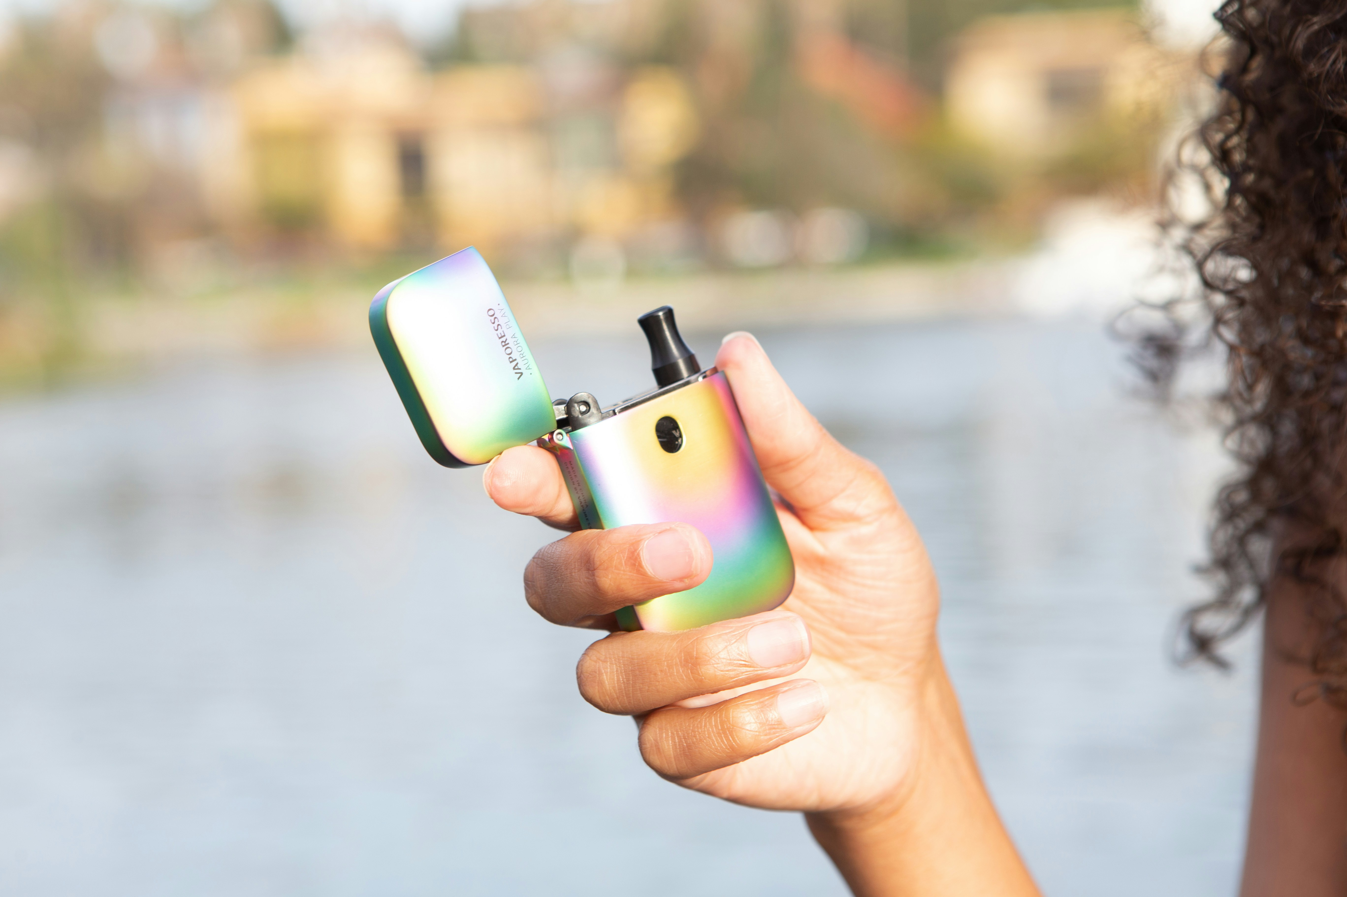
Vaping During Lactation
Little is known about safety of vaping during lactation
  considered similar to tobacco use
Vaping may deliver harmful chemicals into breastmilk
No recommendation to quit breastfeeding
Best to avoid or to minimize vaping during lactation
Notes:
Vaping during Lactation
There is very little information known about the extent to which harmful chemicals from vaping gets into breastmilk.
It is thought to have similar effects as tobacco during lactation, according to the ABM protocol on substance use disorder, published in 2023 (https://abm.memberclicks.net/assets/DOCUMENTS/PROTOCOLS/ABM%20Clinical%20Protocol%2021%20SUD_English.pdf)
It is recommended to avoid vaping during lactation, but vaping is not a reason to quit breastfeeding.

Slide 21
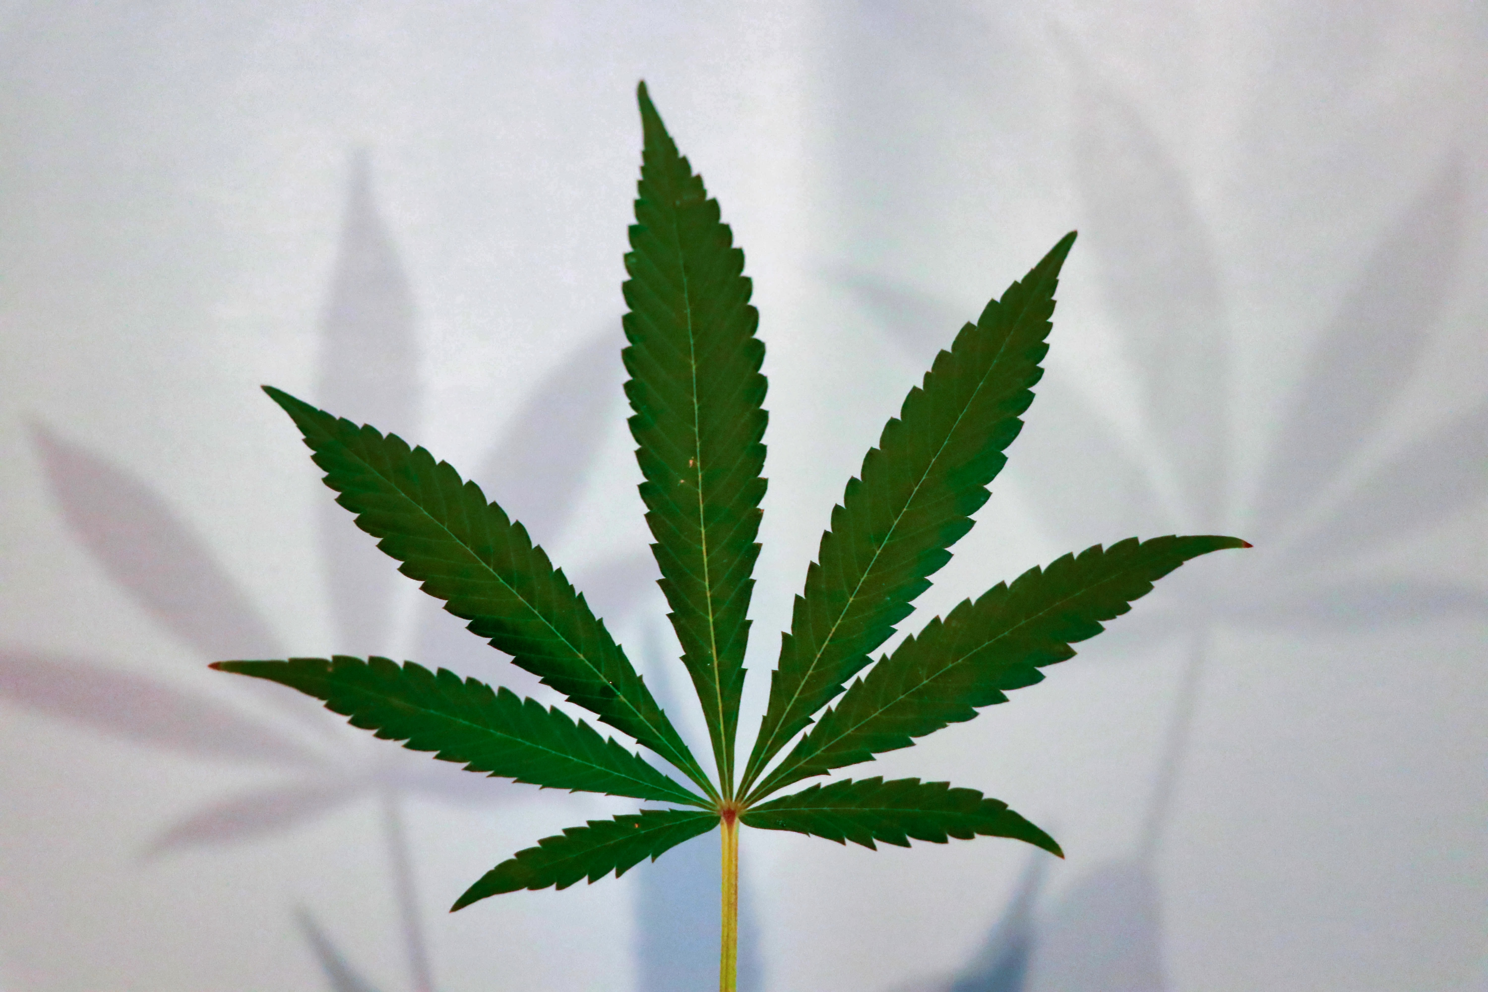
Cannabis Use During Lactation
American Academy of Pediatrics 2018
Cannabis use is not recommended during lactation
  Not enough info on transmission of cannabis into breastmilk
  Concerns that exposure to cannabis in breastmilk may have negative effects on the infant brain
  Infants and nursing mothers should avoid environments with second-hand cannabis smoke
Notes:
Marijuana During Lactation
AAP- 2018
The American Academy of Pediatrics put out a statement in 2018 recommending that lactating parents NOT ingest marijuana during lactation.
We don’t have full understanding of how much THC gets into breastmilk.
There are concerns that infant exposure to THC may have negative effects on infant neurodevelopment
Also, infants and lactating parents should avoid environments with second hand marijuana smoke

Slide 22

Notice the Triage Tool for Over-the-Counter Meds
Notes:
Please point out that this triage tool is in the back of the curriculum book where all of the triage tools are printed, and is very handy to use for the commonly asked question regarding what is safe to take over the counter.

Slide 23
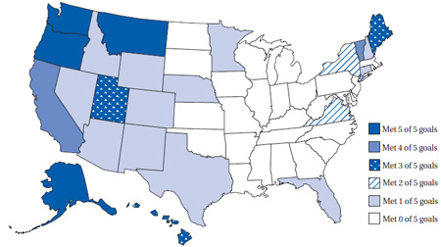
Inequity in Breastfeeding Rates
Lower breastfeeding rates among:
  African American women
  Lower socioeconomic groups
  Populations with lower education
  Geographic
    Southern USA
States that have reached HP 2020 goals
Notes:
Inequity in Breastfeeding Rates
This is a map of the states’ rates of achieving healthy people 2020 breastfeeding goals.
The states in white have not achieved any of the HP 2020 goals
Lower breastfeeding rates among:
We already have discussed that certain populations in the United States have lower rates of breastfeeding. These groups include:
African American women
Lower socioeconomic groups- people of lower income have lower breastfeeding rates
Populations with lower education- the less educated a mother is, the less likely she is to breastfeed.
Geographic
Southern USA- breastfeeding rates are lowest in the Southern States, but educational levels are also lower in these states, and they are some of the poorest states in the country.

Slide 24

What is Equitable Health Care?
(US Institute of Medicine)
Care that does not vary in quality because of:
  Race
  Gender
  Income
  Location
Equal ≠ Equitable
Notes:
What is Equitable Health Care?
(US Institute of Medicine)
The United States Institute of Medicine defines Equitable heath care as:
Care that does not vary in quality because of:
Race
Gender
Income
Location
This means that everyone should have the same opportunity for optimal health care.
Equal does not mean equitable. For example, anyone can walk into an urgent care for medical care, but that does not mean those without insurance, who cannot pay for labs and xrays, will receive the same care as those with insurance. To make care equitable, vulnerable populations may need different services, education, support than others. Therefore, the services for vulnerable populations are not equal to the services of non-vulnerable populations, but the different services allow for equitable health care.

Slide 25

Equitable Health Care Is Not The Same As Equal Health Care
With Permission from the Interaction Institute for Social Change
Notes:
Equitable Health Care Is not the same as Equal Health Care
This picture shows that some populations need different support and care to provide equity, but removing all barriers to optimal breastfeeding would provide liberation

Slide 26

Create a Culture of Equity
Identify Opportunities to Improve Breastfeeding Support in Your Community
Take Action to Improve Health Equity Using an Equity Lens
Photo by Artem Zhukov Unsplash
Notes:
Create a Culture of Equity
A first step in tackling health care equity in your community is to recognize which populations have fewer breastfeeding resources and less support
Because this is a breastfeeding training program, lets talk about breastfeeding inequities in your community.
Identify the differing levels of breastfeeding support in your community
Think about what groups in your community are least likely to initiate breastfeeding?
Which groups are least likely to be continue breastfeeding after leaving the hospital?
Who has access to high quality pumps, and who does not?
Which group(s) struggle with ongoing breastfeeding support?
Then, Take action to improve equity using an equity lens
If you identify inequities of breastfeeding support in your population, consider addressing ways to improve the differences. You will need to use an equity lens, which we will discuss on the next few slides

Slide 27

Apply an Equity Lens
Equity lens
  Analyzes impact of policies and programs on vulnerable populations
Work with individuals within the population(s)
  Enhances understanding
  Addresses trauma- informed care
  Builds trust in target populations
Notes:
Apply an Equity Lens
An equity lens allows people to analyze the impact of their policies and programs on vulnerable populations.
For example, lets say that you are designing a breastfeeding education program for your community. However, a cultural norm in your community is that the grandmother provides much of the care for the infant. Then, in order to be successful, you would want to be sure to invite grandparents to the educational programs, or have educational programs for grandparents, so that they understand the importance of breastfeeding.
To apply an equity lens, one needs to work with individuals in a population to understand opportunities and barriers, address trauma-informed care, and builds trust.
Lets look at some examples on the next slide

Slide 28



Examples of Working with Others in Populations to
Apply an Equity Lens
Communicate with and involve leaders- You learn that a rural Latinx population with a history of low breastfeeding rates has a major barrier- The local employer who expects all workers back 30 days after birth, and there are poor accommodations for lactation breaks
Trauma informed care- Your goal is to start a transgender lactation support group. You find out that transgender individuals are very uncomfortable discussing the option of lactation with local healthcare providers, given their history of receiving insensitive healthcare.
Build Trust – A public health department may have difficulty executing a postpartum in-home lactation support program in a Native American population without trained individuals of the community providing the in-home care.
Notes:
In this slide, there is 1 example of the importance of communicating and involving leaders in a community; employing trauma informed care; and building trust, in order for your efforts to be impactful in a community

Slide 29

Let’s Apply an Equity Lens in a Community Breastfeeding Project
Notes:
The Project
During this unit participants will practice the concept of incorporating diversity mindfulness while planning a breastfeeding initiative. The participants will learn from each other in small groups of 4-5. If you are conducting this training online, you may want to do this as a large group, especially if breaking into smaller groups does not work on your webinar platform.
Learning Objectives:
1. Practice including mindfulness of diversity in planning activities
2. Identify at least 2 groups of people that would be affected adversely when designing a breastfeeding promotion project in the community
3. Learn 2 new ways to include diverse groups of people in a breastfeeding activity
Teaching strategy:
5 minutes
Have participants pull out the diversity worksheet from their folders.
Explain the project. Read the breastfeeding project out loud, and read the questions that they will work on in small groups. Ask that the trainees gather in groups of 4-5.
15 minutes
Allow the group to talk and share ideas. They will work together to come up with some answers to the questions, and record them.
10 minutes
Ask a spokesperson from each group to give a 1-2 minute summary of some answers they came up with.

Slide 30
Incorporating Diversity in a Community Breastfeeding Project
As the breastfeeding champion for your place of work, you are the contact person for parents and families who have breastfeeding questions and problems. You recognize the benefit of breastfeeding parents getting to know each other in your community for peer support.
You decide to send a letter to all breastfeeding parents and invite them to a Tuesday evening parent-baby breastfeeding support group.
You will be the moderator for the group.
Notes:
Introduce this project to everyone, and on the following slides, the participants will discuss the issues regarding this, using an equity lens of person, place and process.

Slide 31

Community Breastfeeding Support Project
People
Which people would be positively or negatively affected by your plan to hold Tues evening breastfeeding groups?
What changes could be made to increase diversity and decrease challenges to attendance?
Notes:
The support project of having group meetings may support certain people more than others. Who may not be able to attend? Who would attend? Is this project designed to reach the target population? What could the breastfeeding champion do to diversify participants and decrease challenges to attendance?

Slide 32

Community Breastfeeding Support Project
Place
What features of a location would be important to provide for comfort and safety of the participants?
Notes:
Another aspect to an equity lens is recognizing the limitations/benefits of the place chosen to have the support group. What are considerations in making sure the location is appropriate for the target population?

Slide 33

Community Breastfeeding Support Project
Process
How does the structure of the program affect different participants? Will a support group encourage certain people and dissuade others?
Notes:
A third aspect to an equity lens is to consider process. The process of running the support group may attract some people and turn away others. What are some considerations for the process to encourage diversity and inclusion?

Slide 34

You Did It!! Congrats!
Now Let’s Practice a Few Cases…
Notes:
This is a transition slide to show that we are going to finish the course with a few cases. If people can pair up to discuss the cases, that is fine, otherwise do them the large group, particularly if you are on webinar and cannot divide individuals up.

Slide 35
Case #1
Eleanor’s baby Sammy is now 3 weeks old, and Sammy has not latched yet. Eleanor is primarily pumping, and her milk production is low.
Sammy never latched well in the hospital, and so Eleanor started pumping on day 2 postpartum. Sammy was tongue tied and had the tongue frenulum clipped, but this didn’t help Sammy latch.
Eleanor is pumping every 3 hours, and production is low. She is pumping about 1.5 oz every 3 hours, and Sammy takes that plus another 1.5 oz of formula at each feeding.
Eleanor tried to nurse Sammy a few times at home, but Sammy just screamed at the breast.
Eleanor is feeling overwhelmed by pumping and bottle feeding, especially since production is low. She is not sure that she wants to continue lactating. She wonders if it really matters if she feeds Sammy formula rather than breastmilk.
Notes:
This case can be discussed with everyone as a group, or break your group into partners, and one person will act as Marta, while the other person is the breastfeeding champion.

Slide 36
Case 1 Discussion
What are the parent’s concerns?
What are the parent’s goals?
How can you empathize with her?
What advice can you offer her?
  How can this be done in a shared-decision manner?
Notes:
Case 1 Discussion
What are mom’s concerns?
The baby has not latched.
Her milk production is low.
The baby screams at the breast.
Life seems overwhelming
What are mom’s goals?
To find out if there is hope for improvement
To find out if it is worth pursuing breastfeeding anymore
To find out if the baby will ever really latch and nurse
To find out if she really has to continue to pump and bottle feed, ie is there an end to this?
How can you empathize with her?
Acknowledge her dedication, with pumping every 3 hours, since she also has to continue bottle feeding too
Comment that it makes sense that pumping and bottle feeding is not sustainable
Let her know that you will support her by helping in whatever way you can.
What pieces of advice would help her?
You would like to check her pump to make sure it is working well.
Hold the baby skin to skin as often as possible to allow the baby to move down to the breast on her own, when the baby is not overly hungry.
Don’t allow the baby to become ‘mad’ at the breast by making the baby try to latch when she is hungry, before giving her a bottle.
Ask for people to come over to help with all of the other home tasks, so that she can have time to hold the baby and relax/enjoy the baby.
Refer her to a lactation consultant or knowledgeable provider for galactogogues
Shared decision making:
How does she feel about trying skin to skin to put the baby to the breast?
Is she comfortable continuing to pump to maintain her production as she works on bringing the baby to the breast?
Does she feel comfortable seeing a lactation consultant in her community?
Does she have friends or family who she would be comfortable inviting over to help?

Slide 37
Case #2
Case #2
Marta’s baby Jack is 5 months, and you are meeting with Marta for various concerns.
Marta notices that her production has gone down a bit over the last few months since being back to work and is worried about producing enough milk for the future.
Marta is pumping 3 times a day at work which is stressful, and Jack seems to pull and tug more at the breast in the evening.
Jack is also waking up more at night to nurse.
Marta is worried about Jack’s weight, and wonder if she should give Jack formula, or give solids.
Marta is not sure if she can keep up with the pumping frequency at work.
Sometime later in the conversation Marta admits that she, her partner Steve, and Jack will be driving 6 hours to attend Steve’s family reunion.
Marta is worried that Steve’s family might be uncomfortable if she nurses Jack in public around them.
Notes:
This case can be discussed with everyone as a group, or break your group into partners, and one person will act as Marta, while the other person is the breastfeeding champion.

Slide 38
Case 2 Discussion
What are mom’s concerns?
What are mom’s goals?
How can you empathize with her?
What advice can you offer her?
  How can this be done in a shared-decision manner?
Notes:
Case 1 Discussion
What are mom’s concerns?
Milk production has decreased
The baby is pulling and tugging at the breast in the evening, not sure why.
The baby is up more at night to nurse
Does the baby need solids?
What are mom’s goals?
Figure out how she can increase her production
Wants to make pumping easier, possibly less often, at work.
Not have the baby wake up as much at night to breastfeed.
Improve the baby’s behavior at the breast in the evening.
Find out how to manage breastfeeding around her partner’s relatives.
How can you empathize with her?
Acknowledge her dedication with nursing and pumping
Comment that it must be exhausting to be working all day and still be up at night for the baby.
You want to help make this all easier for her.
What pieces of advice would help her?
Pump tips, such as pumping in the am after nursing, before leaving for work
Ways to relax and encourage her letdown at work
Permission to use some formula during the day if needed. She does not have to breastfeed 100% to be successful
Wait until 6 mo for solids, so best to supplement with formula before 6 mo if needed
Counsel on travelling and breastfeeding. Encourage her to tell her family at times that she needs to rest at times with the baby.
Shared decision making:
Does she still want to keep pumping regularly at work, or would she prefer to introduce formula?
Is she comfortable waiting until 6 months to start solids?
Does she feel comfortable leaving her family members to nurse somewhere else?

Slide 39

Conclusions Session 8
Most medications are safe during lactation.
Use evidence-based resources to counsel on medications during lactation.
Parents who drink alcohol and who smoke may continue to breastfeed or provide their expressed milk safely.
Applying an equity lens allows professionals to be impactful in their communities.
Notes:
Read the Conclusions for Session 8

