Slide 1

The Outpatient
Breastfeeding
Champion Program
Session 4

Slide 2

The Instructor has no conflicts of interest to disclose
Continuing medical education credits (CMEs) and continuing education recognition points (CERPs) for IBCLE are awarded commensurate with participation and complete/submission of the evaluation form
CMEs can be used for nursing credits

Slide 3

Session 4 OBC
Sore Nipples- The Most Common Causes
Managing Nipple Sores
Breast Swelling and Engorgement
Infant Biting
Infectious Causes of Breast/Nipple Pain
Non-Infectious Causes of Breast/Nipple Pain
Notes:
These are the topics covered in this session

Slide 4
Objectives for Session 4
Describe at least 4 common causes of nipple and breast pain during lactation.
Identify 3 main pieces of advice to give individuals who call with cracked sore nipples.
Manage initial recommendations for sore nipples over the phone.
Notes:
These are the topics covered in this session

Slide 5
Objectives for Session 4
Describe
  3 instructions typically given to the lactating parent with acute mastitis.
  How to advise the lactating parent who might have shingles or herpes on a breast.
  Typical advice given to an individual with clogged ducts.
  How to identify and advise care of vasospasm.
  Initial advice in the care of nipple dermatitis.
Notes:
These are the topics covered in this session

Slide 6
Mom calls you on day 4 pp because her baby, who was nursing fine, now won’t latch. Her breasts feel very heavy, and the infant is crying. Your initial recommendations are:
The baby might be sick and should be seen ASAP
Her breasts are probably engorged, and the baby cannot grasp the breast. Express some milk so the breast is more compressible.
She should bottle feed the baby because the baby clearly does not want to nurse anymore.
Notes:
The Correct Answer is B

Slide 7
A parent calls concerned that their term 10-day old baby is nursing too often, every 2 hours, and that his partner does not have enough milk. He reports 3 stools & 6 wet diapers/day. When seen on day 3, the baby’s weight was up 1 oz (30g) from day 2. You advise:
Everything sounds fine, keep the 2-week exam appt. The feeding frequency sounds normal.
Ask family to come in for a visit and weight check.
Advise the lactating parent to switch to pumping and bottle feeding so they can measure the amount of milk she has.
Notes:
The Correct Answer is B
A parent called with a concern, so that automatically means that they need reassurance by having the baby weighed.
Some doctors will tell the parent to pump and bottle feed to see their volumes (C). The problem here is that the parent is taking the baby off the breast and giving a bottle. This is not a good idea until the parent is seen. If the baby is weighed and not found to have gained well, then pumping after feeding to measure residual would be reasonable, to determine adequacy of milk production.

Slide 8
This same baby comes in for a weight check. You advise:
Birth Weight | 8 lb 0 oz (3628g)
Day 2 | 7 lb 9 oz (3430g)
Day 3 | 7 lb 10 oz (3460g)
Day 10 | 7 lb 12 oz (3520g)
Things are fine, your baby gained another 2 oz and has another 4 days to get to birth weight.
The baby is gaining slowly, lets try to figure out why this is.
The parent’s milk production is low, and formula should be given after breastfeeding.
B&C
Notes:
The Correct Answer is B
A is not correct, since the baby only gained 2 oz in 7 days. Even though the baby is not too far from birth weight, the most recent weight gain is a problem.
C is not correct because it is possible that the baby is not transferring milk well, and there is plenty of milk in the breasts. We will talk about how to manage this problem later.

Slide 9

Mom calls and states that her 3-week-old baby is nursing too often. He wants to nurse every 45 minutes most of the day and never seems satisfied. Her breasts feel larger, and they leak. You advise:
Your milk production is probably low. Give a supplement of formula after nursing.
Your baby is falling asleep at the breast, try to keep the baby awake while feeding. No need to worry.
Please come in for a visit, to check the infant’s weight and observe feeding.
Notes:
The Correct Answer is C
A is incorrect because she feels that her milk production is adequate. If anything, she can express milk after feeding and supplement with expressed breastmilk as needed.
B- incorrect- it can be hard to keep the baby awake at the breast. This is much easier said than done, and we also don’t know if this is the problem
C- this is correct, the baby needs a weight check and to observe a feeding
If mom brings a breast pump, she could pump when she sees you to see how much milk she has left over.

Slide 10

Dad mentions at the 2 week visit that his baby is nursing every hour overnight, and sleeps in the day. He wonders what to do. You advise:
He should get up, give the baby a bottle, and let mom get some rest.
Don’t let the baby sleep away the day. Try to feed the baby often in the day and try to keep the baby up in the evening.
It is normal, mom should nap in the day with the baby so that she has the energy to be up with the baby at night.
Notes:
The Correct Answer is B
A is not correct. We don’t want the lactating parent to sleep all night, since that will lead to a drop in milk production.
C- it is best to not cater to the baby staying awake all night. It is best to get the baby up regularly during the day so that the baby gets his days/nights turned around.

Slide 11
A lactating parent calls, reporting that their 3-week-old is fussy and has not stooled for 2 days. They believe their milk production is low because the baby wants to constantly breastfeed. The other parent wants to give a bottle to the baby. You advise:
Although this might be a growth spurt, the baby should come in for a weight check.
Because the baby is 3 weeks old, she is in a growth spurt. It will improve in a few days.
The baby is probably having a reaction to something in the parent’s diet, so the parent should just pump and give the baby formula for now.
Notes:
The Correct Answer is A
B- you cannot assume that this is a growth spurt. That diagnosis is based on excluding other reasons for fussiness and less stooling. An evaluate is needed to address these concerns.
C- It is not likely that the baby is reacting to something in the milk. Also, this cannot be determined over the phone. They need to be seen for an evaluation to make sure the problem is not something like insufficient milk production.

Slide 12

Dad calls because he wants to give their 1-week-old a pacifier. All the baby wants to do is suck at the breast, and he is sick of it. You advise:
Let me talk to mom.
Let’s see the baby in the office. It would be great if both parents could come.
It is fine to give a pacifier if the baby is nursing at least every 3 hours.
A & B
Notes:
The Correct Answer is B
C is incorrect because if the baby wants to suck all the time, the baby might not be taking enough calories. The baby needs to be weighed.
D- some people will answer D, and that is not entirely wrong. ‘A’ can be OK, to ask to talk to mom, as long as dad is not excluded from decision making.

Slide 13
At her term baby’s 4-week visit, mom wonders if she still needs to wake the baby up every 3 hours at night to nurse. The baby’s weight is great. You advise:
Limiting the night-time break to 5 hours in the first few months postpartum will help to maintain milk production.
Given the baby’s young age, it is reasonable to wake the baby up after a 5-hour break for feeding.
It is fine to let the baby sleep as long as they want. No need to get up to pump.
You need to feed the baby every 3 hours at night for at least a few months.
A & B
Notes:
The Best Answer is E
C is incorrect- IF mom takes more than a 5-hour break over night during the first few months postpartum, her production may decrease significantly.
D- incorrect. She does not need to feed the baby every 3 hours over night. The baby should be fine to sleep for 5 hours over night at this point. Allowing the baby to sleep much longer at such a young age may be associated with insufficient infant growth, as the infant would be missing a feed or 2.

Slide 14

Finding Additional Lactation Help in Your Community
The Triage Tools default to referral to lactation consultants/physicians/providers
Not all communities or individuals have access to these levels of care
Please share other resources you are aware of in your community, such as doulas, local breastfeeding support groups, or a breastfeeding coalition.
Notes:
This slide is put in now because the participants already reviewed 1 triage tool in session 2, and will review more this session 4. This slide is a reminder that although the triage tools default to LCs and providers, not everyone has access to this level of care.
Ask participants if there are other levels of support that they know of in the community, so that participants can share this info with others

Slide 15

Breast Pain and
Nipple Soreness

Slide 16
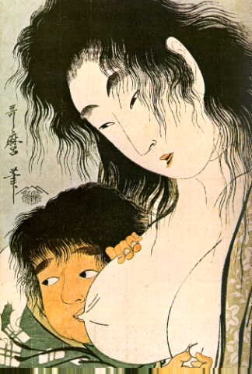
Myths re Sore Nipples
Having to ‘toughen up’
The baby having a strong suck
Nursing the baby too much or too long
Notes:
There are myths out there about sore nipples. Nipples do not become ‘tougher’ or calloused with feeding.
A strong suck is not an issue. It has much more to do with how the vacuum is applied/where the nipple is in the baby’s mouth.
Nursing too long or too much should not cause sore nipples, if the latch and positioning are ideal to prevent nipple trauma.

Slide 17
Nipple Pain Starts Early
  Up to 96% of lactating individuals have nipple pain at some point
    43% with sore nipples at hospital D/C
    73-76% with sore nipples at 3 days pp
    19-26% having cracks
Notes:
Several studies have been done looking to see how common sore nipples are in nursing women.
The incidence of sore nipples varies depending on the study, found to be 11-96% of all women have nipple pain at some point (Blair A. et al Brfeed Review 2003)
In one study, 43% of mothers had sore nipples at hospital D/C (Oliveira JHL 22(3) 2006)
In addition, it has been found that 73-76% of new moms had sore nipples at 3 days pp, with 19-26% having cracks. (Centuori JHL 15(2) 1999)

Slide 18
Cause of Nipple/Breast Pain
Latch
Suck
Trauma
Pregnancy
High
production
Infection
Dermatitis
Vaso-spasm
Notes:
These are the causes of nipple pain. We are going to go thru these different causes. However, we won’t talk about pregnancy. It is important to know that pregnancy can cause nipple pain, and pregnancy can happen even if the parent has not started menstruating yet.

Slide 19
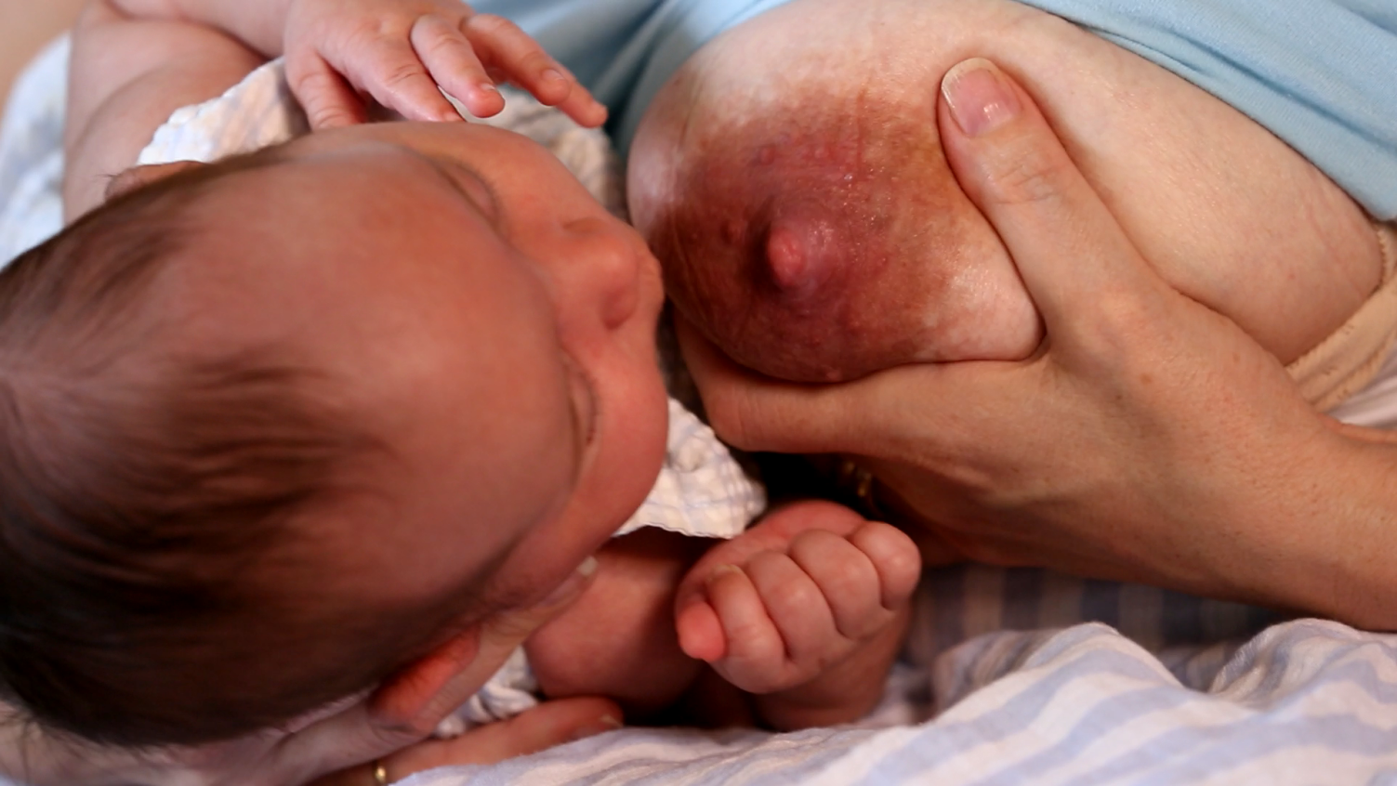
Engorgement
Days 3-5 postpartum
Major reason for sore nipples
  Leads to a shallow latch
Notes:
We discussed engorgement in detail in session 3.
Engorgement by itself does not cause sore nipples, but engorgement makes it very hard for the baby to latch on deeply. A shallow latch will cause nipple soreness/trauma.
As you know, engorgement occurs when the milk ‘comes in’ on days 3-5 post.
This is one of the most common times that women will say that they develop sore nipples.
Because the breasts are so full and firm, the baby has trouble latching deeply onto the breast, as we discussed before.

Slide 20
Review of Engorgement Treatment
What are means of treating engorgement?
What is the best way to prevent engorgement?
Notes:
Just as a review of session 3, the General principles include:
Use heat before nursing to promote milk flow
Cold compresses in between nursing to reduce edema
Reverse Pressure Softening
Breast lymphatic massage before feeding/pumping
Hand express some colostrum before latch.
Prevent engorgement by nursing frequently.

Slide 21
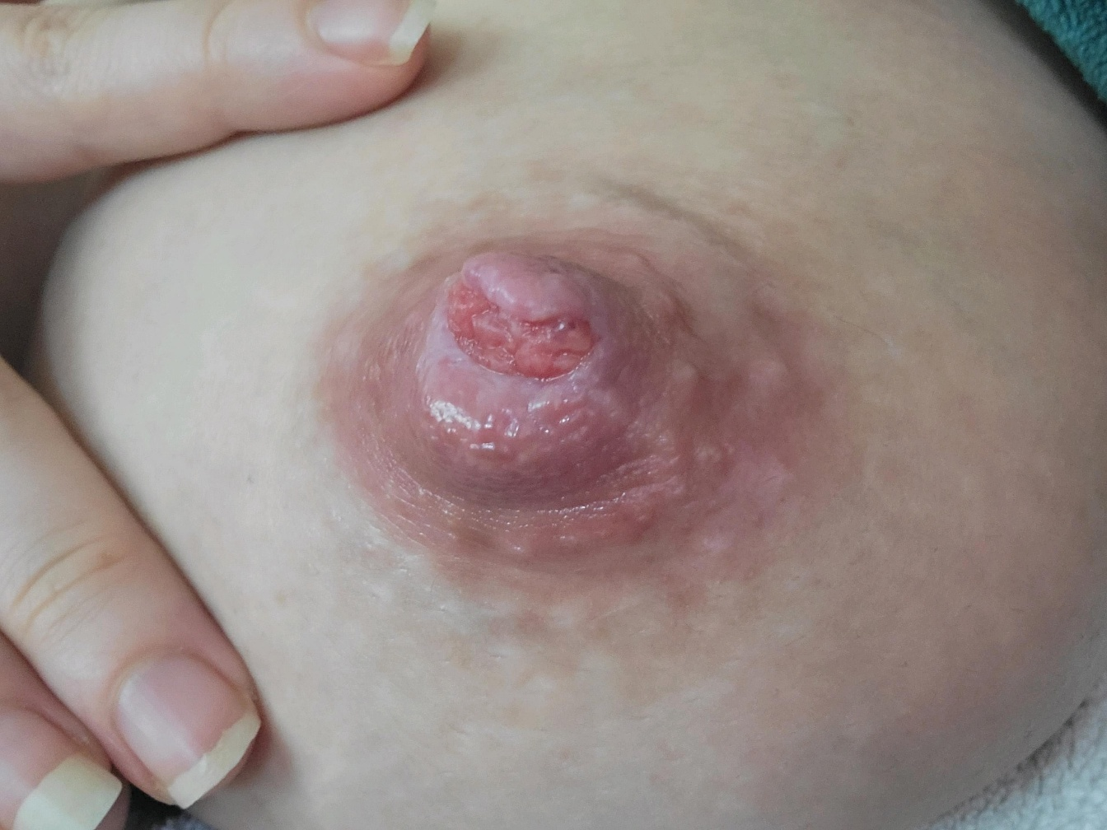
What is the most likely reason for nipple wounds like this on day 4 postpartum?
What can we recommend to help heal her nipple wound?
Notes:
This nipple has a severe wound at the tip. This is certainly due to the way the baby is nursing. The baby is nursing shallowly, just on the tip of the nipple. The baby should be latched to the breast so that the nipple is far back into the baby’s mouth.
We need to recommend moist wound healing and evaluate for engorgement, positioning, and latch to determine why the baby is nursing so shallowly. It is also possible that the parent may need to pump for a few days until the infant’s issues can be sorted out, engorgement managed, and nipple trauma is resolved.

Slide 22
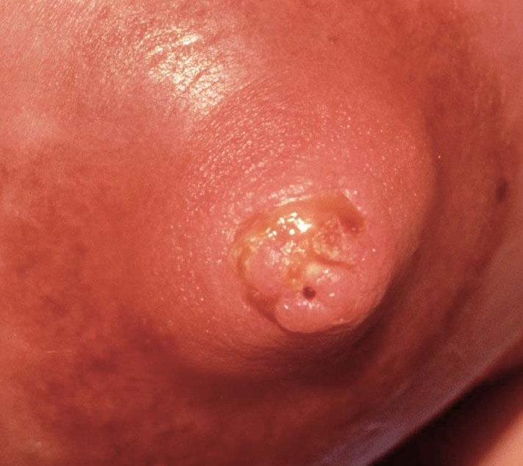
Nipple Wound Treatment
Moist wound healing
  Treat open nipple wounds like burns or skin abrasions
  Keep covered with moist substance and nonstick cover
    Prevents sticking to bra/breast pad. Sticking re-injures the nipples when nipples are uncovered
    Prevents scabbing
    Healing is faster
    Alleviates nipple pain between feeds
Notes:
Nipple Wound Treatment (This is a picture of a scabbed nipple)
Moist wound healing is the medical principle in wound care.
Treat nipple wounds like any other wound, such as a burn or skin abrasion. By keeping wounds covered with a moist substance and a nonstick cover, the wound will not stick to the bra or breast pad. This is important, because if the nipple sticks to the bra or breast pad, the wound is re-injured every time mom removes the bra flap or breast pad. Scabbing delays healing, and moist wound healing prevents scabbing. Keeping the nipple wound covered with moist wound healing also decreases nipple pain and sensitivity between times of nursing or pumping.

Slide 23

Options for Moist Wound Healing
Moist barrier
    Coconut oil or olive oil
    Lanolin- but increases risk of rash
    Nipple balm
    Medicinal honey
    APNO should NOT be used
      No role for steroids/ antifungal/antibacterial ointments for wounds
Nonstick cover
  Nonstick pads
  Hydrogels
  Parchment paper
Notes:
Options for Moist Wound Healing
This photo is used to show that we typically use nonstick covers over wounds, often with something moist like ointment or Vaseline.
Moist barrier options include coconut oil, olive oil, lanolin, a commercial nipple balm, or medicinal honey. Lanolin can cause skin dermatitis, as many people are allergic to it. APNO, also known as all-purpose nipple ointment, is a common concoction of topical steroid/antifungal/antibacterial creams. Steroids, antifungals and antibiotic ointments have no role in the healing of wounds from trauma.
Nonstick covers can include commercial nonstick pads, medicinal foam pads, or even parchment paper. It would be best to avoid covers with tape because the tape may irritate the breast skin.

Slide 24
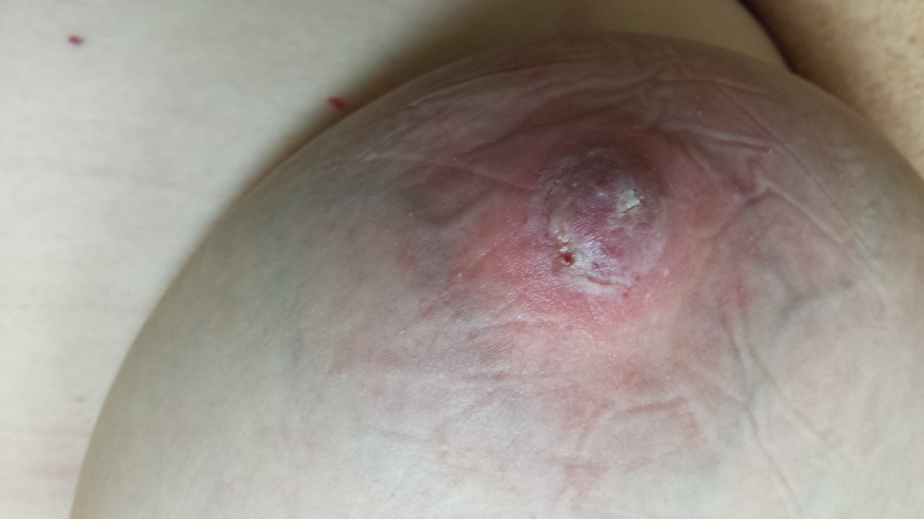
Triage Tool Sore Nipples
Group 2
Notes:
Sore Nipples Triage Tool- Session 4
This is your second baby
Your baby is 3 weeks old
You had cracks of your nipples in the hospital, then the pain seemed to improve, and now the nipples hurt again. The cracks are not healed yet. It hurts to latch the baby on. You don’t know if you can keep nursing the baby with this degree of pain.
You don’t have a fever, redness or swelling

Slide 25
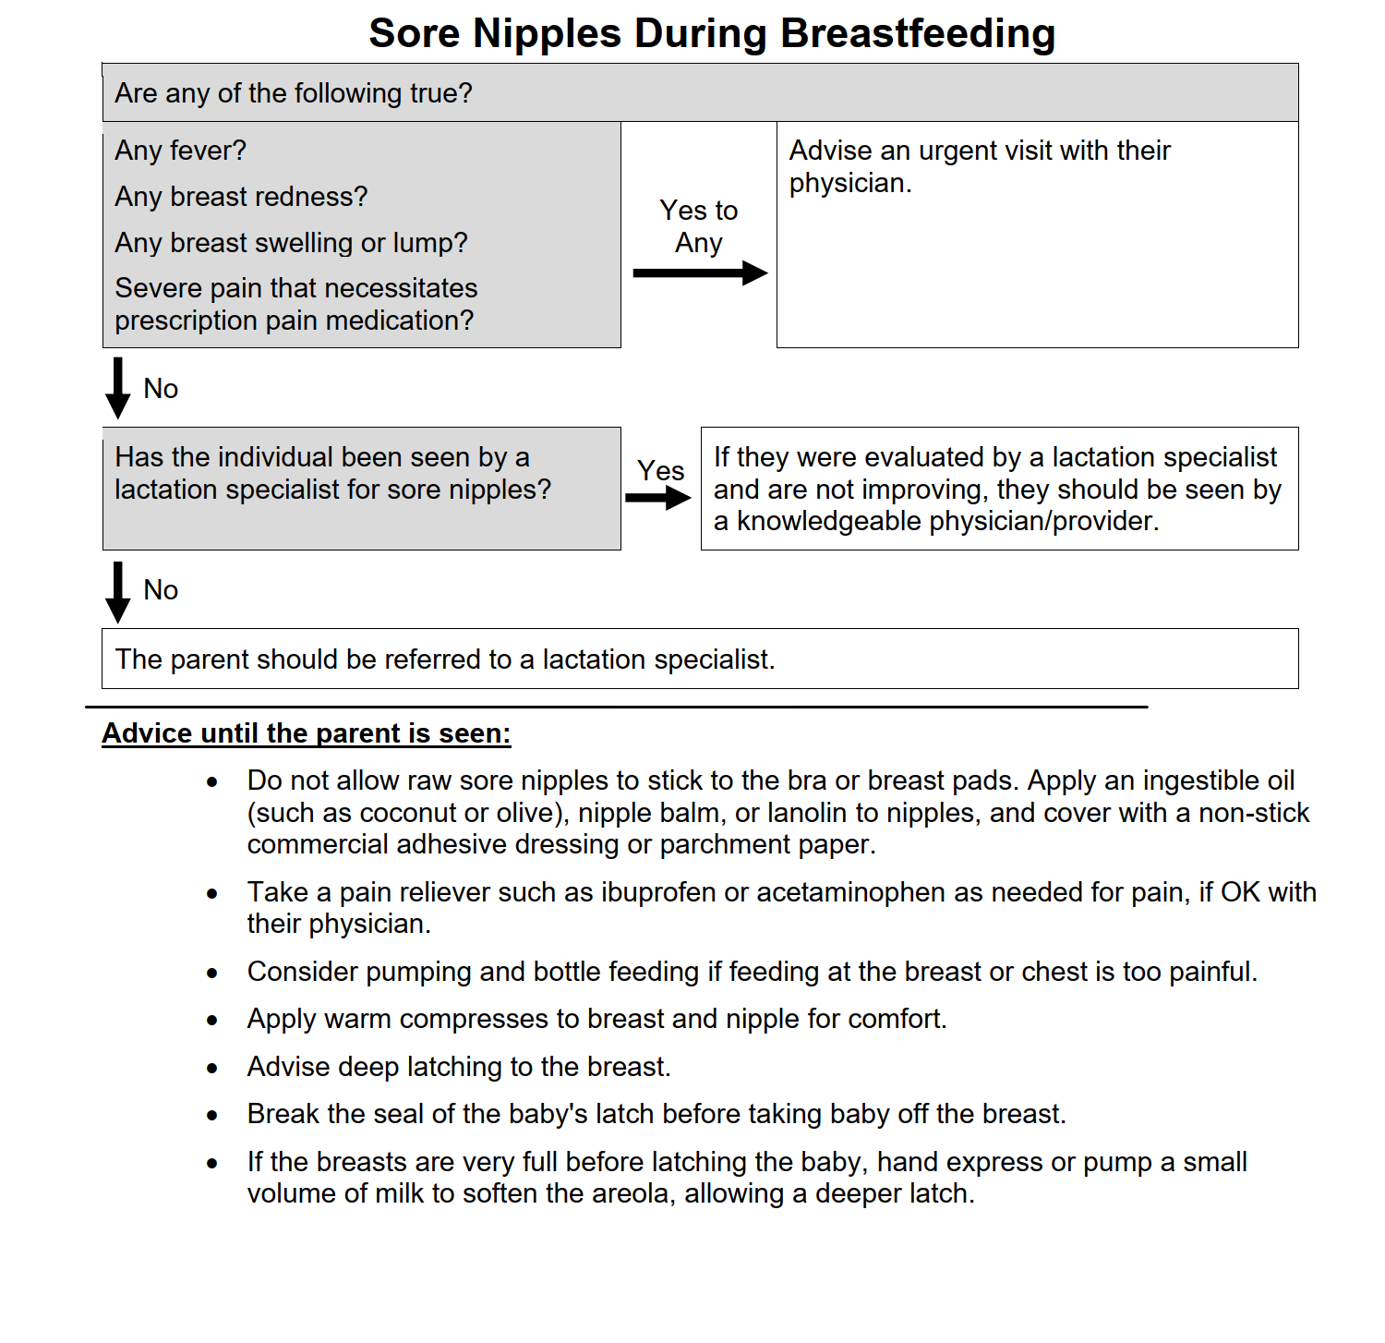
This is your second baby
Your baby is 3 weeks old
You had cracks of your nipples in the hospital, then the pain seemed to improve, and now the nipples hurt again. The cracks are not healed yet.
It hurts to latch the baby on.
You don’t know if you can keep nursing the baby with this degree of pain.
You don’t have a fever, redness or swelling

Slide 26
Discussion Sore Nipple Case
What are some pieces of advice that can help this parent right away, to decrease their pain?
What are things that you can do as a breastfeeding champion to help this mom, if she comes in to see you in person?
Notes:
What are some pieces of advice that can help this parent right away, to decrease their pain?
Try taking something OTC for pain
Nonstick covers with a moist wound barrier such as a nipple balm, coconut/olive oil
Try just pumping
What are things that you can do as a breastfeeding champion to help this parent, if they comes in to see you?
Make sure latch is deep and baby is positioned properly
Teach how to use their pump
Teach how to break the seal when taking the baby off the breast

Slide 27
Underlying Problem | Management Strategy
Infant movement limitations due to torticollis, fractured clavicle, etc | Work on positioning, and refer for more help for underlying problems
Prematurity/Low tone/sleepiness | Limit time at breast, pump to maintain production, supplement
Broad flat nipples | Roll out nipples before latch, soften areola
Overactive letdown | Change positioning, reduce milk production
Infant disinterest due to low flow | Supplement with a feeding tube at the breast/chest
Oral defensiveness | Bottle/finger feeding, speech eval
Tight lingual frenulum | Clip the tongue tie
Oromotor dysfunction | Speech eval
Latch refusal | Infant-led latch
Notes:
This chart demonstrates typical management strategies that lactation consultants use for certain problems that cause traumatic nipple pain.
You don’t need to go over these in detail, but perhaps explain a few problems and solutions very briefly.
The goal of this slide is for the instructor to demonstrate to attendees that there are more advanced issues that lactation consultants deal with, which are beyond the scope of this training course.

Slide 28
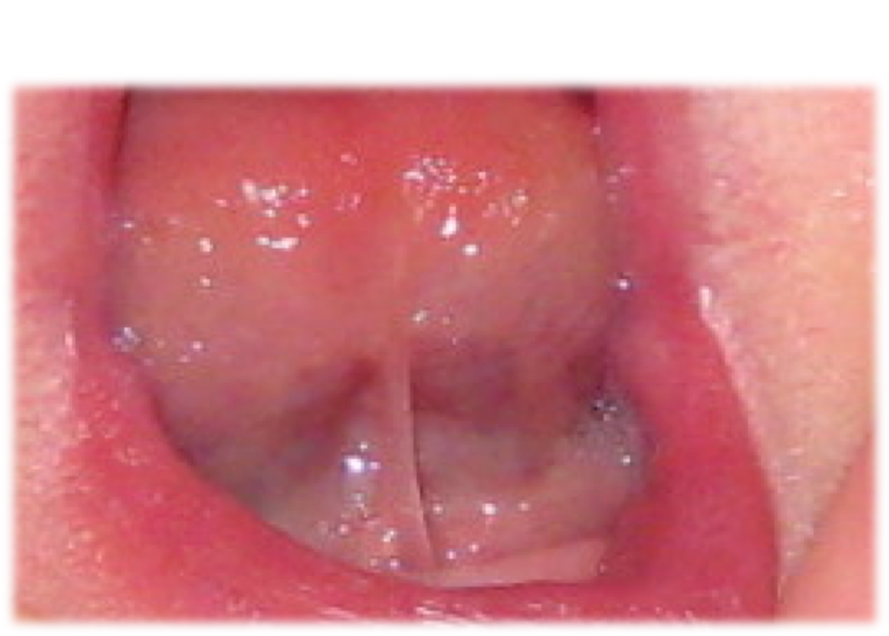
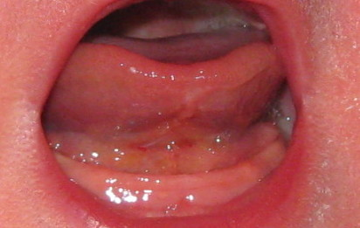
Before clipping
After clipping
Notes:
Here is an example of a tongue tie before and after clipping
A tongue tie is a common reason why infant latch and suck can cause nipple trauma. The baby cannot extend the tongue far out beyond the lower gum line,
So the nipple is not swept back deeply into the mouth.
Instead, the nipple is caught between the tongue and the hard palate, causing trauma.

Slide 29
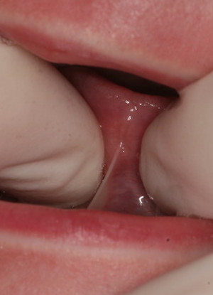
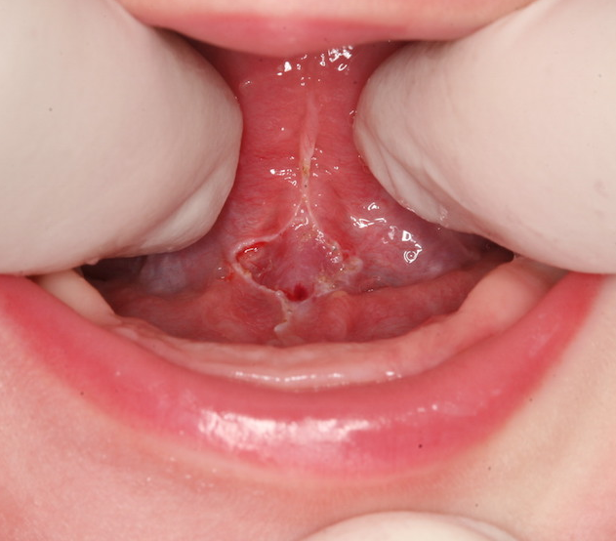
After laser treatment
Before treatment
Notes:
This is a picture of a tongue tie before and after laser treatment

Slide 30
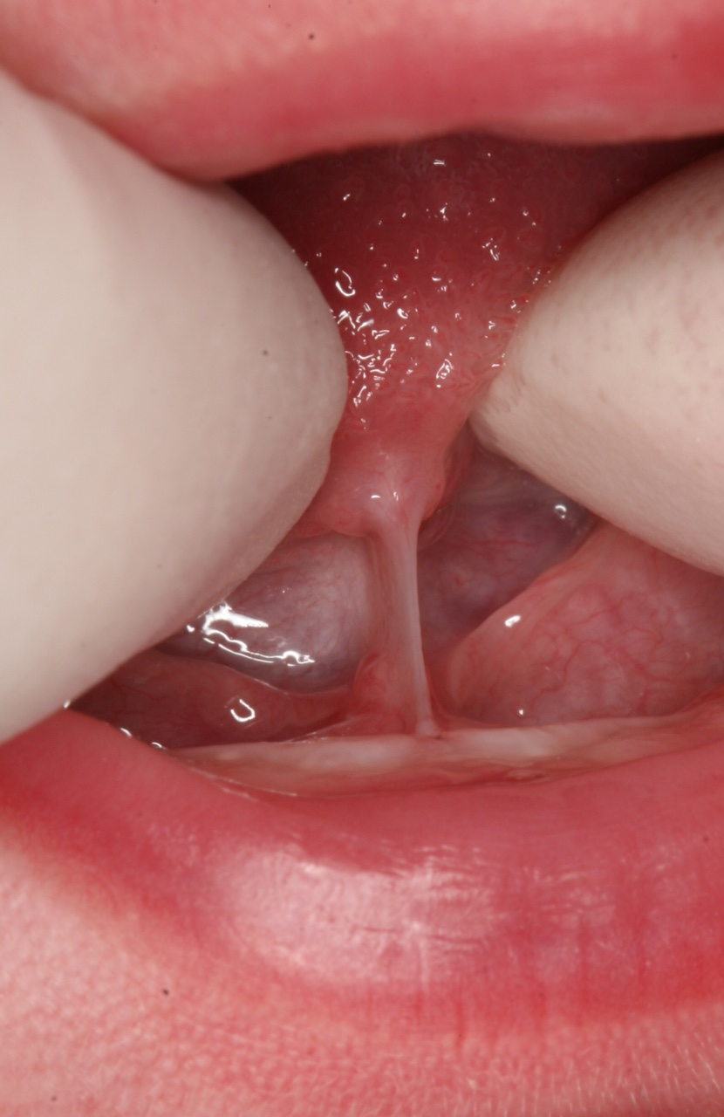
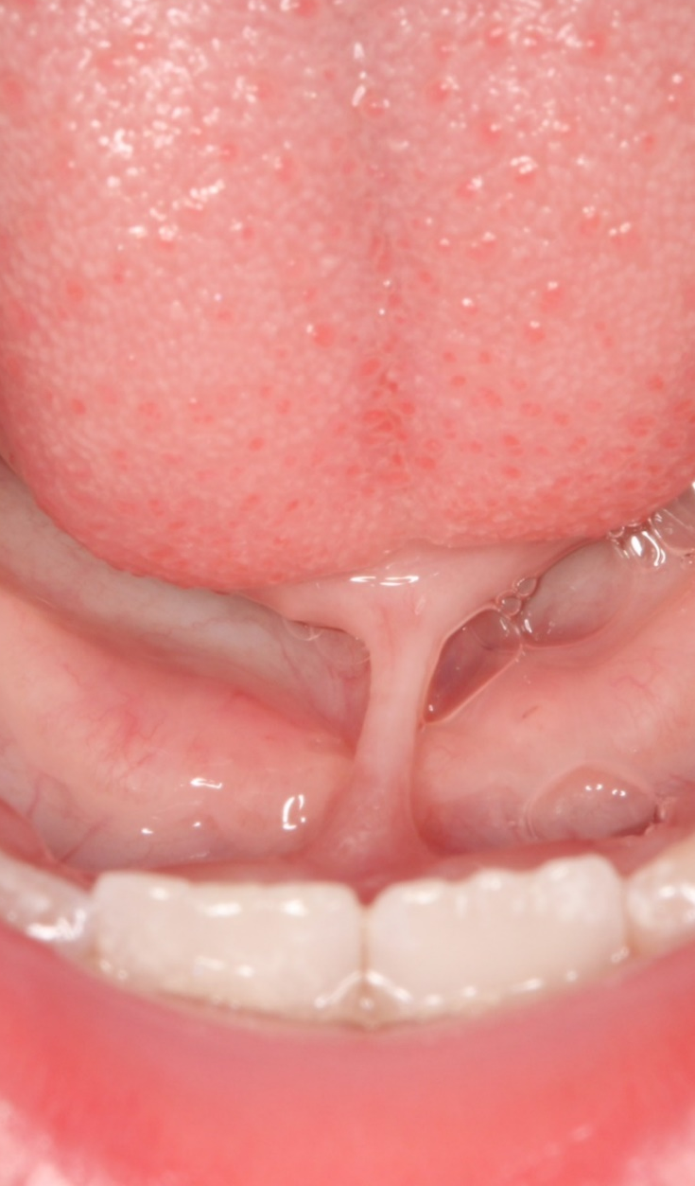
Notes:
Here are 2 other examples of tongue tie, both of which extend to the tip of the tongue.. On the right side, you can see that the tongue tie is much thicker than the left. The person on the R is also older (has teeth)

Slide 31
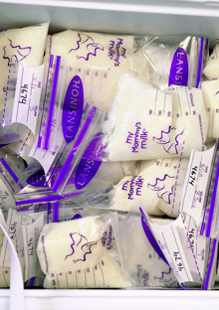
Hyperlactation= Over-Production
Common symptoms
  Pain mainly when breasts are full
  Frequent breast fullness
  Recurrent mastitis
  Infant struggling to manage heavy letdown
  Infant feeds on one side for short periods
  High production when pumping
    People who are well matched typically express 3-5 oz (90-150ml) every 3 hours
Notes:
Hyperlactation is a common cause of sore nipples and sore breasts.
The pain is mainly present when the breasts feel full. Pain improves after feeding, when breasts are less full.
People with hyperlactation have a higher risk of mastitis because they are often not emptying their breasts as completely and/or as often as others who have milk production that is well matched to the infant’s needs.
Sometimes the milk can appears stringy or have mucous globs.
Infant often have symptoms when the milk production is high- the milk flow can be brisk and heavy, leading the infant to coughing and gasping during letdown. Because of the high production they will typically feed from just 1 side.
People identify high production when they pump high volumes. Typical milk production is around 3-5 oz (90-150ml) every 3 hours

Slide 32
Over production (relative to milk removal)
Regional areas of swelling (edema), AKA clogged ducts
Acute mastitis
Notes:
In this next several slides we are going to discuss how over production of milk, relative to milk removal, can lead to clogged ducts and mastitis

Slide 33
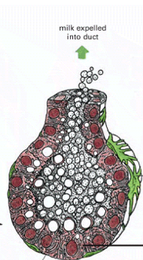
Overfullness => areas of swelling (clogs) => mastitis
Duct is narrowed due to external pressure from swelling and milk cannot leave
vv
vv
vv
vv
vv
vv
vv
vv
vv
Normally milk stays inside the alveolus and is expelled thru the ducts
When overly full, milk will leak out between the cells, causing areas of swelling around the alveoli
Notes:
On the L is a normal alveolus, lined with cells that make milk. The milk globules are excreted into the center of the alveolus, and the milk is expelled thru the duct (at the top).
On the R is an alveolus that is overfull, to the point that milk leaked out between the cells, to the area outside of the alveolus. This area is called the interstitial tissue. When milk leaks into the interstitial tissue, swelling occurs, making it hard for milk to leave thru the duct. This is, essentially, a clogged duct.

Slide 34
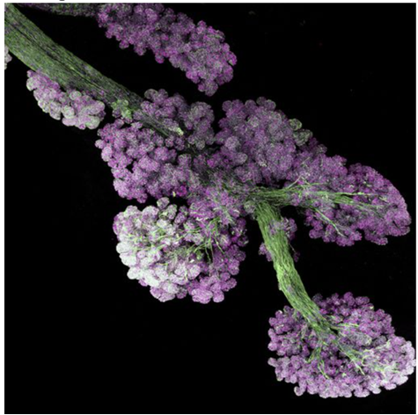
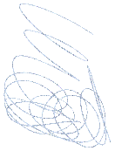




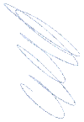
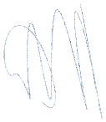



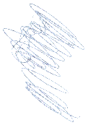
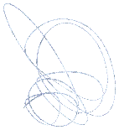
What are Clogged Ducts?
A swollen area of the breast
The milk in the swollen region cannot move through the ducts until the swelling resolves
When the swelling resolves, clots of milk are sometimes expressed
There is no such thing as a ‘plug in a duct’
Regional swelling
Notes:
What are clogged ducts?
These are regions where there is swelling in the breast tissue. The swelling makes it impossible for the milk to flow thru the ducts. It is essentially a localized area of engorgement. There is no such thing as a plug inside of a duct. The photo in this slide is a real microscopy view of breast tissue. You can see how numerous and tiny the ducts are. The white hand-drawn region is meant to portray an area of swelling due to milk production in that region being higher than what is being removed, causing milk to spill from the alveoli to the interstitial region.

Slide 35
What are Risk Factors for Clogged Ducts?
Notes:
Have them answer this first, then the risk factors will be discussed in the next slide.

Slide 36
Risk Factors for Clogged Ducts
All situations are associated with insufficient milk removal=> alveolar distension=> fluid moving from alveoli to surround regions in the breast
High milk production
Return to work
Irreg feeding/pumping
Poor pump fit
Change in feeding positions
Restrictive clothing or other external compression
Notes:
Risk factors for clogged ducts include:
High milk production
Situations when there is higher milk production than what is being removed
Returning to work or maternal/infant separation
Women who are separated from their babies don’t remove milk as well using a pump as they do when the baby nurses. This lack of good milk removal increases the risk of clogged ducts
Longer duration of sleeping over night
This also creates a situation of higher milk produced than what is being removed. Many women will wake up feeling as though they have mastitis. They have areas of swelling that have occurred over night.
Irregular feeding pattern
Some women who feed on an irregular schedule might go long periods of time with too much fullness
Restrictive clothing/underwire bra/seat belt/pump flange
Any situation that prevents milk removal increases the risk of clogs. Some restrictive clothing might make it hard to achieve adequate milk removal in some areas of the breasts

Slide 37

Symptoms of Clogged Ducts
  Tender localized area of fullness
  Pain radiates to/from the nipple during nursing
  No/minimal breast redness, no fever
  Drop in milk production because the breast does not completely empty
Notes:
Symptoms of Plugged Ducts
Tender localized area of fullness.
Lactating individuals will feel this in one area of the breast, sometimes in a pie-shaped area of the breast
Pain radiates to/from the nipple during nursing
No breast redness or fever
A plugged area will have redness with fever if there is an infection. If there is not an infection, the parent should not have redness or fever
Drop in milk production because the breast does not fully drain
These parents notice that the milk production has slowed. It is harder to express sufficient milk from the area that is not draining well

Slide 38

Treatment of Clogged Ducts
  Remain with normal routine of nursing/pumping
    Do NOT increase demand
  Ice for swelling and comfort
  No aggressive massage, just light lymphatic massage
  Vary nursing positions
  If the swollen region does not resolve in 48 hours, needs a visit
  Lecithin 1200mg 2-4 a day for prevention may help (no evidence)
Source: US Breastfeeding Committee
Notes:
Treatment of Clogged Ducts
Rest
Adequate nursing/pumping
Use the best strategy to remove milk and stay on the same nursing or pumping schedule. Do not increase demand, as this can increase swelling.
Heat and avoid massaging the area
Cool compresses can reduce swelling in the region.
Ultrasound therapy
In some places, physical therapists are providing ultrasound therapy for plugged ducts
Vary nursing positions
Babies may be more effective at removing milk than the pump is, and varying positions may help.
If the swollen region does not resolve in 48 hours, the parent needs to be seen, to r/o an abscess, galactocele or other mass.
After 48 hours, the swelling should not be considered clogged ducts. An exam is needed at that point, and possibly an ultrasound
Lecithin 1200mg capsules twice a day for recurrent plugs
Lecithin can help to prevent plugs in the future, for people prone to plugs.

Slide 39
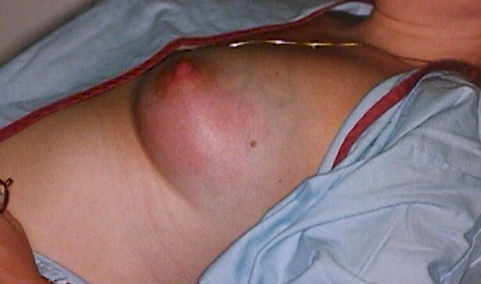
Acute Mastitis
‘Flu’ in the lactating individual is mastitis until proven otherwise!
Notes:
Now let’s talk about mastitis.
An old adage is that ‘Flu in the mother is mastitis until proven otherwise’. This is because mastitis feels like the flu, with achy joints, fever, chills and headache. Sometimes the lactating individual does not realize that one or both breasts are pink and tender. This is because the entire body feels sore. In addition, in early mastitis the breast changes are a light pink, which can be hard to see depending on skin color, ability to see the breast, and lighting in the house.

Slide 40
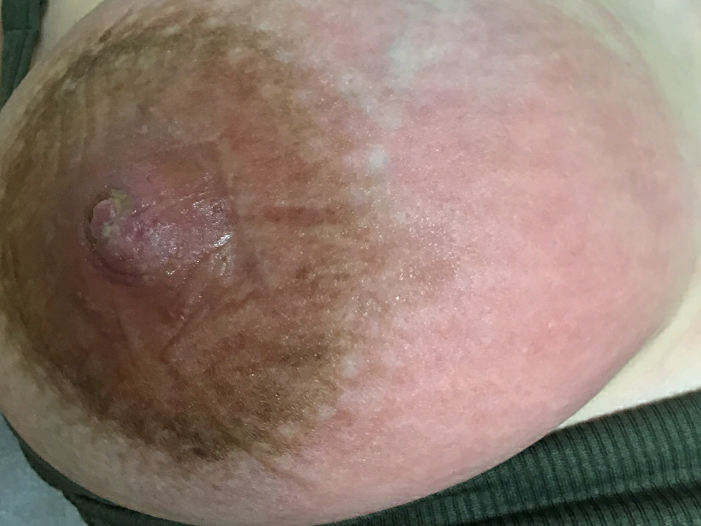
Acute Mastitis Symptoms
Flu symptoms
Breast pinkness- early stage
  Harder to identify on darker skin
Breast swelling and redness later
Possible nipple sores
Often preceded by clogged ducts
Notes:
Symptoms of Acute Mastitis
‘Flu’- with body aches, headache, fever, and nausea
Early on there is minimal breast pain and pinkness, but these symptoms worsen over time. The pink changes might be harder to identify on darker skin.
In a day or 2 the breast can become swollen, more red, firm, and very tender
Nipples may have open sores or blisters
Many women notice that mastitis will follow a plugged duct, or she notices more frequent plugged ducts while she has mastitis.

Slide 41
What are Risk Factors for Mastitis?
Notes:
Pose this question to the group. The answers will be on the next slide

Slide 42

Risk Factors for Mastitis
The first 26 weeks postpartum
Nipple wounds
Staph aureus in milk or having a staph infection elsewhere such as cesarean incision
High milk production and/or an imbalance of milk production relative to milk removal
Wilson E, Wood SL JHL 2020 online; ABM Mastitis Protocol 2022, bfmed.org
Source: US Breastfeeding Committee
Notes:
Who is at risk for developing mastitis?
This data comes from a recent systematic review (Wilson, Wood et al 2020 JHL) of articles regarding the risk of mastitis, as well as the Academy of Breastfeeding Medicine protocol on the Mastitis Spectrum
Women who are at higher risk include:
Mothers who are in the first 26 weeks postpartum
History of nipple damage/pain. The nipple wounds are the entrance way for infection. For this reason, it is so important to work on proper latch and positioning early.
Staph aureus bacteria in milk
IF the infant carries staph in their nose or has a staph infection on the skin
High production or when the amount of milk being made is higher than what is being removed

Slide 43
Over production (relative to milk removal)
Regional areas of swelling (edema), AKA clogged ducts
Acute mastitis
Most mastitis is due to recent clogged ducts, so are not infectious. Antibiotics are often not needed
Notes:
We are showing this slide again, emphasizing that because most cases of mastitis occur from clogged ducts, and many do not need antibiotics.

Slide 44
Noninfectious vs Infectious Mastitis
Difficult to Determine Difference
Non-Infectious
Infectious
High fever
Dizziness, nausea, weakness, headache and other systemic symptoms
Breast redness and warmth
Breast pain/tenderness
May worsen over 48 hours
No fever or possibly low grade
Systemically feels OK
Mild or no breast redness
Breast pain/tenderness
Typically improves in 48 hours
Notes:
Non infectious mastitis may progress to infectious mastitis. We don’t have a good way to determine if a mastitis is infectious or not, so we must use clinical considerations. In other words, if there is a high fever, with other bodily symptoms such as dizziness, nausea, weakness, headache, then it will more likely be infectious.

Slide 45
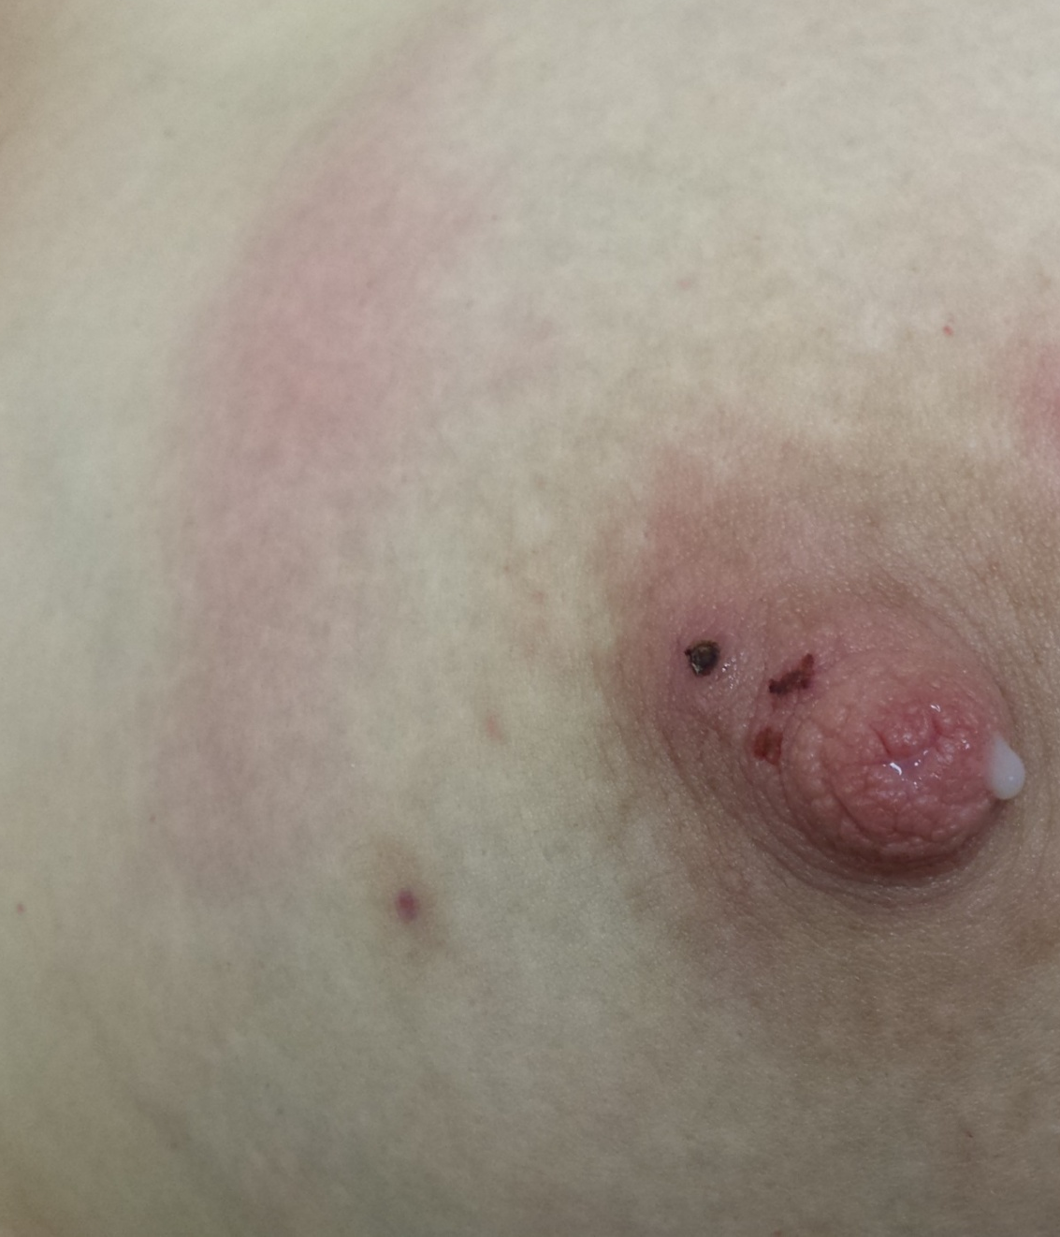
Mastitis Treatment
Determine if due to overproduction or over-fullness
Rest
Cool compresses to reduce swelling
Stay on a regular nursing or pumping schedule (do not over-pump)
Anti-inflammatories- ibuprofen as needed for pain, fever.
Antibiotics if ill, or not improving in 24 hours
Notes:
How do we treat mastitis?
First we want to determine if overfullness is the reason for the mastitis. This is a non-infectious mastitis, due to over fullness and swelling, causing the breast to feel warm and red. The mother will not typically have a fever, body aches, headache, or feel overall ill.
The individual needs to rest, apply moist heat or ice to the breast, whichever feels better, to the breast every few hours for about 15 minutes, and nurse or pump on a regular schedule. Do not increase frequency of pumping, as that will drive up production and increase risk of further infections
The milk is safe to give to the baby.
Antibiotics that are anti-staph are needed if the lactating person is ill with fever, body aches, and feeling generally ill. Common antibiotics include: dicloxacillin, clindamycin, cephalexin, augmentin
Anti-inflammatories can help with fever, body aches, and decrease breast pain. Ibuprofen is the safest anti-inflammatory during lactation.

Slide 46

What NOT to do for mastitis!
Avoid deep massage or vibration- this damages tissue, creating abscesses and larger areas of inflammation
Avoid increasing frequency of nursing or pumping- more milk production will worsen swelling
Notes:
What NOT to do for mastitis
Avoid deep massage or vibration- these will aggravate the areas of edema, creating more swelling. These behaviors can lead to abscesses, galactoceles and phlegmon, which are serious complications of mastitis, and require physician/provider intervention.
Avoid increasing the frequency of nursing or pumping. Again, we are not trying to ‘get a plug out’. Increasing nursing or pumping is going to create more milk production. The milk does not have anywhere to go because of the swelling, so this will make the swelling worse.

Slide 47
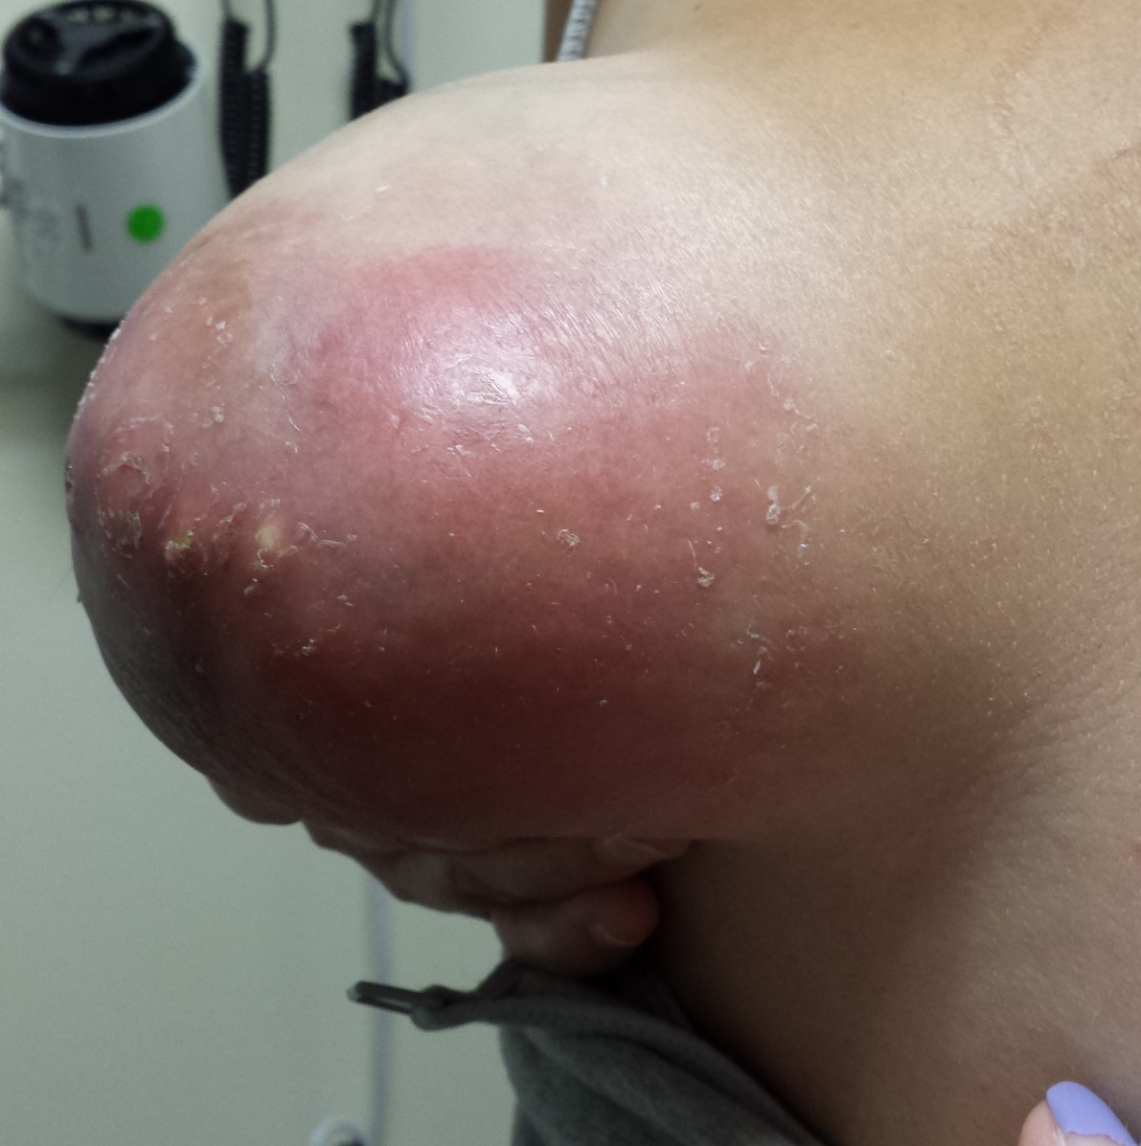
Abscesses during Lactation
Isolated regions of infected fluid in the breast
Often arise from deep massage/vibration in the setting of clogged ducts.
Require drainage
Continue antibiotics, rely on culture results
Continue nursing or pumping; do not increase frequency of drainage
Baby may nurse if milk is not purulent
Notes:
Abscesses during lactation
These most often come from the belief that areas of swelling in the breast are ‘plugs in ducts’, leading mothers to deeply massage and vibrate the tissue to ‘get the plug out’.
If the abscess is small, a needle can be put into the abscess to withdraw the fluid.
Larger abscesses need to be open and drained, or a drain can be placed by the radiologist, to allow the material to drain out over a few days.
Antibiotics are given during the time treatment.
The fluid withdrawn from the abscess is cultured to identify the bacteria
Breastfeeding/pumping should continue as usual, and the milk can be given to the baby unless it has a great deal of infected fluid (pus)

Slide 48
A mother and infant see you at a 6-week postpartum visit. The baby has been nursing well but latch still hurts. The nipple pain improves somewhat during nursing, but then after nursing, mom notices sharp, deep aching and burning sensations in her nipples that radiate into her breasts.
What are the most likely reasons?
Inadequate latch
Over-production
Neuropathic pain
Vasospasm
Dermatitis
Notes:
This is to present the differential diagnosis, and we will review each of these, other than the inadequate latch, which was reviewed in past sessions.

Slide 49
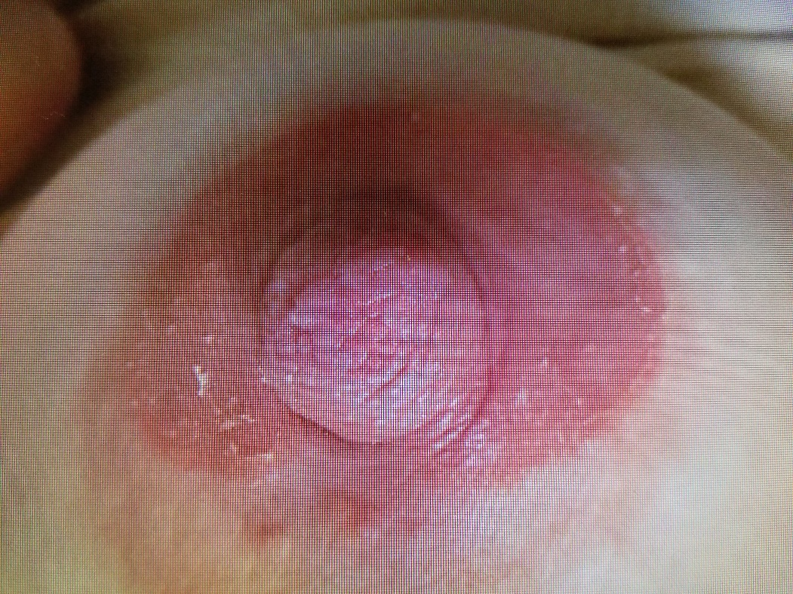
Common Causes of Nipple Dermatitis
History of skin disease, e.g., eczema or psoriasis
Reaction to an exposure on the nipple/areolar region
Notes:
Let’s first talk about Nipple Dermatitis
Causes often include:
Underlying Eczema
Underlying psoriasis
A reaction to something that mom has come into contact with.
Reactions can be quite varied. Reactions can occur from things that come into contact with the breasts, such as breast pads or nipple creams. Sometimes parents have a reaction to something that is in the baby’s mouth, such as antibiotics or foods, once they start solids. For example, if the parent is allergic to penicillin and the baby is given Amoxicillin for an ear infection, the parent can develop a rash on the nipple/areolar region. Many lactating parents develop a rash due to the use of scented dish soap used to wash their flanges.

Slide 50
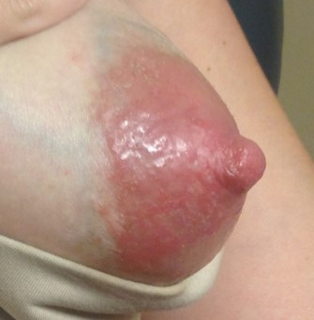
Symptoms of Dermatitis
Itchiness, pain
Red and/or scaly
May start during pregnancy or any time postpartum
Notes:
Nipple and Areolar Dermatitis
Itchiness, pain
Nursing is often uncomfortable
Red, scaly
The nipples will almost always look red and scaly in Caucasians. The redness might be hard to see in women of color, and instead the skin may appear irritated, raised, and scaly
May start during pregnancy or any time postpartum

Slide 51
What do you think are irritants that can cause a rash on the nipple/areolar region?

Slide 52
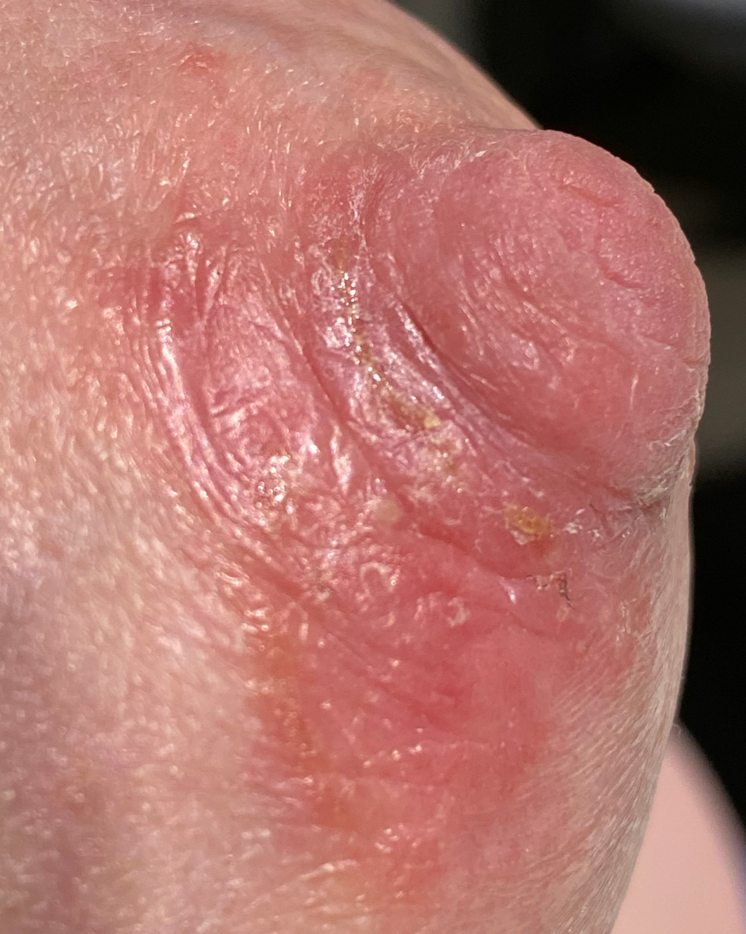
Treatment of Dermatitis
Possible irritants
  Infant oral medications
  Soaps, creams, topical medications
  Breast pads
  Pump flanges (soaps/cleansers used)
Treatment
  Frequent repeated moisturization with an oil/non-petroleum jelly
  Topical steroids are typically needed
    see her primary care provider or dermatologist for treatment
Notes:
Treatment of Dermatitis
Identify underlying cause
This is a process that providers do regularly when a person presents with a rash. In lactating individuals, it is important to find out if the parent has underlying eczema or psoriasis
Avoid irritants
Once certain irritants are suspected, ask the parent to avoid them
Frequent repeated moisturization with an oil/petroleum jelly
Irritated skin tends to improve with moisturization using an oily barrier, such as coconut oil or petroleum jelly
Topical Steroids
Topical steroids tend to work well to reduced nipple pain, cracking and irritation, but the breastfeeding champions should not recommend steroids until the parent is seen by their physician or other provider
If not improving, see a dermatologist
If the rash is not improving, they may need to see a dermatologist for a biopsy. A rare form of breast cancer is called Paget’s disease, which can present as a dermatitis of the nipple

Slide 53
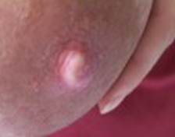
Vasospasm
(decreased blood flow to the nipple)
Nipple turns pale-blue-red
Burning nipple pain
Sharp breast pains
Pain lasts variable duration of time
  Color changes occur with pain
Triggered by cold
  Not just associated with feeding
Often worse for people with overproduction
Notes:
Lets talk about Vasospasm of the Nipples
This is a common problem that can cause pain. It is also known as Raynaud’s syndrome
Classic symptoms include:
Nipple go thru a cycle of color changes. These occur because there is a decrease in blood flow to the nipples First the nipples turn pale, then dusky or blue, and then flush-red when the blood supply returns- this is the typical pattern of vasospasm
Nipple and breast pain can last a variable amount of time
The pain is associated with the color changes. Once the nipples are flush-red again, the pain is often going away. The pain is a frequent burning of the nipples and sharp pains into breasts. Some parents describe a constant burning of the nipples during, after and between feedings. This is most often due to vasospasm.
Triggered by cold
Lactating individuals will notice vasospasm with feeding, especially if the infant is biting or causing suck trauma. A cold environment will also induce the same pain from vasospasm.

Slide 54
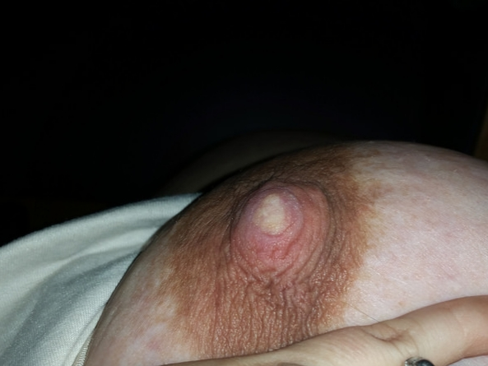
Notes:
Here is a picture of a nipple that is pale in the early blanched vasospasm phase. Vasospasm usually starts as blanched, then proceeds to purple changes (cyanosis), then flush-red.

Slide 55
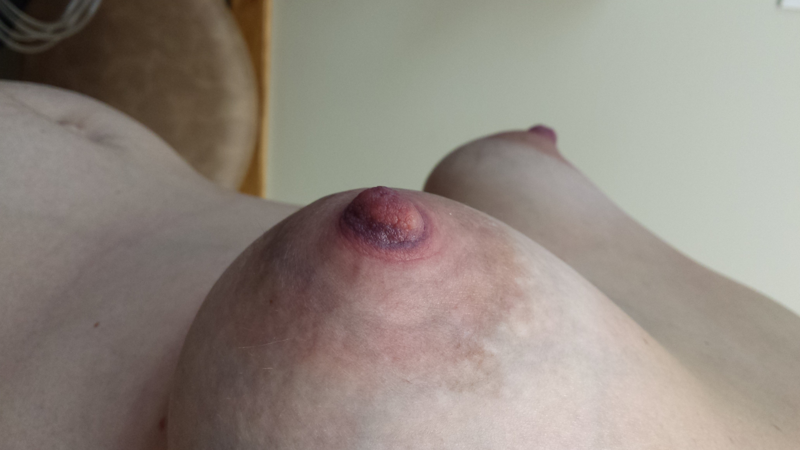
Notes:
This is a picture of a nipple that has vasospasm. It is in the purple, or cyanotic stage.

Slide 56

Treatment of Vasospasm
Avoid infant biting
Apply heat immediately after nursing
Keep breasts warm
  Flannel or wool pads
  Foot warmers applied to backs of nursing pads- do not allow these to directly touch the breast/nipple!
  Medications
Source: US Breastfeeding Committee
Notes:
Treatment of Vasospasm
Avoid infant biting
Take the baby off the breast at the end of feeding when the baby is non-nutritively sucking, meaning when the baby is no longer swallowing.
Apply heat immediately after nursing
There are a few ways to do this. The parent can apply a heating pad on the low setting to the nipples after covering with a bra for a few minutes after nursing. Another way is to apply warm moist compresses. Disposable diapers make nice moist compresses. The gel in the diaper retains heat well.
Keep breasts/nipples warm
Wear warm clothes, keep bra on. Use wool or flannel nursing pads, or pieces of such fabric inside bra.
Medications
Certain medications that are also used for Raynauds of the hands and feet can open the blood vessels and prevent the blood vessels from clamping down, causing the vasospasm.

Slide 57

Neuropathic Nipple/Breast Pain
Pain starts early postpartum
  Occasionally during pregnancy
Nipples often appear normal
Pain includes:
  Sensitivity
  Constant tenderness
  Pain with pumping or breastfeeding
    Throughout feeding/pumping and afterwards
Not necessarily with over-production
May be associated with anxiety/depression
Often severe enough to wean
Most effective treatment includes antidepressants
Notes:
Neuropathic nipple and breast pain.
This tends to be a very chronic persistent nipple and breast pain that occasionally is present in pregnancy, but usually is most noticeable during breastfeeding.
The parent complains of extreme nipple sensitivity, such that it is very hard to breastfeed, and the nipples are uncomfortably tender and sensitive between feeding. Pumping is just as uncomfortable as nursing.
The symptoms are similar to vasospasm, but do not improve with heat, and are not worse with cold.
It can be associated with anxiety and/or depression.
Unlike vasospasm, over production is not causative.
The most effective treatment are SSRI antidepressants. Even low doses work very well.

Slide 58
Uncommon causes of nipple/breast pain
Herpes
Shingles
Yeast
Subacute mastitis
Notes:
These are very uncommon causes of nipple pain, and we won’t go into these in detail. We will discuss these briefly. Even though it was popular to believe that nipple pain is due to yeast, that is not the case. The most common causes of nipple pain are on the previous slides.

Slide 59
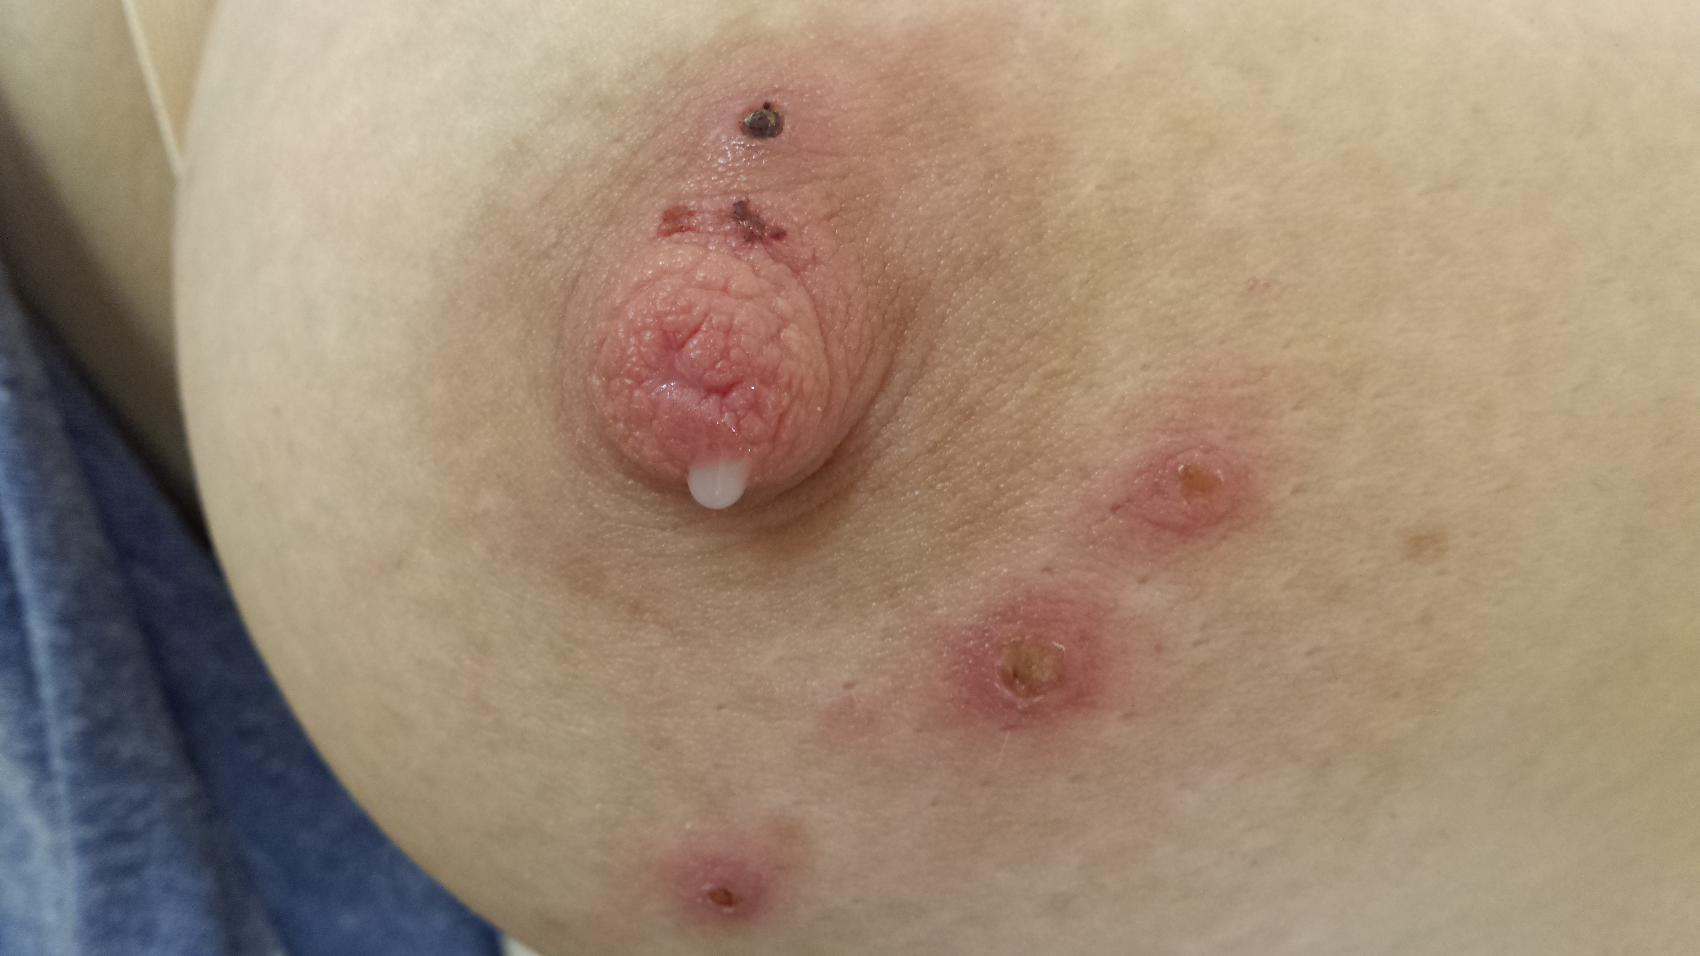
Herpes Simplex on
The Breast
Notes:
This is a picture of herpes lesions of the breast. You can see that these are no longer blistered, but are in the healing stage with scabs formed.

Slide 60

Herpes on the Breast
Herpes Simplex
  Can cause herpes in infant
  The lactating parent is infected from nursing toddler with cold sores
Management
  Avoid direct contact of lesions with baby
  Express and discard milk on affected breast
  OK to nurse on an unaffected side
    Often is on both breasts
  Cover lesions until scabbed over
  Anti-viral medication
Notes:
Herpes Simplex on the Breast
Herpes Simplex
Herpes Simplex can cause severe illness in an infant, so we don’t want infants exposed to this. Most lactating individuals who develop herpes simplex on their nipples/breasts contract the herpes from the infant or child, who had a case of cold sores.
Management of herpes simplex
Avoid direct contact of lesions with baby
When the lesions are blistered, they can give the baby herpes. Herpes infections in young infants can be fatal. If the parent contracted the blisters from a toddler with herpes around the mouth, then it probably won’t matter as much if the toddler keeps nursing with the nipple blisters. But once the parent has herpes, it can come back and infect a new baby. So if the lesions occur after the birth of another infant, the new baby should not be exposed to the lesions.
Express and discard milk on affected breast
To prevent exposing a new baby to herpes lesions, the parent will need to express and discard the milk from the affected breast, until the lesions are scabbed over. The parent can continue to nurse on the other side. The parent should keep the lesions covered until the lesions are scabbed over.

Slide 61
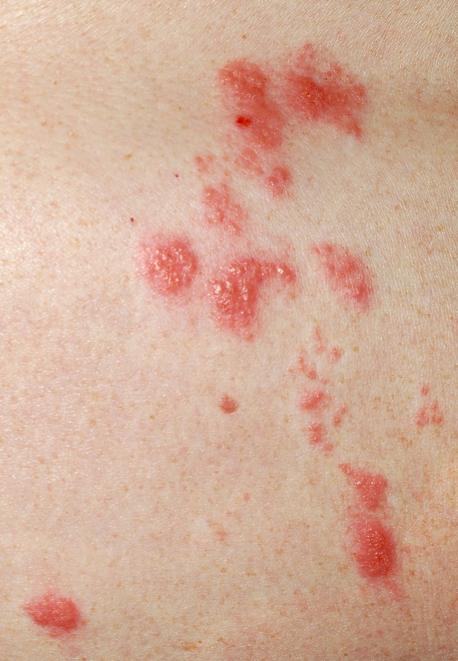
Shingles on the Breast
Shingles- reactivated chickenpox
  Blisters spread chickenpox
Occur on 1 side of body
Can develop over 1 breast region
Management
  Avoid direct contact of lesions with baby
  Express and discard milk on affected breast
  OK to nurse on the other side
  Cover lesions until scabbed over
  Anti-viral medication
Notes:
Shingles on the Breast
Shingles- Reactivated Chickenpox
Shingles is an illness that is caused by the chickenpox virus. Once a person has had chicken pox or has received the vaccine, the virus lives in the person’s body. At some point a large % of the population has an outbreak of shingles, which occurs along one nerve. It will occur as painful blisters along one side of the body. If it occurs in an area exposed to the baby, the baby can contract chicken pox.
Management of shingles
Avoid direct contact of lesions with baby
When the lesions are blistered, they can give the baby chickenpox
Express and discard milk on affected breast
To prevent exposing a new baby to the shingles lesions, the parent will need to express and discard the milk from the affected breast, until the lesions are scabbed over. The parent can continue to nurse on the other side. The breast with the lesions should be kept covered, so that the baby is not exposed to the lesions until they are scabbed over.

Slide 62
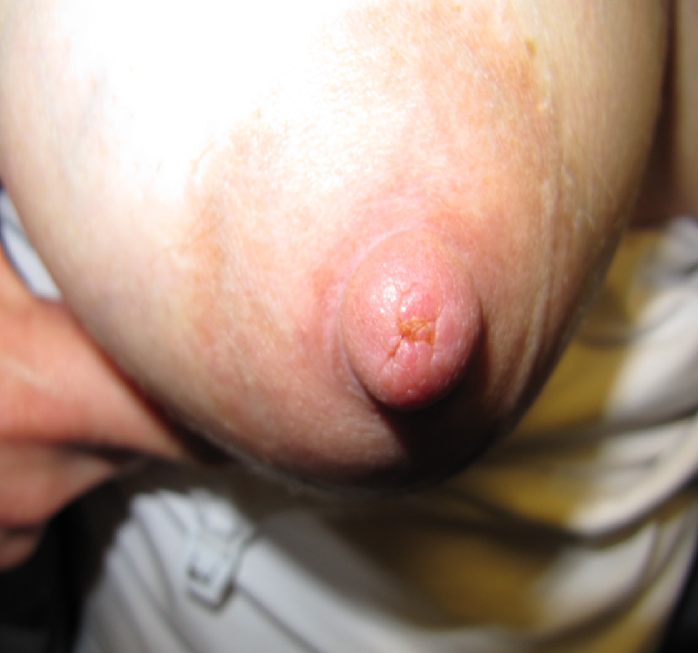
Symptoms of Subacute Mastitis or Mammary Dysbiosis
Usually nipple pain
Deep breast pain after feeding
Breasts feel tender/bruised
Recurrent clogged ducts
Nipple scabs
Notes:
Symptoms of a Subacute Mastitis or Mammary Dysbiosis
Nipple Pain
The nipples are usually tender and latch hurts. Often the lactating parent will describe extreme nipple pain in the shower or when the nipples are touched.
Deep breast pain after feeding
This problem is often considered ‘yeast’ because of the sharp shooting breast pains and dull aching after feeding. Sometimes the pain starts about 30 minutes after nursing or pumping has finished.
Breasts feel tender
The parent will describe having breast tenderness when holding the baby against their chest, or when hugging the baby
Recurrent plugged ducts
The parent often describe having repeated plugs in their breasts. This is often associated with a decrease in her supply.
Nipple Scabs or Cracks
Nipples might have yellowish scabs at the tips, like the photo in this slide. Many parents have normal appearing nipples, and others might have cracks in their nipples that are not healing.

Slide 63
Management of
Subacute mastitis
This is a bacterial-overgrowth situation
Breast exam and breastmilk culture
Reduce over-production of milk
Antibiotics based on culture results
Probiotics with Lactobacillus Salivarius and Lactobacillus Fermentum
  Uncertain if it will help
Refer to breastfeeding specialist for management if possible
Notes:
Management of a mammary dysbiosis
This is a bacterial-overgrowth situation
Many lactating individuals will be told that they have a yeast infection. There is often 40-60% improvement in the pain with anti-fungals, likely because most individuals have this bacterial-overgrowth situation.
Breast exam and breastmilk culture
These parents need a breast exam and a breast milk culture, that should be done by a knowledgeable professional
Reduce over-production
Lactating individuals with over-production of milk will have very similar symptoms of breast and nipple pain. Treatment of over production is needed to help resolve the symptoms. The easiest way to do this is with block feeding, when the parent nurses from one breast for a 3-hour stretch, then nursing from the other for a 3-hour stretch. They continue to do this 24 hours a day. Usually within 2 days the supply is down significantly.
Antibiotics based on culture results
The decision on antibiotics will be based on culture results
Probiotics
Some research shows that taking lactobacillus salivarius and lactobacillus fermentum might help breast infections, but it is unclear, there is not enough evidence for this yet. These are expensive.
If mammary dysbiosis is suspected refer to a physician who is a breastfeeding medicine specialist, if possible.

Slide 64
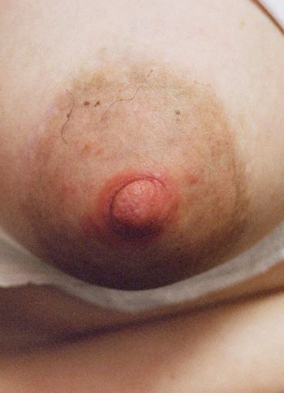
When Yeast is Suspected
Classic nipple symptoms described as tender, burning, ‘shards of glass’ pain, itchiness
Nipple/areolar region is red, shiny, with pimply satellite lesions
More likely if the infant has moderate oral thrush
Usually due to dermatitis or subacute mastitis, and rarely due to yeast
Nipple with dermatitis, not yeast
Notes:
‘Yeast’ Overgrowth of the Nipple and Breast
Yeast (Candida albicans) lives in and on our bodies normally. It is when it becomes out of balance with the “good” bacteria that it can cause symptoms. So it is not an “infection” in the sense it is somewhere where it does not belong
Typical symptoms when yeast is suspected
The typical nipple symptoms of what many consider yeast include nipple burning, itching, ‘shards of glass’ pain, sharp shooting pains, and nipple redness. . It occurs on BOTH sides. There is no evidence as of now that yeast can “infect” the breast…most breast pain associated with red and sore nipples is referred pain from the nipples.
Classic Risks
Lactating parents are at risk for candida infection of the nipples if the infant has oral thrush (yeast), or if they have diabetes.
Often treated by phone
Lactating individuals often call their doctor’s office and describe their symptoms, and are given treatment in the form of topical creams or oral anti-fungals Unfortunately, many of these lactating individuals don’t improve 100%. They often improve to a certain degree because they usually don’t have a yeast infection.
Symptoms are often not due to yeast
There are several other reasons for nipple pain, such as over production, vasospasm or mammary dysbiosis. Yeast is very over-diagnosed.

Slide 65
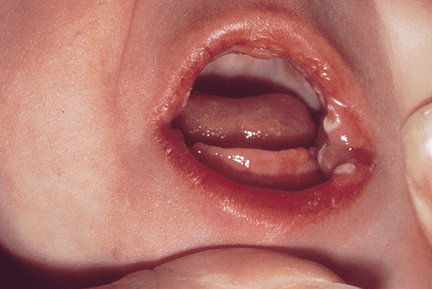
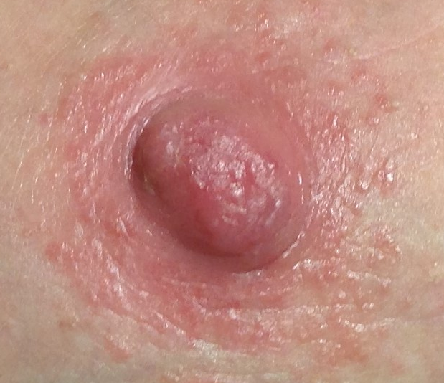
When to Consider Yeast Treatment
Classic symptoms (on previous slide)
Dermatitis is ruled out
Infant has known oral thrush
A culture or swab is positive for yeast
Treatment is often oral antifungals for the mother/parent.
Notes:
When to Consider Treatment for Yeast
Classic symptoms as described on the previous slide
Dermatitis is much more likely as a diagnosis than yeast, so if the physician/provider should be certain that the rash is not due to dermatitis.
Known Infant Thrush
If the baby has been diagnosed with thrush AND lactating individual has symptoms of nipple redness, soreness and itchiness, there is a higher likelihood that the mother has yeast.
If nipples look normal and she has pain
If the lactating individual’s nipples appear normal, it is not yeast.

Slide 66
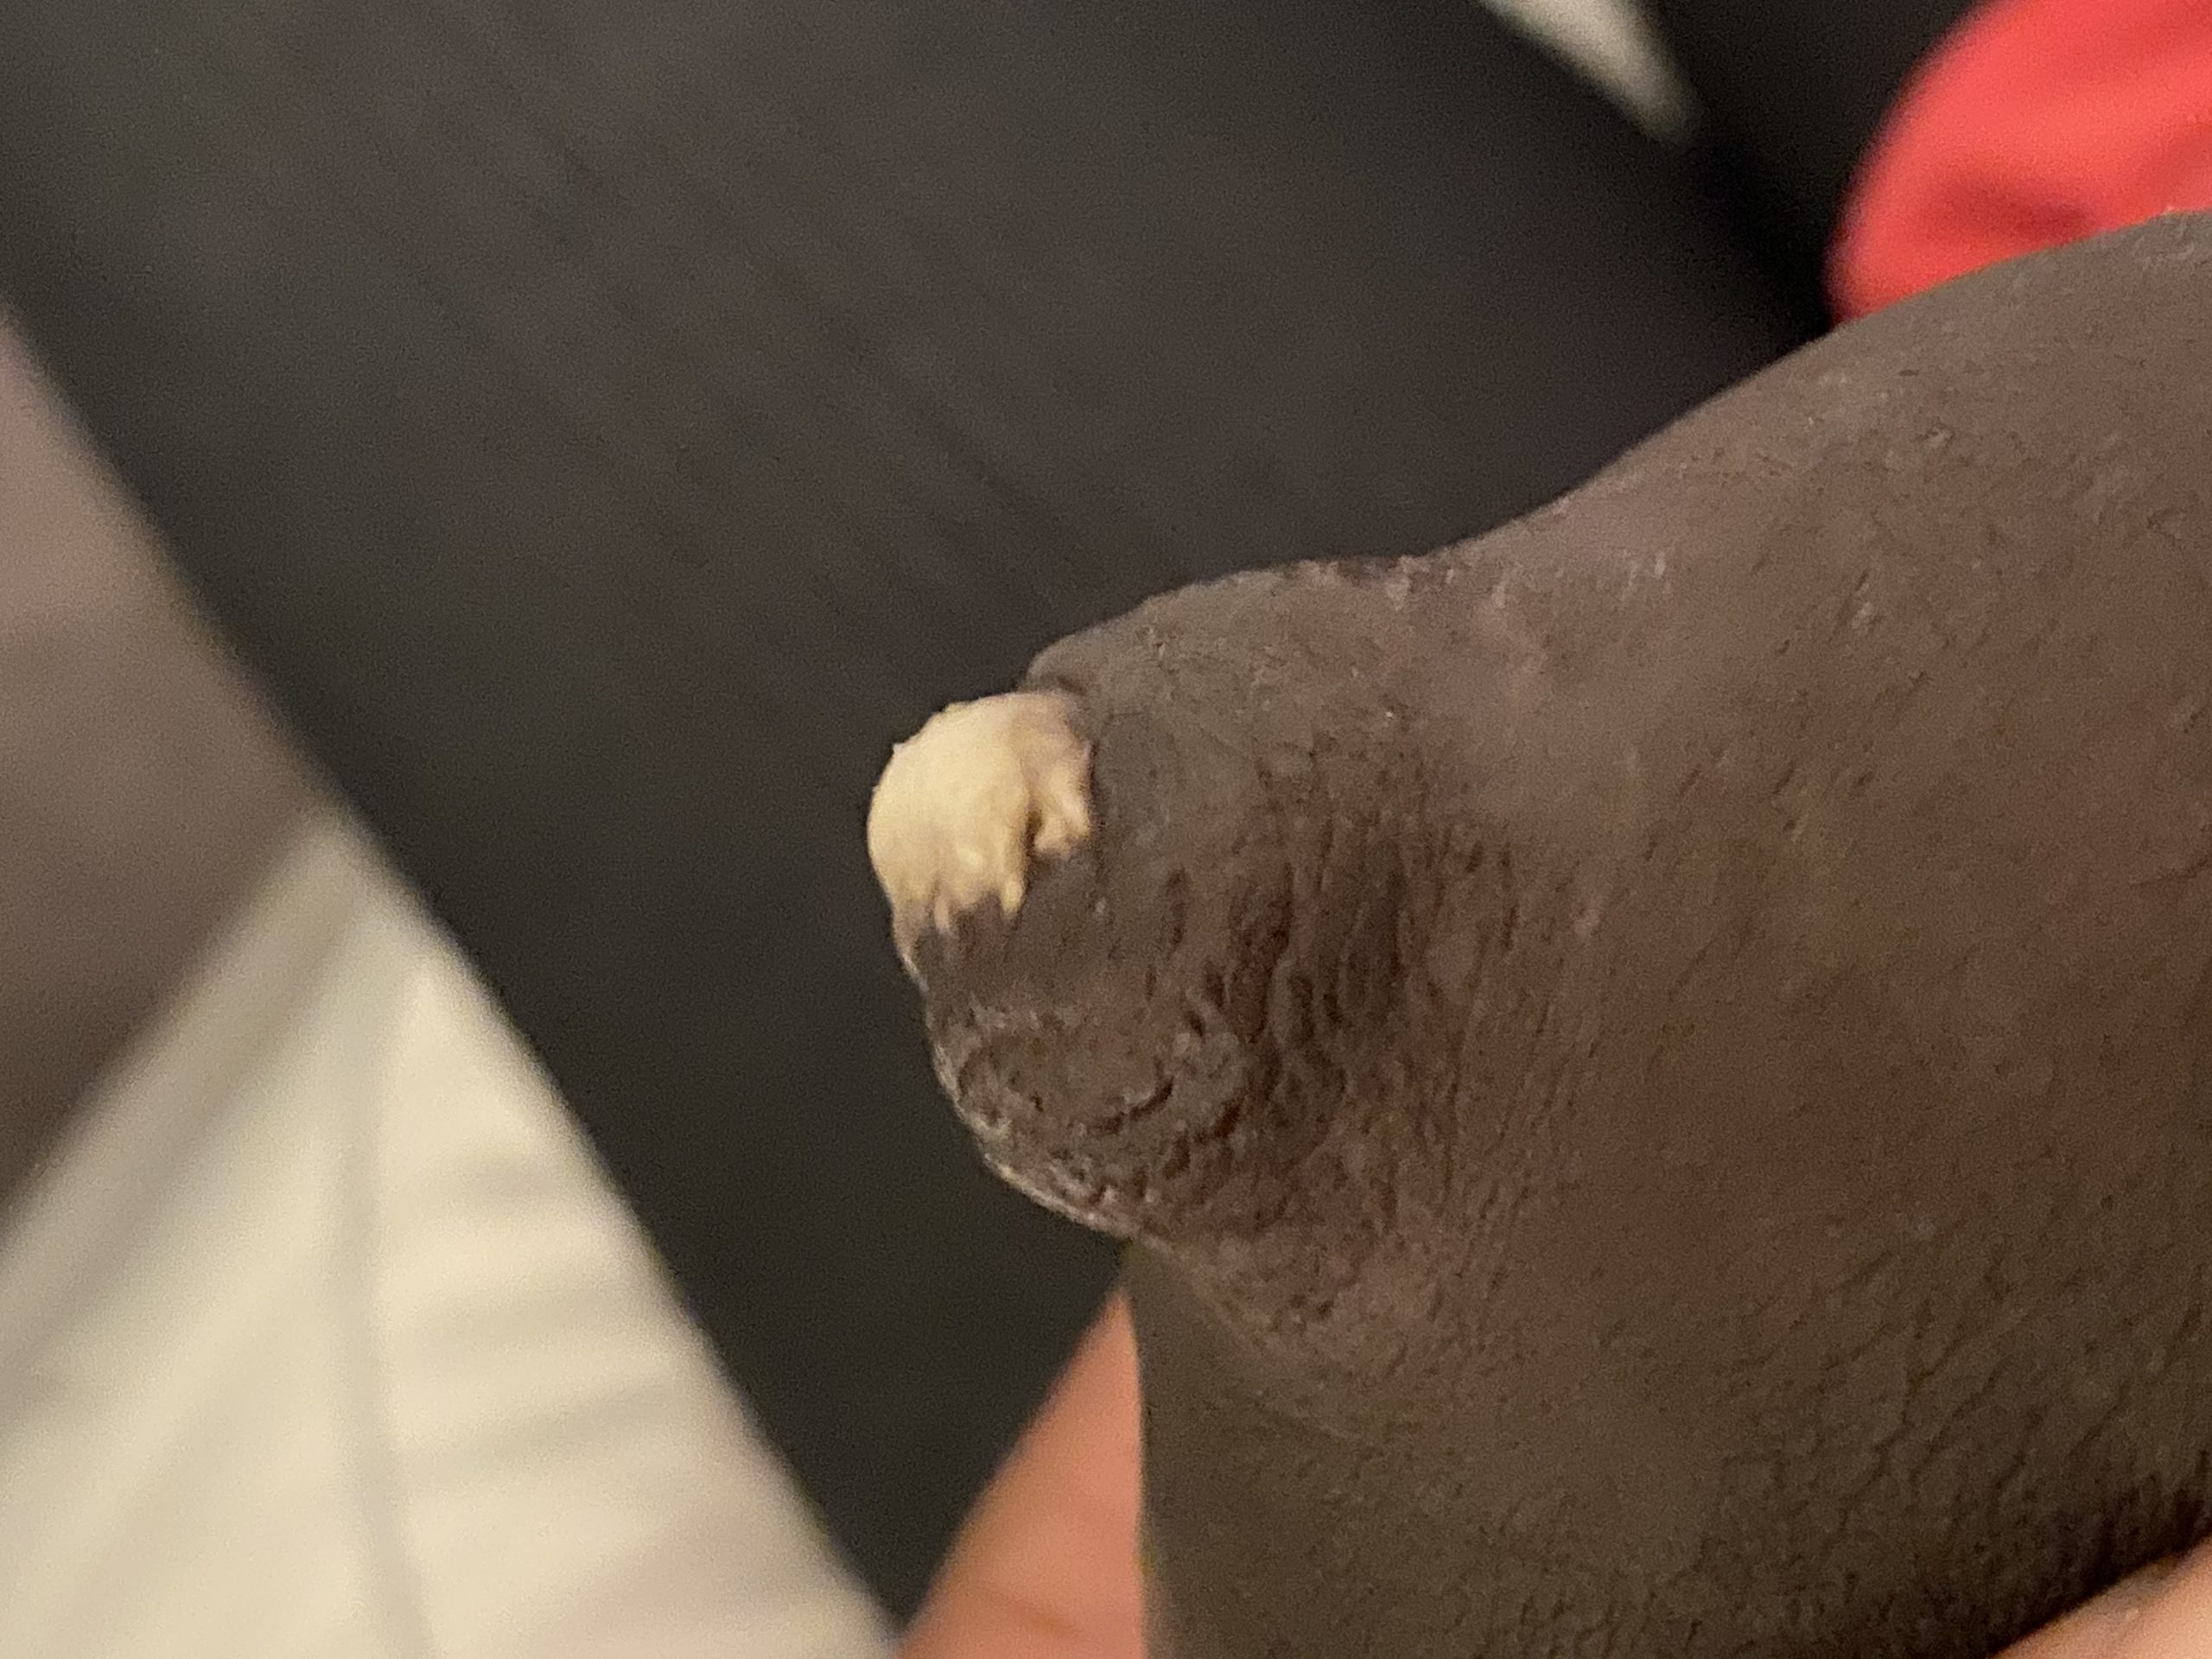
Nipple Blebs
A milk-colored lesion on the nipple
May or may not be painful
Sometimes associated with clogged milk ducts
Notes:
This is a photo of an pretty advanced bleb.
It is a milk colored lesion at the tip of the nipple
It may or may not be bothersome.
Sometimes these are associated with tugging and pulling on the nipple. For others, it is associated with a deep plug

Slide 67
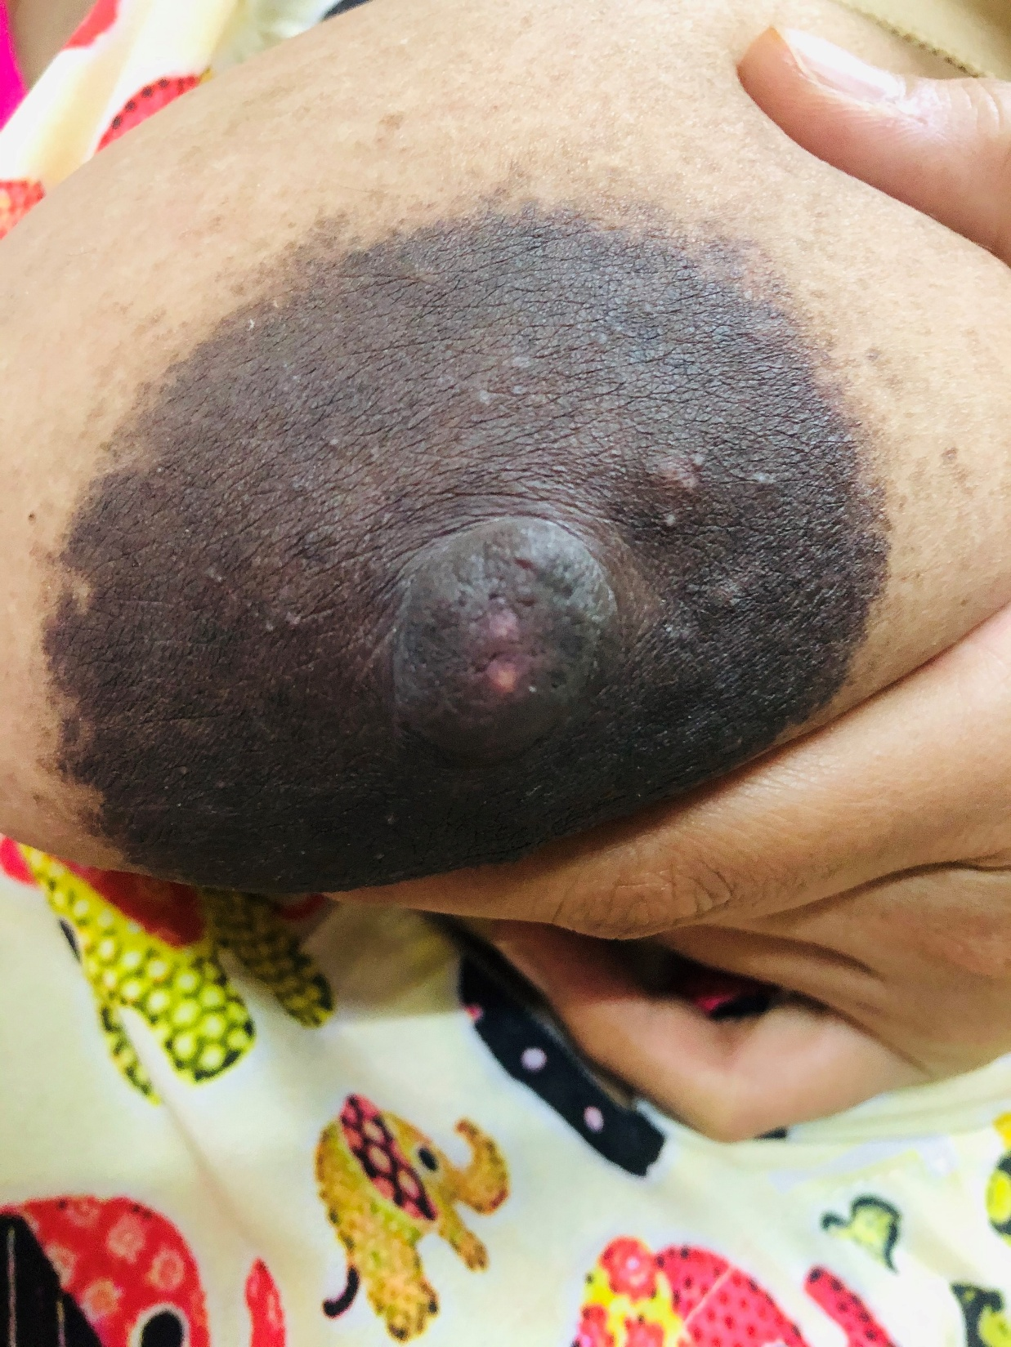
Bleb Treatment
Treatment
  If no pain and no underlying clogged duct, no need for treatment
  If recurrent, best to manage underlying overproduction or clogged ducts
  Steroid ointment may help
  Surgical unroofing does not help
Photo- Kathy Leeper MD
Notes:
Treatment of a Bleb
If it does not bother the parent, they can leave it alone.
If it is painful, the most effective treatment is a topical steroid, which is typically by prescription.
Surgical unroofing does not help and can cause nipple trauma and scarring.
If blebs are recurrent, underlying difficulties with over production and/or clogged ducts needs to be addressed

Slide 68

Infant Biting
Most often during teething
Other causes:
  Bite reflex
  Rapid or heavy milk flow
Notes:
Infant Biting
Infant biting is a common problem
Most often teething- Usually infant biting is a problem that occurs when babies start to teeth, earliest around 3 months, but usually after 4 months. For the most part, they will be dealing with biting due to teething.
Other Causes- Occasionally there are other causes of biting
Newborn bite reflex- This is also known as the ‘tonic bite reflex’ It occurs in babies under 2 months, only when the tongue is inside the mouth. If is a simple reflex that usually goes away by 2 months, but can be worse if the baby is tongue tied. If the infant is under 2 months of age and is biting the baby should be referred to a lactation consultant.
Milk flow- Babies might bite down early in the first several weeks if the milk flow is fast or heavy, such that the baby has trouble controlling the flow. Biting down on the nipple can help to slow the flow, but also obviously hurts the parent.

Slide 69

Infant Biting During Teething
Occurs with teething
During non-nutritive sucking
Treatment
  Keep the baby close
  Avoid non-nutritive sucking
  Alternative for infant teething
Photo by Deedee Geli on Unsplash
Notes:
Infant Biting
Occurs with teething
Most biting will occur when the baby is teething, which is 3 months at the earliest, so let’s just focus on teething as a cause of biting.
During non-nutritive sucking
Biting due to teething is most likely to occur at the end of a feeding, when the baby is no longer swallowing. When the baby swallows, the tongue stays over the lower gum line. When swallowing is over and the milk is not flowing, the baby will retract the tongue, allowing the baby to bite down.
Treatment
Keep the baby close
This means keeping the nose and chin close to the breast, so that the baby cannot pull back and bit down on the nipple. By keeping the baby close to the breast, the baby’s mouth will stay wider open.
Avoid non-nutritive sucking
If the baby seems to be done swallowing and is non-nutritively sucking, the baby is more likely to bite. When the baby seems to be in a biting mood or stage, it is best to take the baby off the breast when he is done swallowing to prevent biting.
Alternative for infant teething
When the baby begins to bite, take the baby off and offer a cool moist cloth to bite on, or a chilled teething toy

Slide 70
Conclusions for Session 4
The most common causes of sore nipples are positioning and latch issues
Breast engorgement during the first week increases the risk of nipple trauma
People with sore nipples who are not improved by changes in positioning and latch should be referred to a knowledgeable provider
Notes:
These are the topics covered in this session

Slide 71
You are seeing mom & her term healthy infant at 14 days postpartum. She complains that her nipples are sore when the baby latches on and the pain continues throughout feeding. When the baby comes off the breast, the nipple looks pinched and pale. You advise:
You have vasospasm of your nipples. Use heat on your breasts after nursing.
You likely have a yeast infection of your nipples. You will need to contact your provider for treatment.
You need to have the latch checked. Either I can do this or let's have a lactation consultant see you.
Notes:
The correct answer is C
A is not correct because the problem is nipple trauma, not pure vasospasm. The nipple trauma needs to be corrected.
B is not correct. Pale pinched nipples do not represent yeast.

Slide 72
A lactating individual who is 6 weeks postpartum reports stinging burning nipple pain for 1 week. Prior to this, they had no lactation problems. They would like to know what could possibly be wrong. You advise:
Your baby may not be latching properly.
You might have over-production, causing fullness and breast discomfort.
Your let-down is too fast, causing the baby to pinch the nipple.
You might have vasospasm.
You might a nipple/areolar rash.
All of the above are possible.
Notes:
The correct answer is F.
All of these problems are possible.
This is why sore nipples cannot be managed over the phone

Slide 73
A mother who is 20 days postpartum reports that her nipples are still cracked, sore, and the sores stick to her breast pad. She denies deep breast pain, fever or breast redness. Breastfeeding hurts with latch and improves during feeding. You advise:
You need to see a lactation specialist.
In the meantime, apply breastmilk, coconut oil, or lanolin and a nonstick pad over the wounds after each nursing.
B. Your nipples won’t heal until you stop nursing. Just pump and bottle feed for now.
C. Use a nipple shield to reduce pain and allow the sores to heal.
Notes:
The correct answer is A
She has had sore nipples for almost 3 weeks, so she needs an evaluation to rule out problems such as prolonged nonnutritive sucking, pump trauma, or a skin problem like eczema.
B is incorrect. IF the sucking is not traumatic, then she should continue to nurse. In this case, she just has pain with latch, and not during feeding, which means that the baby is probably doing a fine job sucking. These are probably not healing because she is allowing her nipples to stick to the breast pad. These sores will heal faster if they no longer stick to a bra or breast pad.
C is incorrect. Nipple shields can cause a drop in milk production, reduce milk transfer, and can cause more nipple pain and trauma because the baby often ends up sucking on the nipple and not the breast, causing the nipple shield to press down on the nipple sores. Also, the baby might start to refuse to nurse without the nipple shield.

Slide 74

A lactating individual who is 3 months postpartum reports nipple redness with burning, stinging pain for 2 weeks. People on their Facebook support group suggested that they may have thrush. They wonder what you think. You advise:
You should be seen by a lactation consultant or breastfeeding medicine specialist to evaluate your pain.
Yes, it sounds like yeast. Call your physician for medication.
It sounds like vasospasm. Use heat on your nipples after nursing.
You should throw out your stored breastmilk in case it has yeast in it.
Notes:
The correct answer is A
B is incorrect. Nipple pain cannot be evaluated on the phone. The latch needs to be checked, and a breast exam is necessary for signs of yeast or other changes such as vasospasm
C is incorrect, for the same reasons as outlined above.
D. Is incorrect, women do not need to throw out their milk if yeast is suspected. There is no evidence for this. Most women don’t have a yeast infection

Slide 75
Mom calls 4 months postpartum reporting recurrent clogged ducts. She finds that they usually resolve in about 24 hours, but this one has been present for 4 days. She has no fever, chills or redness of the breast, but the area is tender. You advise:
Come in to be seen to have that area checked.
Try to nurse frequently, pump after nursing, use heat and massage as much as possible. IF it still is not gone in 3 days, call back. Watch for signs of infection.
You probably have too much milk, you should stop pumping so much extra milk.
Notes:
The correct answer is A
B is incorrect. She has had the problem for 4 days ,so needs to be seen. Excessive breast stimulation will make it worse
C is incorrect. It is possible that she has too much milk, but this advice will not help solve her current problem.

Slide 76
A parent calls 7 mo postpartum with a recent diagnosis of shingles by their physician. They describe painful red skin lesions along the upper back and onto the R breast, involving the nipple. The physician advised weaning and the parent wants your opinion. You advise:
The baby is now old enough to be safely exposed to these shingles lesions, so no worries, keep nursing.
It is best to not nurse from that breast. Express and dump the milk until the lesions on the nipple and sores are dried up. Keep the area covered.
Don’t nurse from the R breast, but you can express milk from that breast and give it to the infant.
Notes:
The correct answer is B
A is incorrect. We don’t want the baby exposed to shingles, since the baby could contract chickenpox
C is incorrect. The expressed milk can have chickenpox in it, so it needs to be dumped

Slide 77
A mother with her 4mo old reports that her infant is teething and wonders how to prevent biting. She was told that babies need to wean when teeth come in. You advise:
Yes, sometimes babies bite. Good luck.
Pump and bottle feed when teething seems the worst.
Babies bite most often at the end of feeding. Keep the baby deeply latched to prevent biting. Take her off when she is biting and no longer seriously drinking.
Make sure to respond loudly and clearly, to scare the baby into never doing that again.
Notes:
The correct answer is C
A is incorrect, since there are strategies to deal with this
B is incorrect. Pumping and bottle feeding is not sustainable for most moms. She has a higher likelihood of weaning early if she switches to pumping and bottle feeding.
D is incorrect. Scaring the baby might frighten the baby into a nursing strike.

