Slide 1

The Outpatient
Breastfeeding
Champion Program
Session 1

Slide 2

The Instructor has no conflicts of interest to disclose
Continuing medical education credits (CMEs) and continuing education recognition points (CERPs) for IBCLE are awarded commensurate with participation and complete/submission of the evaluation form
CMEs can be used for nursing credits

Slide 3

What is the IABLE?
Non-profit, membership organization
Establish Outpatient Breastfeeding-Knowledgeable Health Systems and Communities
Provide free lactation education for supporters
  Case discussion series 2nd Sunday of each month
  LactFact podcast once a month
  Free videos on Youtube and at lacted.org
  Breastfeeding education handouts
  Breastfeeding Medicine podcast series
Premium memberships support our free projects
Notes:
Nonprofit= after reasonable salaries are paid, all profits must go into fulfilling mission. No “owners” or shareholders.
Provide free breastfeeding education for supporters:
The following list are projects that provide free ongoing education for both providers and nonproviders
Case discussion series 2nd Sunday of each month
A LactFact podcast
Free videos on Youtube, Vimeo
Breastfeeding education handouts
Breastfeeding Medicine podcast series

Slide 4
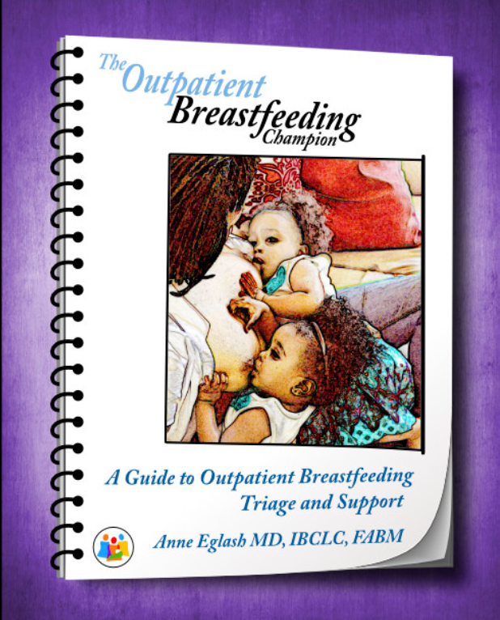
Your Learning Materials
Powerpoint Slides
  All lectures in the course are based on the slides
Activity PDF
  Class exercises
Curriculum Book
  Excellent reference guide as a Breastfeeding Champion
  Has the same information as the slides, but structured organized differently
All references for the course are in the curriculum book
Notes:
Please explain that it is best for the participants to follow along with the powerpoint slides. It will be confusing for them to follow the lectures by reading the curriculum book, since it is set up differently. It is an excellent reference for when they are back to work, and it has the same information on the slides.
The references for all of the slides are in the curriculum book.

Slide 5

Your Triage Tools and Breastfeeding Education Handouts
All triage tools are printed in your curriculum book
  In the back, after the green divider page
There are many more triage tools than the ones we cover in class
Triage tools can be shared with colleagues at your institution
Notes:
This slide is self-explanatory

Slide 6
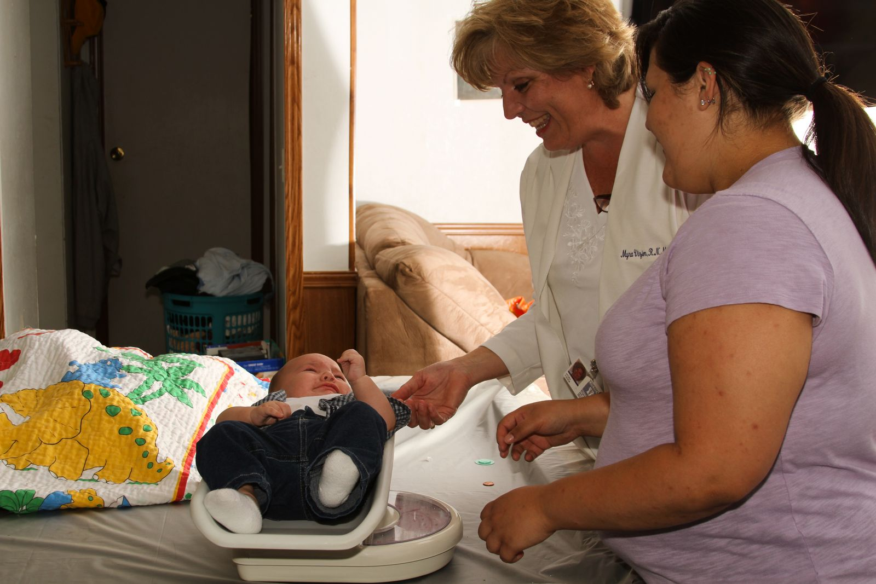
Objectives for the Outpatient Breastfeeding Champion (OBC)
Lactation resource person at work
  Colleagues, other staff
Education, counseling, and support for clients/patients
Breastfeeding promotion
Notes:
The Objectives for the Outpatient Breastfeeding Champion
Roles for the Outpatient Breastfeeding Champion can include:
1. Become the resource person for breastfeeding problems and questions- The Champion can provide education and resources for colleagues at work
2. Provide evidence-based phone and in-person triage for lactating parents- The Champion will have triage tools which can be used to provide optimal phone triage and counseling for breastfeeding problems.
3. Some OBCs have done breastfeeding promotion and support for families in the office- The Champion can be creative with ways to promote breastfeeding at work. Some ideas include providing an educational packet for each pregnant person encountered, or simply making sure that every pregnant person or new mom/family has her contact information. See Appendix in the Curriculum Booklet for more information on strategies to provide prenatal support.

Slide 7

Ideas for OBC Roles
Phone triage
Weight checks the first week
Hospital visits
Nurse visits
Phone check-ins
Congratulation program
Office support groups
Touch base at well child checks
Educate coworkers
Notes:
Ideas for OBC Roles
1. Phone triage – the busy OBC might primarily do phone triage for breastfeeding concerns.
2. Weight checks the first week- As an example, the OBC could see every newborn on day 3-4 before the provider comes in the room, or visit each family after a specific provider visit, such as the first office visit, or at 2 weeks.
3. Hospital visits-See new moms at the hospital. This works well if the office is close, and the OBC has a flexible schedule. This would allow the OBC to establish a relationship with each new dyad
4. Nurse office visits- if the OBC is an RN, she can establish a schedule for nurse visits for pump use, check latch, check weights, and teach how to use a feeding tube.
5. Phone check-ins- the OBC would call all new moms at some point to check in, often times done the first week, such as day 5-7
6. Congratulation program- come up with a program such as handing out onesies at 1 year that congratulates mom on nursing for a year. Or a special gift to moms who have demonstrated commitment to pumping at work.
7. Office support groups- these could be group visits for nursing dyads, 1-2 hours a week, for families to establish support with one another. Or they could be formed around special topics, such as going back to work and breastfeeding, or starting solids for the breastfed baby.
8.Touch base at well child checks-Target certain visits, such as 2 mo well-child checks, or 6 week postpartum visits to briefly discuss back to work and breastfeeding.
9. Educate office staff- examples could be to teach others in the office how to use the triage tools, and how to use medication resources during breastfeeding.

Slide 8

Scope of Practice
Your job description may not allow you to apply this knowledge or set of skills in practice
Knowledge that you cannot apply can be helpful in giving guidance to parents about what they can expect from their care with a lactation consultant.
Notes:
Some participants may complain that they are not allowed to triage phone calls, or may not be allowed to watch a parent latch, etc. The participant may voice frustration about attending the course because of concerns regarding scope of practice.
Please explain that even though they cannot apply this knowledge in practice, knowing this information can help them prepare a parent for some of the questions or thoughts that the lactation consultant may have.
For example, you are not planning to do breast surgery, but attending a lecture by a surgeon about the least invasive way to do a breast reduction may help you counsel your parents that different breast surgeries can be better than others, and the surgeon will explain this more in detail during the visit.

Slide 9

Every Participant Here Today:
Understands that people in this course may never have breastfed and/or may have had trauma related to breastfeeding
Brings valuable knowledge and experiences to share
Is encouraged to respect each other’s identities and stories
Is doing the best to listen with their heart
Notes:
This is self-explanatory

Slide 10

Session 1
Breastfeeding
Basics
Notes:
Now we will start on our first session for the OBC program

Slide 11

OBC Session 1 Topics
Special properties of human milk
The entero-mammary pathway
Risks of not breastfeeding
Special considerations regarding breastfeeding
Breastfeeding demographics
Healthy People 2030 goals
Barriers to breastfeeding/lactation
Prenatal counseling
Counseling the breastfeeding/lactating parent
Notes:
This slide reviews the topics that we will cover in session 1

Slide 12
Objectives for Session 1
Describe components of human milk that provide immunologic protection from illness.
Recite how antibodies directed against pathogens enter human milk.
Identify infant risks of not breastfeeding/receiving human milk and maternal risks of not lactating.
Explain current recommendations on duration of lactation.
Recite relative contraindications to breastfeeding.
Identify ways that pregnant individuals can be supported to breastfeed
Describe how to demonstrate empathy, respect and support for lactating parents
Notes:
These are the objectives for this Session 1.

Slide 13
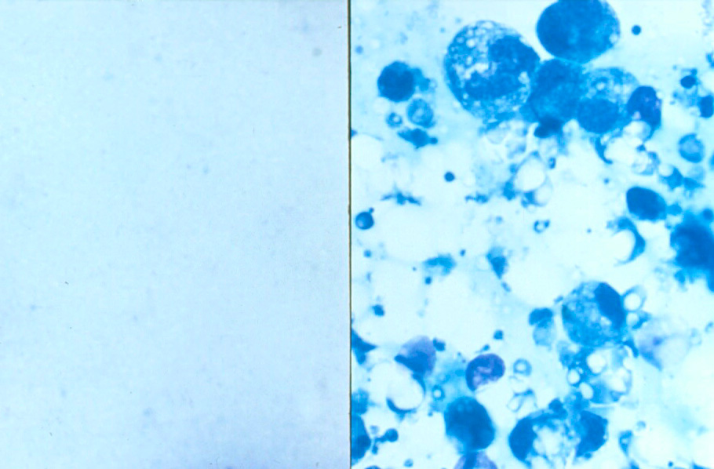
Notes:
Here you can see the difference between formula and breastmilk under the microscope.
The area on the left is formula. You can see that formula has no active biologic material. It is a liquid filled with chemicals.
On the right side is a microscopic view of breastmilk. You can see that there are active cellular components in breastmilk. For example, some of these living cells are infection- fighting white cells, such as macrophages and leukocytes. Milk globules are present, which are surrounded by living cell membranes. Enzymes are also present, in addition to healthy bacteria called probiotics.

Slide 14


Comparing Breastmilk and Formula = Comparing Apples and Oranges
Human Milk
Formula
Water
Protein
Carbs
DHA/ARA
Fat
Vitamins
Minerals
Water
Protein
Carbs
DHA/ARA
Fat
Vitamins
Minerals
PLUS:
Hormones
Antibodies
Active white cells
Enzymes
Anti-viral proteins
Antibacterial agents
++Oligosaccharides
Anti-allergy factors
Carotenoids
Protaglandins
Cytokines
Peptides
Etc!!!
Notes:
Comparing breastmilk and formula is like comparing apples to oranges. They are different foods, with different qualities.
Both human milk and formula have essential nutrients for the growth of the human body. (The essential ingredient are listed on each fruit)
But human milk has so much more, as listed below the orange.
Human milk has many living, active components, such as hormones, growth hormones, enzymes, white cells and antibodies, that have an effect on the infant’s immune system and growth of various tissues.
Breastmilk is considered superior for infant growth and development as compared to formula.

Slide 15

Formula is not evil
There are times that formula is essential
Notes:
There is no intention in this course to frame formula as evil. It is an essential nutritional source when supplementation is needed, when parents’ own milk and donor milk is not available.

Slide 16

Infants are at Risk
Immature immune system at birth
  High risk for infection
Breastmilk
  Protects from infection
  Promotes brain and immune system maturity
  Reduces inflammation
  Optimal nutrition
Notes:
Infants are at risk:
When a baby is born, the baby is immature in many ways. Think about the baby’s immature neurologic system. The baby cannot walk, talk, or grab a toy.
In the same way, an infant’s immune system is immature. This is obvious, as we know that young babies are very prone to severe illness and death from infection, such as viral diarrhea, RSV (respiratory syncytial virus), pneumonia and meningitis. Breastmilk serves to protect the baby’s immature immune system, and markedly reduces the risk of infant death and severe disease.
Breastmilk does this in a variety of ways. The components of milk provide;
Direct protection from infection- breastmilk will kill pathogens (germs) such as bacteria and viruses
Promote growth and development of the immune system- the immune system is stronger when babies are breastfed, especially by maturing the gut
Breastmilk has the right hormones and fatty acids to mature the brain tissue to a greater extent than a formula-fed baby, resulting in a higher IQ and better vision
Protection from one’s own inflammation, which can damage the infant’s system. Babies are at less risk for autoimmune illnesses such as Crohn's disease and type 1 diabetes
Optimal nutrition- breastmilk is the perfect food. No supplementation is needed except vitamin D, unless mom has a high vitamin D level. Some babies need added iron, particularly if the baby is premature.

Slide 17

Lets Look at Examples of How Human Milk Alters the Infants’ Immune System and Metabolism
Notes:
This is an intro slide to a set of examples of various ways breastmilk plays a role in shaping the infant’s immune system

Slide 18
Can you identify some breastmilk components that help infants develop and/or fight infection?
Notes:
Ask participants if they are aware of any milk components that help the infant fight off infection, or that help mature the baby’s organs, such as further developing the brain or gut.

Slide 19


Human Milk Oligosaccharides
Notes:
Human Milk Oligosaccharides (HMOs)
-The oligosaccharides are carbohydrates that are not absorbable.
-HMOs provide food for bacteria that populate the infant gut, which promotes the growth of the healthier bacteria.
-There are very few oligosaccharides in formula as compared to breastmilk.
Because formula does not nearly the same number of HMOs, healthy bacteria that thrive on HMOs cannot grow in the gut of the formula fed infant.
The healthier gut bacteria in the breastfed infant help to prevent diarrhea and other infant illnesses. The healthier bacteria also promote maturity of the gut lining, reducing the risk of intestinal diseases. J Perinat Neonat Nurs 34(3) 2020

Slide 20
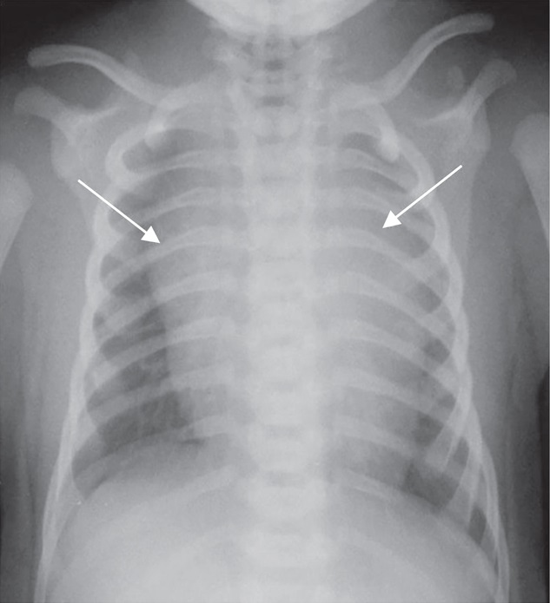
Breastmilk Factor Interleukin-7 keeps the thymus larger in breastfed infants, until weaning, improving infant immunity
Notes:
This is an x-ray of an infant chest, and you can see how very large the thymus is. It appears to drape over much of the heart and lungs! The thymus is much larger in breastfed infants vs formula fed infants. The thymus plays a very important role in making T cells, which are a type of cell that makes antibodies. The Interleukin 7 in breastmilk appears to keep the thymus large, helping the thymus to make more T cells and a stronger immune system. Frontiers in Pediatrics Sept 2018 Vol 6 Article 268

Slide 21

Breastfed Children have less Risk of Obesity
Possible Reasons:
Differences in metabolism
Hormones in breastmilk
Breastfed infants drink smaller volumes
Notes:
Breastfed infants have a lower risk of childhood obesity as they age.
Breastmilk has an effect on childhood metabolism, leading to lower BP, cholesterol, and less insulin resistance
Breastmilk has hormones that may play a role in appetite in the first year. Studies show that breastfed infants take less calories, not only of milk but also fewer calories from solids in the first year. Obesity 28(2) Feb 2020

Slide 22
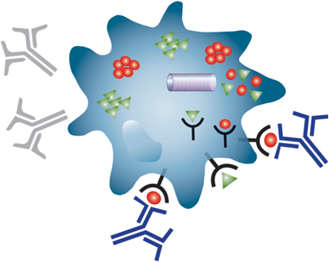
Examples of Other Super-Heroes in
Human Milk
Notes:
The following slides are examples of just a few of the hundreds of bioactive components in breastmilk. Many people think that the main benefit of breastmilk is the antibodies, but there are so many other factors that play an active role for infant health. And, many more have not even been identified yet.

Slide 23

Antibodies in Breastmilk Attack Viruses and Bacteria
Notes:
Antibodies- especially secretory IgA (immunoglobulin A)
These are substances that help fight infection by directly attacking bacteria and viruses that enter the nose, ears, throat, gut and bladder, reducing many different types of bacterial and viral infections.

Slide 24
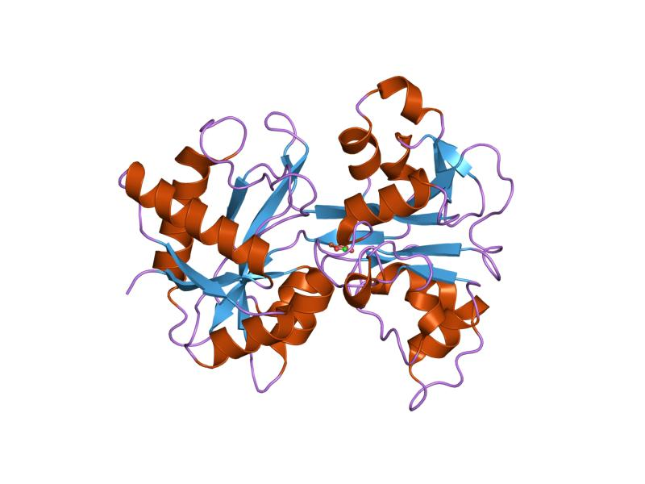


Lactoferrin
FE
FE
FE
FE
Notes:
This is what lactoferrin looks like. It is a protein that binds iron molecules (FE), keeping the iron from bacteria. Bacteria in the gut require iron to thrive and multiply. Lactoferrin breastmilk prevents dangerous bacteria from thriving in the gut of the breastfed infant.

Slide 25

Lysozyme
Lactadherin
Macrophages
Haptocorrin
Mucins
Oligosaccharides
Casein
Notes:
Many other factors in breastmilk kill bacteria and viruses. They work in many different ways to kill germs and keep them from growing, or from invading the intestinal wall Lonnderdal J Paediatrics and Child Health 49(Suppl 1) 2013

Slide 26
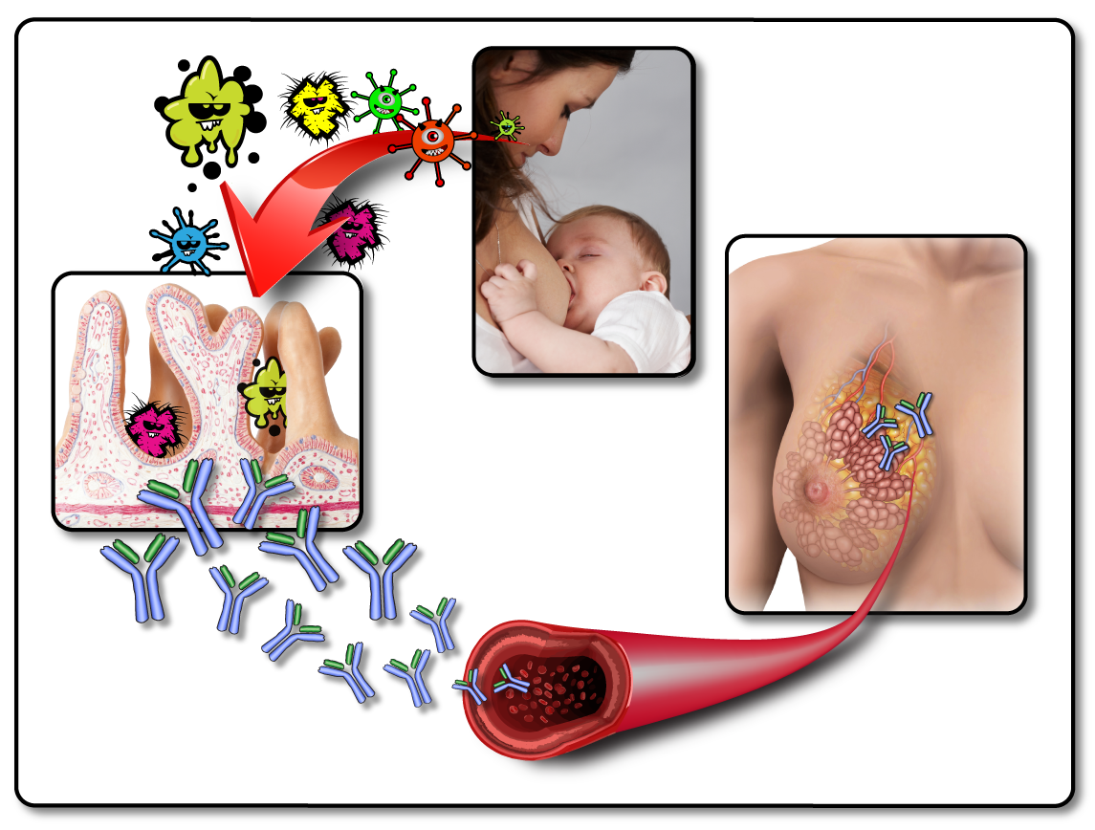
Entero-Mammary Circulation of Antibodies
Notes:
The Entero-mammary Circulation System
This is the pathway that allows parents to provide antibodies in their breastmilk against germs that they have recently encountered.
For example, it is often heard that if mom has a cold, she has antibodies in her breastmilk that will help the baby fight against the cold.
Here is how it works:
The parent has encountered a virus, such as a cold virus or a stomach virus.
The virus is swallowed and enters her gut.
The lining of the gut absorbs the virus.
Her immune system in the walls of the gut manufacture antibodies against the virus.
The antibodies travel thru mom’s blood vessels to her breast tissue, where they populate her breastmilk.
The baby receives the antibodies thru her breastmilk.

Slide 27
What do you know are benefits of breastfeeding for children (or risks of not breastfeeding)?
Notes:
Ask the participants to list what they know as benefits of breastfeeding/risks of not breastfeeding

Slide 28

Special Properties of Human Milk
Anti-Inflammatory
Anti-Infective
Neurological
Allergies
Asthma
Eczema
Severe bacterial
infections
Ear infections
Gastroenteritis
Higher IQ
Retinal maturity
Brain maturity
Hormonal
Immune-Modulating
Safety
Lower insulin levels
Less diabetes
Less obesity
Decreased SIDS
Improved bonding
Certain cancers
Arthritis
Notes:
This slide shows the special properties of breastmilk that protect the infant. It explains the benefits of breastfeeding
Anti-inflammatory- infants who breastfeed have a lower risk of eczema. They also tend to have less severe allergies and asthma.
Anti-infective-Breastfeeding infants are less likely to become severely ill from infections.
Formula fed infants are at much higher risk for ear infections compared to breastfed infants. Breastfed infants are less likely to be hospitalized for meningitis, pneumonia. When faced with a stomach virus, they are less likely to need hospitalization for vomiting and diarrhea. Usually stomach viruses are very mild in breastfed infants, compared to formula fed infants.
Neurological- Breastfed infants have higher IQs compared to formula fed infants.
Breastmilk has the optimal fatty acids for growth of brain tissue, and now we know that the protective sheaths around brain cells, called myelin, is more elaborately developed in breastfed vs formula fed babies. This means that the brain processes information faster and functions better. The retina in the eye is just like brain tissue and matures faster in breastfed vs formula fed infants.
Hormonal- Breastfed infants have lower insulin levels and are less likely to develop type 2 diabetes when older. They are also less likely to develop type 1 diabetes, which is juvenile onset.
Breastfeeding has a powerful effect on infant weight and reduces the risk of obesity. The longer an infant nurses, the lower the risk of obesity.
Safety- Breastfed infants have a lower risk of Sudden Infant Death Syndrome
We also see enhanced bonding between breastfed infant and mom, compared to a formula feeding baby and his mom.
Immune-modulating- Breastfed infants have a lower risk of 2 types of juvenile cancers- leukemia and lymphomas. This has to do with the effect of breastmilk on bone marrow.
We also see a lower risk of autoimmune diseases such as juvenile rheumatoid arthritis (JRA)

Slide 29
What do you know are benefits of breastfeeding for mothers (or risks of not breastfeeding)?
Notes:
Please ask the attendees what they know about the benefits of breastfeeding for mothers/risks of not breastfeeding

Slide 30


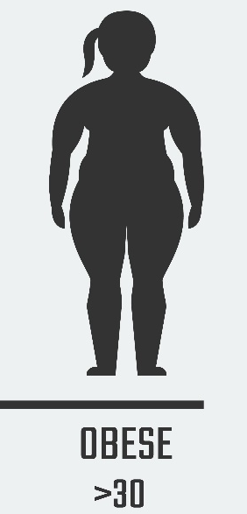
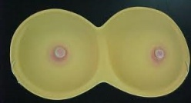

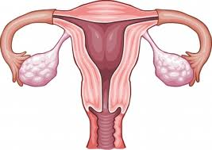

Maternal Benefits
Relaxation and Bonding
Notes:
Maternal Benefits
Mothers also have lower risk of several diseases if they breastfeed. Breastfeeding is a normal physiologic process, so if mothers don’t nurse, they have higher risk of disease. These include:
Breast Cancer- Mothers who breastfeed have a lower risk of breast cancer. An easy fact to remember is that a breastfeeding mother has a 25% decreased risk of breast cancer if she nurses for 2 years cumulatively (not consecutively)
Relaxation and Bonding- The hormonal changes that occur during breastfeeding have an effect on mom’s brain. She becomes much more empathetic, relaxed, and strongly bonded to her baby. Mothers who have formula fed some babies and nursed others will often say that they have a different type of relationship with the breastfed babies than their formula fed babies.
Ovarian Cancer-Mothers who breastfeed don’t get their menses back for several months. If a mother is exclusively nursing, ie no formula or food before 6 months postpartum, she often won’t get her period back until 9 months or later. The fact that breastfeeding mothers menstruate less decreases their risk of ovarian cancer. The less often that a woman ovulates, the lower her risk of ovarian cancer.
Enhanced child spacing –
Because breastfeeding mothers don’t ovulate soon after birth like a non breastfeeding mother, her babies will be spaced farther apart, usually at least 2-3 years apart as opposed to 12 months apart for moms who don’t nurse.
Obesity-Breastfeeding mothers use 500 calories a day to make breastmilk. This is much more than the extra 300 calories a day needed during pregnancy. This allows breastfeeding mothers to lose her pregnancy weight easier.
Type 2 Diabetes-
When women are pregnant, they have a higher risk of diabetes. This is because women are less sensitive to their own body’s insulin during pregnancy. Breastfeeding is thought to re-set their metabolism, making them more sensitive to their own insulin again.
If a mother develops gestational diabetes, she can reduce her risk of diabetes in the future if she breastfeeds.
Postpartum Depression-
Breastfeeding decreases the risk of postpartum depression. Asking a woman to wean in order to take medications for depression can worsen her postpartum depression.
Decreased high blood pressure and stroke- women who breastfeed have a lower risk of high blood pressure when they are older, and a lower risk of stroke and heart disease. The longer women breastfeed, the lower these risks. These decreased risks may be related to improved cholesterol profiles among women who breastfed. In addition, women who have breastfed have less visceral fat ,which is the fat in the abdomen. This fat is a much more dangerous fat as compared to fat in the buttock and thigh region. Abdominal fat is more metabolically active and inflammatory, and increases the risk of stroke and heart disease.

Slide 31

Not Breastfeeding?
Risks of infant formula
  Bacterial contamination
    Cronobacter sakazakii
  Other contaminants
    Bug parts
    Metals
  Absence of nutrients
Environmental risks
  Waste
    Packaging
Notes:
Not Breastfeeding?
Here are other risks of not breastfeeding:
Risks of infant formula itself-
There have been many reports of bacteria contamination in formula, (specifically a bacteria called cronobacter sakazakii, which can kill premature and sick infants. Powdered formula is not sterile.
Other items reportedly found in formula include pieces of metal and bug parts.
There have been times when vital nutrients have been accidently left out during manufacturing.
Formula is not healthy for our environment-
There is a great deal of waste from manufacturing and packaging of formula
A great deal of energy is put into the growth of food for cows to make formula. That food could be used to feed people

Slide 32
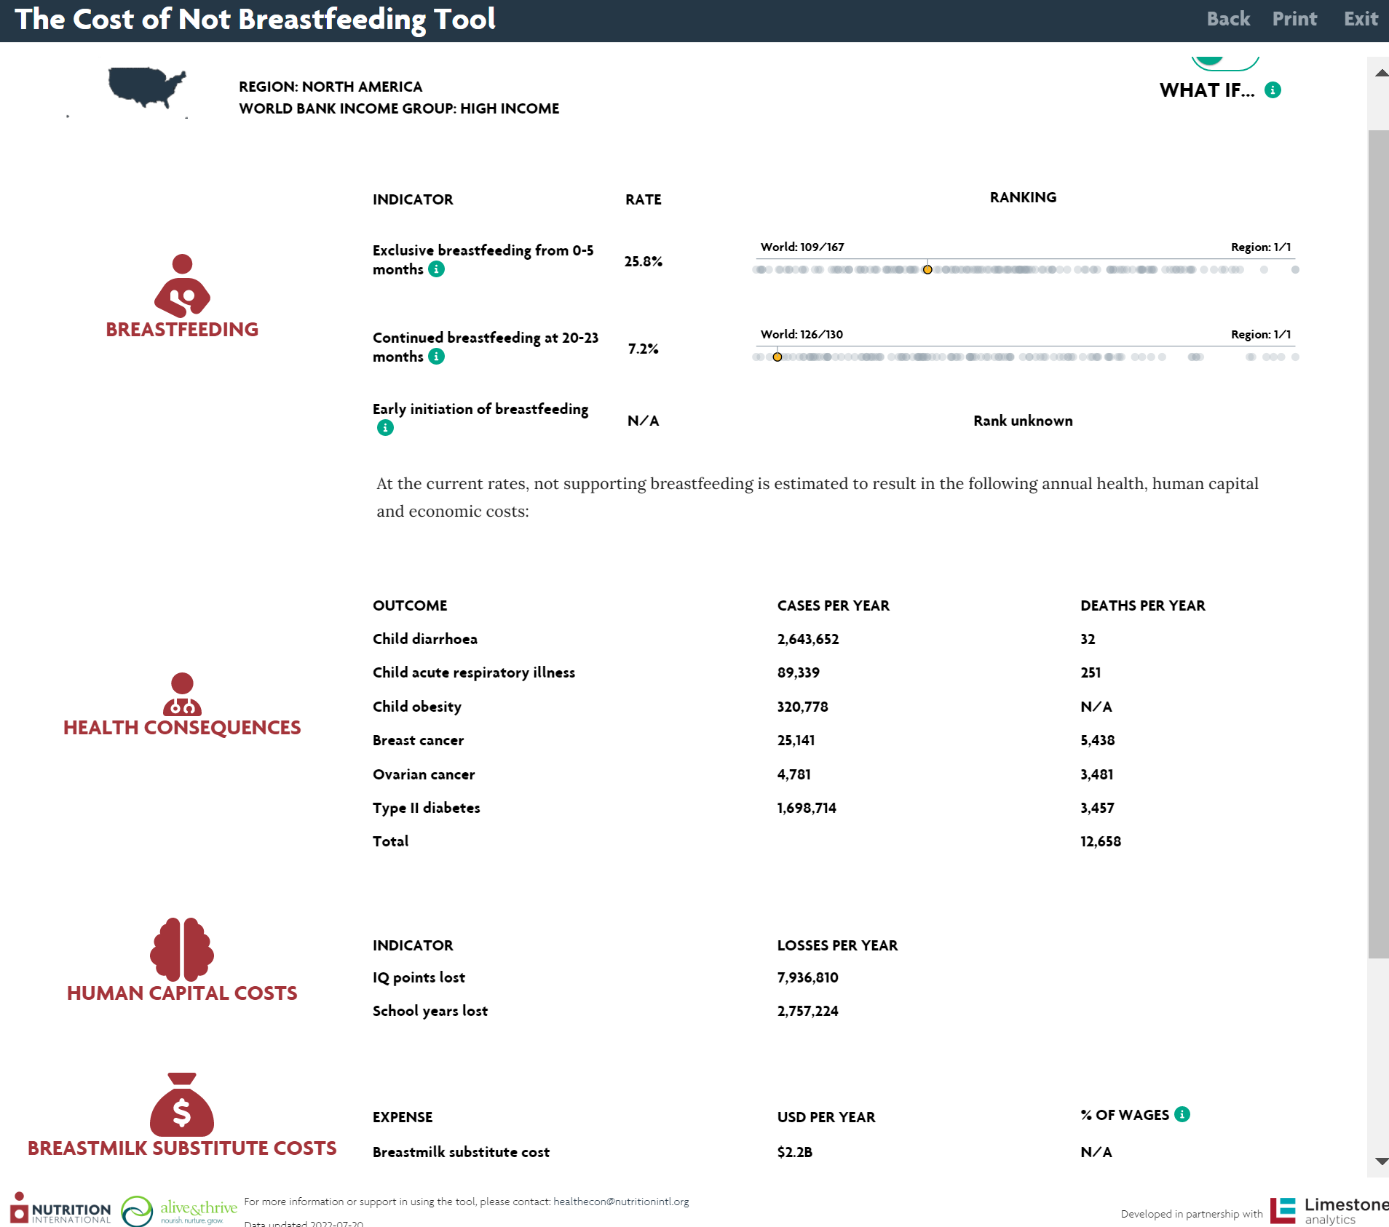
https://www.nutritionintl.org/learning-resource/the-cost-of-not-breastfeeding-tool/
Notes:
This is the new Cost of Not Breastfeeding Tool from a group called the Global Breastfeeding Collective, which is a group of international breastfeeding organizations, partially funded by the Melinda and Bill Gates Foundation. Please review the following:
The website is on the top of the slide in red
This screen capture is statistics for North America
It show that North America ranks 109/167 regarding exclusive breastfeeding from 0-5 months, and 126/130 for breastfeeding until about 2 years
Please also point out some of the health consequences of current breastfeeding rates in North America:
For example, there are 251 child deaths/year in North America due to respiratory illness, which could have been prevented by breastfeeding
The cost of formula to the country (breastmilk substitutes) is $2.2 billion/year in North America

Slide 33
World Health Organization, American Academy of Family Physicians
Exclusive bfeeding until 6 mo
American Academy of Pediatrics
Exclusive bfeeding until about 6 mo
Continue for 2 years or beyond, as mutually desired
Add solids at 6 mo
Nurse at least until 2 yrs
Add solids at about 6 mo
American College of Obstetrics and Gynecology
Exclusive bfeeding for 6 mo
Continue for 2 years or longer
There is no evidence that a child is too old to breastfeed.
Notes:
Recommendations on duration of breastfeeding from other organizations:
First define exclusive breastfeeding- this means no other foods such as formula, water or solids.
The World Health Organization and the American Academy of Family Physicians-
They advise that all babies should exclusively breastfeed for 6 months, with the addition of complementary foods (solids) at 6 months. Babies should continue to nurse until at least 2 years of age.
The American Academy of Pediatrics-
They advised that all babies should exclusively breastfeed until about 6 months, with the addition of complementary foods (solids) at 6 mo. Babies should continue to nurse until 2 years or beyond, as mutually desired They increased their recommendations from 1 to 2 years in 2022
The American College of OB/Gyn- they also advise exclusive breastfeeding for 6 months, then continue to breastfeed for 2 years or longer.
No one is stating that there is a certain age at which breastfeeding needs to end.

Slide 34

Infant Illnesses Requiring More Evaluation Before Breastfeeding/Providing One’s Milk
Galactosemia type 1- cannot breastfeed
Other metabolic illnesses infants can partially breastfeed, e.g.
  PKU
  Maple syrup urine disease
Notes:
Infant Illnesses that Require More Evaluation Before Breastfeeding/Providing One’s Milk
Infant galactosemia type 1- These babies are missing the enzyme galactase and cannot metabolize lactose. Lactose is the main sugar in breastmilk. There are several lesser-forms of galactosemia, and those infants can breastfeed to some extent
Maple syrup urine disease-This is a rare genetic metabolic illness, 1 in 185,000 births world wide. Newborn screening picks this up in some states. The baby’s urine and ear wax smell like maple syrup. They need restriction in certain amino acids to prevent neurologic problems, which is why they often need some specialty formula in addition to breastfeeding
Phenylketonuria- These babies cannot break down phenylalanine, which is an amino acid. Phenylalanine levels are low in breastmilk, so babies can nurse to a certain extent. A common way for these infants to feed is to take about 30-60 ml of special formula first, then finish the feeding at the breast.

Slide 35

Parental Relative Contraindications to Breastfeeding
HIV- can breastfeed with guidance and shared decision making
  <1% risk of HIV transmission via breastfeeding if viral RNA load is undetectable and they remain on anti-viral medication
Herpes on nipple/breast
Shingles on nipple/breast
A few meds, mainly chemotherapy
Active substance use disorder
Notes:
Maternal Relative Contraindications to Breastfeeding:
HIV- in 2022, the CDC updated their guidelines. If a parent living with HIV has undetectable viral load, and is compliant with antiretroviral therapy, and the baby is on antiretroviral therapy as recommended, the risk of transmission of HIV is less than 1%. All pregnant individuals living with HIV deserve a conversation about this, with allowing shared decision making.
Herpes Simplex on the nipple and breast-
Babies should not nurse on breast with active lesions, wait until the lesions are no longer blistered.
Shingles (herpes zoster) on the nipple and breast-
The baby can nurse from the breast once lesions are no longer blistered. We don’t want the baby exposed to the skin lesions because they secrete chickenpox virus. If the lesions are not around the nipple or areola, she can pump and feed milk to the baby.
Certain medications, mainly medications used for cancer treatment, called chemotherapy.
Active substance use disorder, when not in recovery- heroin, PCP, LSD, cocaine, crystal Meth, heavy marijuana use.

Slide 36
Which individuals are more likely to breastfeed? Least likely?
Notes:
Please ask the attendees to discuss what they know about who is more likely to breastfeed, and which people are less likely

Slide 37
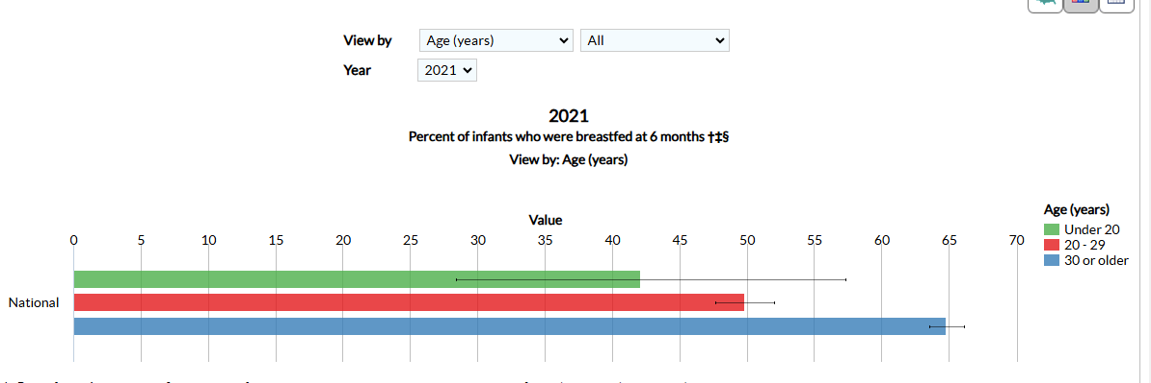
2021 US Breastfeeding Rates at 6 Months by Age
Notes:
This is the 2021 CDC report on breastfeeding rates according to age at 6 months postpartum.
At 6 months pp, you can see that the older mother is, the more likely she is to breastfeed.

Slide 38
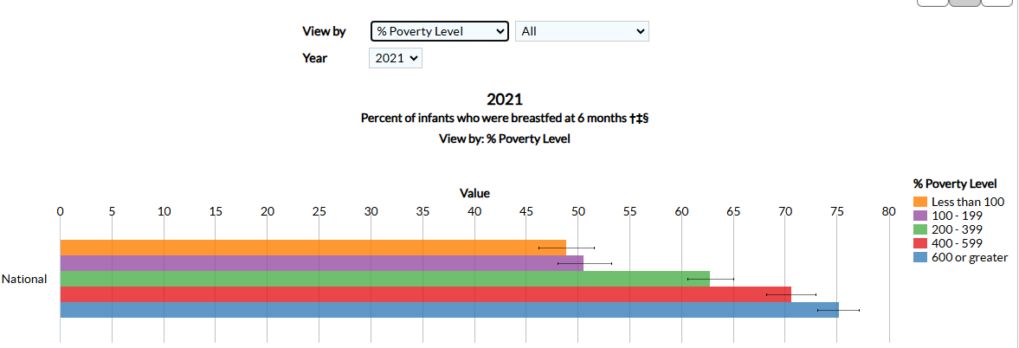
2021 US Breastfeeding Rates at 6 Months by Poverty Level
Notes:
This is the 2021 CDC report on breastfeeding rates at 6 months postpartum according to poverty level. You can see that higher income is associated with higher breastfeeding rates.

Slide 39
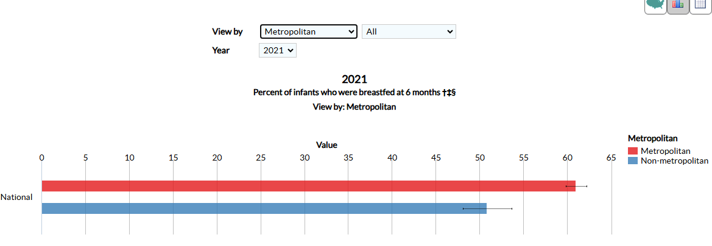
2021 US Breastfeeding Rates at 6 Months by Urban/Rural Living
Notes:
This is the 2021 CDC report on breastfeeding rates at 6 months postpartum according to living urban vs rural. You can see that urban living is associated with higher breastfeeding rates.

Slide 40
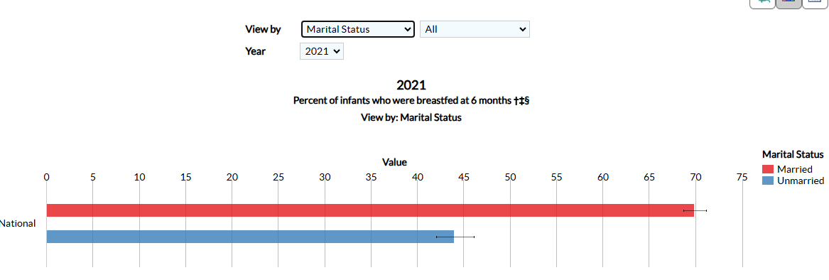
2021 US Breastfeeding Rates at 6 Months by Marital Status
Notes:
This is the 2021 CDC report on breastfeeding rates at 6 months postpartum according to marital status. You can see that marriage is associated with higher breastfeeding rates.

Slide 41
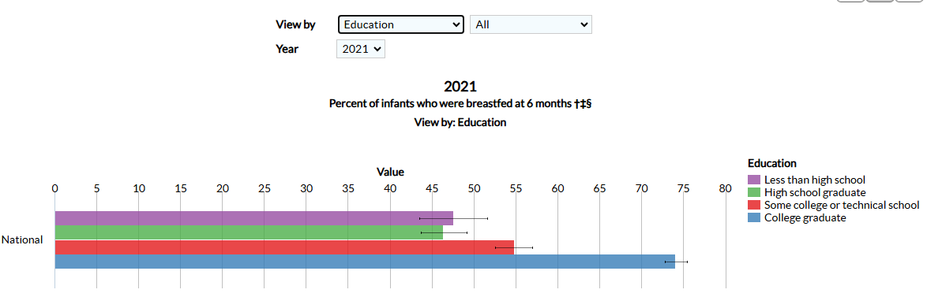
2021 US Breastfeeding Rates at 6 Months by Education Level
Notes:
This is the 2021 CDC report on breastfeeding rates at 6 months postpartum according to education level. You can see the greater the education, the higher the breastfeeding rate, except for those who did not finish high school. This has been a common finding in most years of collecting this data

Slide 42
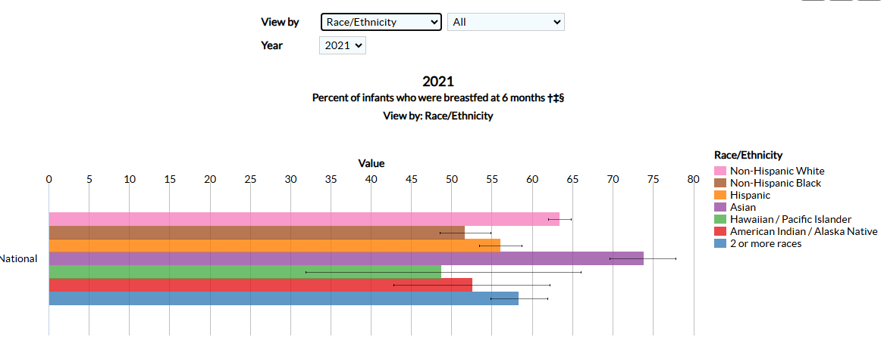
2021 Breastfeeding Rates at 6 Months by Race/Ethnicity
Notes:
This is the 2021 CDC report on breastfeeding rates at 6 months postpartum according to race/ethnicity. You can see that breastfeeding rates are highest among Asian women, and lowest among Hawaiian/Pacific Islanders. Non-Hispanic White women tend to have higher breastfeeding rates than Hispanic women, who have higher rates than Black women. Studies have shown that the intention to breastfeed is similar among Black, Hispanic and non-Hispanic White women, so the differences in rates may have to do with factors that are more difficult to control such as poverty and returning to work at an earlier time postpartum.

Slide 43

Healthy People 2030
National Breastfeeding Goals
Increase the proportion of infants who are breastfed exclusively through 6 months of age to 42.4%
  Was 24.9 % in 2018
Increase the proportion of infants who are breastfed at 1 year to 54.1%
  Was 35.9% in 2018
Notes:
Please note that the 2030 Breastfeeding Goals are many fewer, there are only 2 listed breastfeeding goals for the nation

Slide 44
What do you think are barriers to initiating breastfeeding or lactation, that can be addressed prenatally?
Notes:
Please ask the attendees to discuss what they think are barriers to initiating breastfeeding or lactation that they can discuss prenatally.

Slide 45

Educational Barriers to Breastfeeding
Failure of Counseling by Medical Offices:
  risks of not breastfeeding
  lack of educational materials
  no encouragement to take a class
Lack of availability of classes, and/or cost of classes.
Notes:
Educational Barriers to Breastfeeding
Families need to be counseled on breastfeeding, and one obvious place to do this is the doctor’s office.
Many physician offices don’t counsel pregnant people on infant feeding.
Healthcare systems need to help pregnant individuals with educational resources on infant feeding, and initiate evidence-based conversations about infant feeding. This would also require healthcare staff to become educated about breastfeeding.
Many medical offices don’t offer breastfeeding education to families. People lack breastfeeding education prenatally. Oftentimes they are Although breastfeeding is ‘natural’ it is actually fairly complicated. People who are educated about breastfeeding are more confident about breastfeeding after the baby is born.
Analogy- we don’t want our 12 year old preteens to not learn re their menses, just because it is natural. It is important that they understand their bodies, and the same goes for birth parents who are breastfeeding after birth.

Slide 46

Socio-Cultural Barriers to Breastfeeding
  Social conventions
    Not nursing in public
    Bottle as the norm
  Lack of family/social support
  Racial/ethnic barriers
    Few resources from one’s culture/race
Notes:
Cultural Barriers to Breastfeeding:
Examples of social conventions:
Bottle feeding is the norm for a family. The parents have no role models, and there is a great deal of pressure to feed the baby in the same way as their parents did.
Embarrassed to feed in public- this is not seen very often in some geographic regions or cultures
Examples of lack of family support
Families pressure a new parent to bottle feed if they are having trouble nursing ‘you were formula fed and came out just fine’
Expectations that the parent will also cook, clean, and no one comes to help them
Examples of racial/ethnic barriers
There are very few IBCLCs of color, so that lactation support for breastfeeding comes from specialists who are not from the same culture, and may not speak the same language.

Slide 47

Employment Barriers
Lack of support in the workplace
  US Fair Labor Standards Act on Break time for Nursing Mothers
Job stress
Notes:
Employment Barriers to Breastfeeding
No time or place for pump breaks-
The solution for this is the Fair Labors Standards Act on Breaktime for Nursing Mothers (most recently known as the PUMP ACT)
Employer of 50+ employees needs to allow breaks and a location to pump that is not a bathroom
A copy of this law is in the appendix of the curriculum booklet. This will be reviewed in session 7
No place to pump and store milk-
The law requires the employer to provide a space for milk expression, but does not require provision of a sink or refrigerator.
Some companies have worked to create opportunities for moms to have access to their babies when at work, such as onsite childcare.
A person’s job may be stressful
They might need to travel via car, or plane, which makes it hard to find the time and place to express milk.
They may also be required to travel and stay away overnight. This can make it hard to store expressed milk.
They may have the type of job that makes it hard to take a break, such as airline stewards and nurses.

Slide 48

Breastfeeding Challenges for the Lactating Parent Who is Back to Work
Childcare
Changes in the infant’s feeding behavior
  Increased night feeding
Effect on lactation
Notes:
Breastfeeding Challenges for Working Moms
Childcare- Family needs to find a childcare provider who is:
Supportive of breastfeeding
Knows appropriate handling of human milk
Willing to communicate with the family to optimize mom’s breastfeeding schedule (for example, won’t give a bottle ½ hour before mom arrives)
Changes in the infant’s feeding behavior
Sometimes babies change their feeding behavior when the parent goes back to work.
Some babies begin to reverse cycle nurse. These babies often prefer to breastfeed, so will not take many bottles during the day. These babies instead nurse often in the evening and at night. The parent then is up at night nursing and getting less sleep.
The baby may start taking larger volumes at one time when milk is offered in the bottle rather than the breast. These babies might become irritable at the breast if they prefer the flow and volume of the bottle over the breast.
Effect on lactation
Pumping at work may change the parent’s milk production, either by lowering it because the parent cannot pump as much milk as the baby takes, or raises her production because she pumps more milk than the baby usually takes when nursing.
It is more likely that her production will go down because she cannot pump as often at work as she can nurse when home with the baby.
She also has an increased risk of plugs and mastitis due to inability to drain the breast well using the pump.
Some parents experience nipple and/or breast pain from pump use
Some parents have trouble letting-down to the pump, which can create significant anxiety.

Slide 49

Medical Deterrents to Breastfeeding
History of:
Nipple/breast pain
Low milk production
Excessive milk production
Breast surgery
Parental depression, anxiety, or other mental illness
Parental illnesses and medication
Notes:
Medical Deterrents to breastfeeding-
Sometimes parents decide to not nurse because of previous breastfeeding problems or other medical illnesses such as:
Pain with breastfeeding in the past- some people have post-traumatic stress regarding previous breast or nipple pain. Many people describe their sore nipples or breast pain as being worse than labor.
A history of low milk production- if milk production was very low in the past, the parent might not want to try again.
A history of excessive milk production that was hard to control
A history of breast surgery such as breast reduction or augmentation. Some people are told that they ‘should not’ lactate after breast surgery.
Parental illnesses and medication- the parent may have been told that she cannot take certain meds and breastfeed. She may be concerned about being able to control her underlying illness such as systemic lupus erythematosus or rheumatoid arthritis without the medications that have worked the best for her.
Parental mental illness- underlying psychiatric issues may create feelings of being overwhelmed with breastfeeding, especially if breastfeeding is not going well. There can also be a concern for infant exposure to psychiatric medications, even though we know that most meds are safe during lactation.

Slide 50

Strategies for Prenatal Support
Notes:
We will now talk about ways to support families prenatally

Slide 51

Verbalizing Support
Verbalize support
Start with an open-ended conversation
  How do you plan to feed your baby?
ACOG- Optimizing Support for Breastfeeding As Part of Obstetric Practice
Opinion #658 2016
Notes:
Prenatal Support
Verbalize support- Inform all pregnant people that the office staff and providers are supportive and want to support their decision to breastfeed.
Start with an open-ended conversation re their plans for infant feeding.
How do you plan to feed your baby?
Tell me more about concerns you have?- By doing this, parent is free to speak about their perceived barriers, and the nurse can determine the information that the parent needs to help with their infant feeding decisions.

Slide 52

Address Barriers
  Identify the parent’s perceived barriers
  Consider a prenatal counseling session
    Getting off to a great start
    Develop a feeding plan to address the parent’s concerns
Notes:
Address The parent’s perceived breastfeeding barriers
Some reasons why parents might choose to formula feed:
A parent cannot work and breastfeed.
The parent worries that they cannot take her current medications and breastfeed.
The parent was told ‘do not breastfeed’ by their breast surgeon.
The parent had mastitis last time worries that this may happen again.
Milk production was low last time.
Consider an individual session with a lactation consultant prenatally to address these issues. For example:
The parent might want advice on how to get started on the right track, because her last baby never latched.
Many parents who had trouble with nursing previous children may want a feeding plan, much like a birthing plan.
The plan would be based on problems they had last time:
The parent had sore nipples last time, so what should she do if nipples crack this time?
The parent had a low production last time, so what are signs that indicate the need to supplement this time?

Slide 53

Prenatal
Counseling
Ask all pregnant individuals if you can share the risks to not breastfeeding
Avoid worry of instilling guilt
No need to exert pressure or coercion
ACOG- Optimizing Support for Breastfeeding As Part of Obstetric Practice
Opinion #658 2016
Photo by Mulyadi on Unsplash
Notes:
Prenatal Breastfeeding Counseling
Ask all pregnant people if you can share the risks to not breast feeding.
It is important to not worry about inducing ‘guilt’. It is OK to be matter-of-fact about this. It is truly factual that formula feeding babies are not as healthy as breastfed babies, and families need to understand this. This is not a judgment. Think of it as counseling parents about not smoking in the home, or using seatbelts in the car.
There is no need to exert pressure or coercion. Our role is to educate families, dispel myths, and provide resources for informed decision making

Slide 54

Prenatal Lactation Consultation
History of lactation problems
  Recurrent mastitis
  Low milk production
  Recurrent clogged ducts
  Sudden drop in milk production
  Pump problems
Anticipated possible breastfeeding or lactation challenges
  Medications
  H/o breast cancer, breast surgery
  Medical illnesses, ie rheumatoid
  Upcoming medical procedures postpartum
Notes:
Many pregnant people/families can benefit from a prenatal lactation consultation.
For example, if the pregnant person had difficulty with lactation problems in the past, including:
Recurrent mastitis
Low milk production
Recurrent clogged ducts
Sudden drop in milk production
Pump problems
These problems can be discussed prenatally, with education on how to prevent the same problems again
Some people are worried about upcoming challenges, such as medications, a history of breast cancer, or h/o breast surgery.
Some may have underlying illnesses and need to resume medication.
Others may be anticipating a major surgery postpartum such as having their gallbladder taken out or orthopedic surgery. A lactation specialist can discuss how this all works during lactation.

Slide 55

Need for Prenatal Education
Prenatal breastfeeding class
Give educational resources
  IABLE resource handout
Discuss employment concerns
Source: US Breastfeeding Committee
Notes:
Need for Prenatal Education
Encourage mom and her support people to take a breastfeeding class before delivery
Give information on where to take a class
Inform mom about educational and support resources
Websites, books, videos, phone apps. The OBC curriculum booklet has a list of resources for families in the appendix.
Discuss employment concerns
Encourage her to talk to human resources before she delivers or early postpartum
Make sure her employer know about the Fair Labor Act on Breastfeeding in the Workplace. There is a copy of this law in the appendix of the OBC curriculum booklet, that can be copied and given to lactating parents
Ask the parent about other concerns she has about going back to work. Encourage them to talk to discuss lactation plans when going back to work.
If your community has back-to-work and breastfeeding classes, encourage them to take this class.

Slide 56
Prenatal Toolkits- Free!
ACOG
  https://www.acog.org/About-ACOG/ACOG-Departments/Toolkits-for-Health-Care-Providers/Breastfeeding-Toolkit
Minnesota Bfeeding Coalition Prenatal Toolkit
  https://mnbreastfeedingcoalition.org/prenatal-toolkit-2/
Read-Set- Baby Carolina Global Health Institute
  https://sph.unc.edu/cgbi/resources-ready-set-baby/
Notes:
This is a list of free prenatal toolkits out there, that can be used in medical offices, WIC, or other places, to help educate people prenatally.

Slide 57
Socioeconomic Barriers
Encourage partner/family members to join the pregnant parent for prenatal education, or for a prenatal visit
Refer to WIC if financial concerns re infant feeding
Advocate for individuals with employment barriers
Notes:
There is good evidence that partner/family support are key for breastfeeding success. Therefore, having family or partner joining in on the prenatal education can help to boost support for her at home.
Consider referring to WIC if there are financial concerns. Explain that WIC is supportive of breastfeeding
Discuss possible employment barriers. The prenatal period is a good time for individuals to talk to human resources about their plans to breastfeeding when they return. This is discussed more in session 7

Slide 58

Create a Breastfeeding- Competent Environment Where You Work
NO gift packs of formula
Provide tips for success during prenatal visits
Close follow-up after hospital discharge
Notes:
The Breastfeeding Competent Environment where the Breastfeeding Champion Works
Do NOT give out gift packs of formula
Packs of formula are not gifts. They are messages to families that they can expect breastfeeding to not go well at some point, or that breastmilk will ultimately not be enough for the baby. If offices want to give out gifts, try something like cabinet locks or a coupon for a bike helmet.
Provide advice for early success
Encourage parents to have help at home during the first few weeks.
Recommend that the family avoid using a pacifier in the first 1-2 weeks, until baby is gaining well.
Advise that the family avoid supplementation in the first several days after birth, unless instructed to do so.
The office needs to provide close follow-up for mom and baby, within 24-48 hours after leaving the hospital.
Follow-up time may depend on each family’s and infant’s circumstances

Slide 59

Creating a Breastfeeding Competent Environment
Source: US Breastfeeding Committee
Comfortable place for individuals to feed or pump
Visual messages that normalize breasfeeding
Address lactation concerns
Provide community resources/support groups
Support lactating employees
Notes:
The Breastfeeding Friendly Work Environment
Have a comfortable place for parents to breast/chest feed
Have lactation pillows that are easy to clean
A quiet place where the parent does not have to be interrupted
A place with a sink and accessible water to drink
Visual messages
Avoid having items that promote formula or artificial feeding in the office
Breastfeeding posters or stickers that welcome breastfeeding parents are encouraging
Address breastfeeding concerns
Ask open-ended questions about how breastfeeding is going. Allow moms/families to explain concerns or problems. Help families find solutions to their concerns/problems.
Make sure that families have resources for community support.
Where to find a lactation consultant, Mommy-baby groups for peer support and Breastfeeding support groups such as La Leche League
Support breastfeeding employees
Make sure that nurses, receptionists, and your other coworkers have appropriate pump breaks, and support from colleagues
Office staff who have successfully breastfed are the most enthusiastic supporters for breastfeeding families who come to the office.

Slide 60
Counseling Lactating Parents and Families
Notes:
The next part of this session we will talk about some important aspects of counseling breastfeeding parents.

Slide 61

Parent-Centered Approach to Counseling
Begin with introductions in the room
Start with an upbeat comment
Use understandable language
  Avoid technical terms
  Interpreter as needed
  Speak clearly, not fast
  Avoid over-explaining
Notes:
A parent-centered approach to counseling involves sensitivity to the individual’s needs, compassion, and shared decision-making. Shared decision-making allows the parent to determine their breastfeeding strategies and goals based on their values.
Here are some communication and counseling tips for a parent-centered approach:
Introduce all individuals who are present in the room.
Begin with an upbeat, positive comment, such as ‘your infant looks so happy’ or ‘I am so glad you were able to come in today’
Make sure that language is understandable.
Avoid technical phrases.
Speak clearly, avoid speaking too fast.
Provide an interpreter if needed.
Avoid over-explaining or providing too much information.

Slide 62

Identifying Concerns
Make a list of breastfeeding concerns
If long, ask the parent(s) to identify most important concerns
Allow the parents to use their own words to explain concerns
Notes:
Help organize the visit, by acknowledging that she is seeing you for breastfeeding concerns. Inform her that you would like to make sure to cover as many concerns as possible in the time allowed, so ‘let’s list all concerns’.
If the agenda is long, more than can be covered in the visit, ask which concerns are most important to her, and address those first.
Allow her to explain her concerns in her own words, and interrupt as little as possible.

Slide 63

Source: United States Breastfeeding Committee
Counseling Discussion
Notes:
See Worksheet in the Instructor the Instructor Manual, and in the Activity Sheet PDF
You are seeing a parent who is 2 weeks postpartum with their 4th child. The 3 older children are ages 4, 7 and
10. The baby was born at 37 weeks via vaginal delivery, no complications.
The baby has been sleepy since birth, and has not been gaining enough weight at the breast, according to the
baby’s physician. Mom notices that the baby falls asleep at the breast. She figured out that if she pumps and
bottle feeds, the baby gains sufficient weight. She is seeing you because she really would rather breastfeed her
baby than pump. She is very busy with her 3 older children, and cannot find time to pump and bottle-feed the
baby,
What are mom’s concerns?
What are her goals?
How can you demonstrate to her that you are listening? Verbal and nonverbal cues
How can you say to demonstrate empathy such as respect, support and understanding?

Slide 64
Parent-Centered Approach to Counseling
You are seeing a parent who is 2 weeks postpartum with their 4th child. The 3 older children are ages 4, 7 and 10.
The baby was born at 37 weeks via vaginal delivery, no complications.
The baby has been sleepy since birth and has not been gaining enough weight at the breast, according to the baby’s physician.
Mom notices that the baby falls asleep at the breast. She figured out that if she pumps and bottle feeds, the baby gains sufficient weight.
She is seeing you because she really would rather breastfeed her baby than pump. She is very busy with her 3 older children, and cannot find time to pump and bottle-feed the baby.
What are her concerns and goals?
Notes:
Read the case and ask participants what they think her goals and concerns are.
This mother is concerned about wanting to breastfeed her infant and make sure that her infant gains weight. She does not feel that she can pump and bottle feed realistically, given her current family situation

Slide 65
Parent-Centered Approach to Counseling
You are seeing a parent who is 2 weeks postpartum with their 4th child. The 3 older children are ages 4, 7 and 10.
The baby was born at 37 weeks via vaginal delivery, no complications.
The baby has been sleepy since birth and has not been gaining enough weight at the breast, according to the baby’s physician.
Mom notices that the baby falls asleep at the breast. She figured out that if she pumps and bottle feeds, the baby gains sufficient weight.
She is seeing you because she really would rather breastfeed her baby than pump. She is very busy with her 3 older children and cannot find time to pump and bottle-feed the baby.
How can you demonstrate to her that you are listening?
  Verbal cues
  Nonverbal cues
Notes:
Now ask the participants to discuss ways that they can demonstrate that they are listening. We can demonstrate that we are listening with both verbal and nonverbal cues.
Verbal cues- repeating what they are saying, asking if they can review what the parent is saying for clarity, saying ‘I understand’
Nonverbal cues- nodding yes, eye contact, sitting close, leaning forward, appearing engaged, using facial expressions to express active listening/understanding

Slide 66
Parent-Centered Approach to Counseling
You are seeing a parent who is 2 weeks postpartum with their 4th child. The 3 older children are ages 4, 7 and 10.
The baby was born at 37 weeks via vaginal delivery, no complications.
The baby has been sleepy since birth and has not been gaining enough weight at the breast, according to the baby’s physician.
Mom notices that the baby falls asleep at the breast. She figured out that if she pumps and bottle feeds, the baby gains sufficient weight.
She is seeing you because she really would rather breastfeed her baby than pump. She is very busy with her 3 older children and cannot find time to pump and bottle-feed the baby.
What can you say to demonstrate empathy (respect, support, demonstrate understanding)?
Notes:
Now ask the participants to demonstrate how they can express empathy for the parent. Empathy is not just compassion, but respect and support.
Respect- Praise them for their hard work, perseverance, commitment to their infant
Demonstrate understanding- recite what they have said, ask for clarification, give examples of how others have dealt with the situation.
Support- offer to be there for them, give contact information, plan a follow up, offer to write a letter

Slide 67

Shared Decision Making
This mother does not want to pump and bottle feed, even though you know that this is the best way to make sure the baby gains well and only receives breastmilk.
  What does it mean to do shared decision making in this situation?
Notes:
We are introducing the concept of shared decision making. Shared decision making means that we are going to offer as much education as possible to help the mother make an educated decision. The decision is shared between the counselor/provider and the parent because we also want to agree that the decision is a safe and reasonable one for the parent and infant.

Slide 68
Shared Decision Making
Outline options for managing the breastfeeding concern. Include risks and benefits to each:
  She can continue to pump and bottle feed
  She can nurse, then give a bottle of formula and not pump at all
  Only pump after nursing when someone is with her
Provide realistic encouragement
  Will this improve?
  When will it improve?
Notes:
This slide outlines the options that would be reasonable, to make sure the infant receives sufficient calories. Even though we know that nursing and not pumping may lead to a drop in production, this may be all the mother is able to do at this point. She needs to know that this could decrease her production. Ultimately this is her decision, as she has a great deal to juggle.

Slide 69

Ending the Visit and Follow-up
Recap
  Ask the parent to recite what the plan is
  Provide written instructions, or a video conversation from her phone
Plan a follow-up
  Phone, text, office, home visit? When?
Notes:
Recap of the visit. Make sure that mom has the information she needs from the visit, so that she remembers what you discussed.
Ask mom to recite what the plan is
Provide written instructions
Using her phone to video tape a new skill such as using a feeding tube, finger feeding, asymmetric latch, can help her remember details on how to perform the skill again.
Plan a follow-up
Phone, text, office, home visit? When?
Can you call her to check in?

Slide 70

Conclusions Session 1
There are many immune factors in human milk other than antibodies that provide optimal health for the baby.
There are very few contraindications to breastfeeding.
Individuals are encouraged to breastfeed or lactate to provide milk for at least 2 years.
Medical offices and other systems that work with lactating dyads need to provide lactation encouragement, education and support prenatally and postpartum.

Slide 71
Conclusions Session 1 Cont’d
Identifying parents’ concerns and goals is important to ensure that counseling is parent-focused.
Demonstrating listening skills can be done in verbal and nonverbal ways.
Empathy can be expressed as respect, support, and demonstrating understanding.

Slide 72
A new mom calls at 3 mo postpartum, stating that she will be going back to work next week, and she does not think she would be able to swing working and breastfeeding. She wonders if there are still advantages to nursing past 3 months. You advise:
Once you start solid food at 6 months, breastfeeding really does not matter anymore.
Your baby will benefit from breastfeeding for at least the first 2 years and beyond.
Continuing to nurse, even if you need to supplement, is preferred over weaning.
It would be better to wean now, since working and breastfeeding will be too hard.
B & C
Notes:
The correct answer is E, both B & C

Slide 73
Mom calls with symptoms of the stomach flu and asks if she should stop nursing. You advise:
Keep nursing, but if the baby becomes sick with vomiting and diarrhea, stop nursing.
Keep nursing, and if the baby becomes ill, continue to breastfeed and call your doctor’s office to discuss further management.
Stop nursing to prevent spreading your illness and give your baby either stored breastmilk or formula until you feel fine.
Notes:
The correct answer is B
She should keep nursing because her breastmilk has antibodies against the stomach virus, which will keep the baby healthy.
This is incorrect because breastmilk is the ideal food if the baby has vomiting and diarrhea. The baby should not be switched to clear liquids such as pedialyte.
C. This is incorrect because while the stomach virus might be in the breastmilk, more importantly there are antibodies in her breastmilk to keep the baby from becoming too ill.

Slide 74
A pregnant individual calls and asks if they should not nurse because they have diabetes, asthma and allergies. You advise:
Since you might need various medications for your illnesses, it would be less complicated if you formula feed.
Your baby would have lower risks of these illnesses if you nurse your baby.
If you nurse for just 4 months, your baby will get all of the protection he needs from breastfeeding.
You should not nurse because your blood sugars will become too out-of-control.
Notes:
The correct answer is B
This is incorrect because most medications are compatible with breastfeeding
C. This is incorrect because babies who nurse longer than 4 months continue to benefit from breastfeeding and remain healthier
D. This is incorrect. A mother with insulin-using diabetes may notice that her insulin requirements change, but she may need less insulin. She can make the appropriate adjustments.

Slide 75
Breastfeeding helps to prevent all of the following except:
Severe pneumonia in the infant.
Childhood obesity in the infant.
Ear infections in the infant.
Breast cancer in lactating women.
Certain pediatric cancers.
Gastroesophageal reflux in the infant.
Notes:
The correct answer is F
Breastfeeding does not protect from gastroesophageal reflux. Some scientists believe that reflux occurs in babies in order to splash the healthy immune factors in breastmilk into the nose, throat, and eustachian tubes, in order to keep those organs healthy, and to trap germs before they make their way into the ears or into the stomach or lungs.

Slide 76
Breastfeeding is considered appropriate in which situation?
Parental hepatitis B and C
Infant galactosemia type 1
Chemotherapy treatment by the lactating parent
Active use of heroin by the lactating parent
Notes:
The correct answer is A
Lactating parents with hepatitis B will not pass hepatitis B to their babies if their babies have the hepatitis B vaccine at birth.
Hepatitis C has not been shown to be transmitted thru breastmilk.

Slide 77
Mom calls, concerned that her baby just turned 1 year old. The baby still likes to nurse, but she thought she had to wean at 1 year. She wonders what to do. You advise:
Babies should really wean to cow’s milk because it is healthier. Breast milk is less nutritious after 1 year.
It is natural to keep nursing for at least the first 2 years, and your toddler will be healthier if you continue to nurse.
It is OK to keep nursing but you should never nurse your toddler at night.
It is best to wean because nursing toddlers tend to reject solids, so they don’t get all of their nutrients.
Notes:
The correct answer is B
A.- incorrect- Cow’s milk after 1 year of age is not healthier than breastmilk.
C. Incorrect- There is no professional recommendation to not nurse toddlers at night.
D. Incorrect- It is highly unusual for a toddler to not eat food because they are still breastfeeding.

